Slide 1
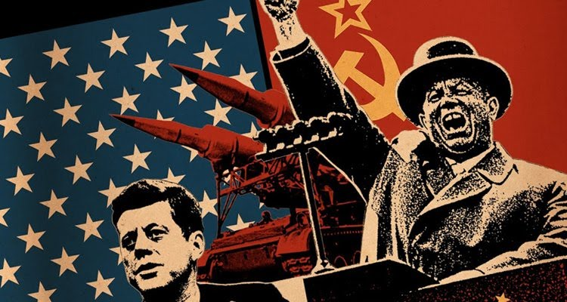
An introduction to Superpower Relations and the Cold War 1941-1991.
Key Questions:
What was the Cold War?
When was the Cold War?
What was ‘East’ and ‘West’?
What is Communism and Capitalism?
The ‘Cold War’ is a term used to describe the relationship between the USA and the Soviet Union (USSR) after the Second World War. No direct fighting took place between the two countries. However, there was a high level of tension between them due to the threats made from each side. For many, the Cold War, was a ‘war of words’ sent from one side against the other.
The USA and the Soviet Union were the world’s two superpowers after 1945. Both sides wanted to prove that their system of government and their ideology (ideas) were the best. These two different ideas were called ‘Capitalism’ and ‘Communism’. Increased media coverage during this time, meant millions around the world were fearful of a nuclear war. The Cold War officially ended in 1991, when the Soviet Union broke up into smaller states. However, aspects of the Cold War remain today with the relationship between Russia and the USA.
How did the superpowers try to compete against each other?
Spies | Media Propaganda | Finance | The Arms Race | The Space Race
Spies would be sent into each other’s or neighbouring countries to find out more about what each country were doing. | Both sides published and broadcast negative stories about each other to win the support of their public. | Both sides gave money to other states/groups who were willing to support them to get them on side. | Both sides competed to develop nuclear, long range (distance) weapons or defence systems. The bigger and more powerful, the better. | Both sides competed to put the first man in space, on the moon and into orbit – all to try and prove who was the most technologically advance.
The main differences between Capitalism and Communism
Capitalism – Western Powers (USA, Britain, France, West Germany) | Communism – Eastern Bloc (The Soviet Union)
Politics Democracy: Several political parties and voting for who should be in power. | Politics Dictatorship: Only one political party – The Communist Party. No choice. No democracy.
Economy Industry owned by individuals - private ownership. Business owners able to make profit and keep any money made. Some people are wealthier than others. Trade with other countries around the world. | Economy All industry and business owned by the government. No private ownership allowed. Money shared equally for fairness. Trade within Communist countries only.
Freedom of speech and censorship. Little censorship of the media. Freedom of speech allowed. | Freedom of speech and censorship. High levels of government censorship and control. Little freedom of speech or ability to criticise the government.

Slide 2
LESSON 1: What were the consequences of the Tehran, Yalta and Potsdam Conferences for the ‘Grand Alliance’?
The Background: Britain, America and Russia were allies (on the same side) during the Second World War. Although they had differences, they were more interested in defeating Hitler’s Germany. Towards the end of the war, Britain, America and Russia became known as ‘The Grand Alliance’. They met 3 times to discuss what should happen to Germany and the rest of Europe after the war. The three meetings took place between 1943 and 1945. It was during these meetings that the differences between the Grand Alliance countries started to become clear. As a consequence, Britain and America’s relationship with Russia declined and tension increased. Britain and America saw Communism as a real threat to their power in the world. This was the origin of the so called ‘Cold War’.
1. Tehran Conference (Nov 1943)
Leaders: Churchill, Roosevelt, Stalin.
LAND CONSEQUENCE It was agreed that Russia could keep land in eastern Europe including Poland if they won the war. This would take land away from Germany who currently occupied it and so weaken Germany. Russia were very happy with this outcome as it gave them more land. INTERNATIONAL CONSEQUENCE It was agreed that an international organisation should be created to settle arguments between countries using discussion not war. MILITARY CONSEQUENCE The USA and Britain would launch a second attack on Germany so the German army would have to reduce its troops in the East against Russia to send troops to fight in the west. This would give Russia a chance to take more land away from Germany and keep the land after the war.
Overall Verdict Russia seemed to be getting everything it wanted including more land for its empire. Britain feared that Russia would become more powerful and Britain would lose its leading role in the world. It improved the relationship for Britain and the USA with Russia by giving Russia what they wanted. The fact the conference was held in Tehran, near the Soviet Union was important because it showed a trusting relationship between the USA and Britain with Russia. It eventually led to the creation of the organisation known as the United Nations.
2. Yalta Conference (Feb 1945)
Leaders: Churchill, Roosevelt, Stalin.
POLITICAL CONSEQUENCE = Churchill was isolated Churchill felt isolated and powerless after Stalin and Roosevelt got on well & made most of the agreements. TERRITORIAL CONSEQUENCE = Germany divided It was agreed that Germany would be divided into 4 zones which would be controlled by Britain, France, USA & Russia. This, to prevent more conflict. TERRITORIAL CONSEQUENCE = Berlin was divided The capital of Germany, Berlin would be divided in 4 zones. Each to be governed as they wished. ECONOMIC CONSEQUENCE = Reparation payments Germany should pay $20 million in reparations. Half would go to the Soviet Union. POLITICAL CONSEQUENCE = Soviet Influence: That east Europe was looked after by Russia in their ‘Soviet Sphere of Influence’. There would be elections.
Overall Verdict There were disagreements with Russia about how much Germany should pay for their reparations. Stalin also wanted more land from Germany in the east and was not happy with the small zone they were given. Russia were not happy that there would be elections in each country to vote for new leaders. Stalin just wanted to rule them as a dictatorship. They met in an area of Russia called ‘Yalta’. Meeting here was important for the status of Russia.
3. Potsdam Conference (Jul 1945)
Leaders: Atlee, Truman, Stalin.
Winston Churchill was defeated in the next General Election in England and replaced with Clement Attlee. Roosevelt was also replaced by Truman. This was a major change. TERRITORIAL CONSEQUENCE: The Soviet troops had defeated Germany and NOT taken away their troops from Eastern Europe. This proved they wanted to stay. POLITICAL CONSEQUENCE: Stalin set up a Communist government in Poland. He had previously promised not to do this. MILITARY CONSEQUENCE: Stalin refused to cut down and ‘demilitarise’ his Soviet army at a time when America and Britain reduced their army after the war. Germany would be demilitarised completely. INTERNATIONAL RELATIONSHIP CONSEQUENCE: Stalin had got on well with Roosevelt but the next President, Harry Truman did not trust Stalin and their relationship suffered. Truman wanted to stand up to Stalin more. TECHNOLOGICAL CONSEQUENCE: The Americans had tested another atomic bomb in the USA. Stalin was furious that he had not been told about this and that he was not involved in the testing of a nuclear bomb.
Overall Verdict There were lots of important issues that the Grand Alliance could not agree on. The two new leaders, Atlee and Truman were not experienced and struggled to negotiate with Stalin. Stalin did not want democratic elections in the countries freed from the Nazis, he wanted them under Soviet control. This angered Truman who from then on began a ‘get tough’ policy against Stalin and the Soviet Union. Truman saw Russia’s ‘Red Army’ as a threat to peace. Truman was not able to challenge Russia too much however as this might cause yet another conflict. A CLEAR DIFFERENCE BETWEEN CAPITALIMS AND COMMUNISM: Most of all, it highlighted the differences between the leaders in their beliefs about how to run a country. The differences between Capitalism and Communism were clear for the leaders and the world to see.

Slide 3
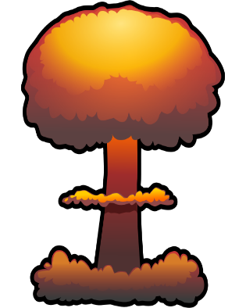
Lesson 2: US-Soviet Relations 1945-6: The dropping of the atomic bomb and the Long & Novikov Telegrams.
Key Questions:
What was the impact of dropping the atomic bomb on US-Soviet relations?
What were the Long and Novikov telegrams?
What did the telegrams prove about US-Soviet relations?
The Background
On 6th August 1945, President Truman dropped two atomic bombs on Hiroshima and Nagasaki in Japan. The bombs were estimated to have killed over 120,000 Japanese civilians. This attack made Japan surrender and ended the Second World War. Stalin however, now saw the American use of atomic weapons as a threat. This resulted in more tension between the two countries and both sides were wanting to find out more about the intentions and attitudes of the other towards them. A form of communication called a telegram, was sent by US and Soviet politicians called ‘diplomats’ working in each other’s countries to inform their leaders about the attitude each government had. These telegrams highlighted the mistrust the US and Soviet Union had of each other and led to a further decline in their relationship.
How did the dropping of the atomic bomb cause a decline in the relationship between the USA & Russia?
What were the telegrams?
Kennan’s ‘Long’ Telegram
The Novikov Telegram from the USA
USA’s President Truman and Russia’s Stalin were worried that a breakup of the Grand Alliance would mean conflict between the countries. Both leaders wanted to find out what each other were thinking.
A form of communication called a telegram was used by diplomats (politicians) living in the other country. These telegrams are known as the Long Telegram and the Novikov Telegrams.
The American Report on the Russian attitude towards them
George Kennan worked as a diplomat for America in Moscow (Russia). He sent a detailed telegram about what the Russian attitude towards America was. It was so detailed that it was called the Long Telegram.
He believed that Stalin wanted to see the destruction of capitalism and that Stalin believed other capitalist countries were a threat to Russia and Communism.
Kennan said that Stalin did not trust the USA
Kennan believed that Russia would back down if faced with a strong, tough response from the USA.
The ‘Long’ Telegram was important, as from that point onwards, America was tough towards Russia and carried out a policy called ‘containment’. This meant that America wanted to stop the spread of communism and ‘contain’ it in The Soviet Union only.
POWER
The USA believed the bomb made them look stronger as they were the first nation to test and use an atomic weapon in war. However, Stalin felt that the USA were now a greater danger to the world. Stalin believed the USA would be capable of using an atomic weapon on Russia as a way to remove Communism.
The telegram sent by a Russian diplomat who worked in America, showed that the Americans did not trust the Russians.
It told the Russians that the Americans wanted to use their massive military to ‘dominate’ the world and would not be frightened of another war.
This led the Russians to believe that they needed to occupy as much land in Eastern Europe as possible to protect themselves against attack if it came.
The telegram confirmed that the USA wanted to defeat communism.
LAND
Stalin responded to the US by taking control of more land in Eastern Europe. The land between Germany and Russia was labelled as a ‘buffer zone’. If the US used Germany to attack Russia, they would need to go through this ‘buffer zone’ made up of Poland, Czechoslovakia and Hungary before they reached Russia itself.
AN ‘ARMS RACE’
The Russians hoped to show the USA that they could build their own nuclear weapons and a successful test was carried out in August 1929. There was now competition between countries to develop more nuclear bombs. This led to the ‘Arms Race’ between the USA and the Soviet Union.

Slide 4
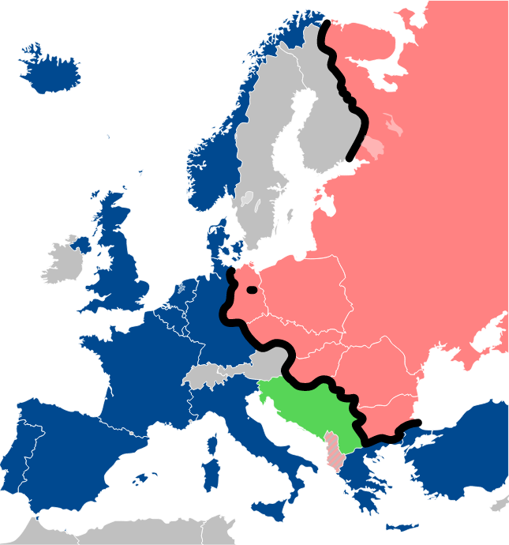
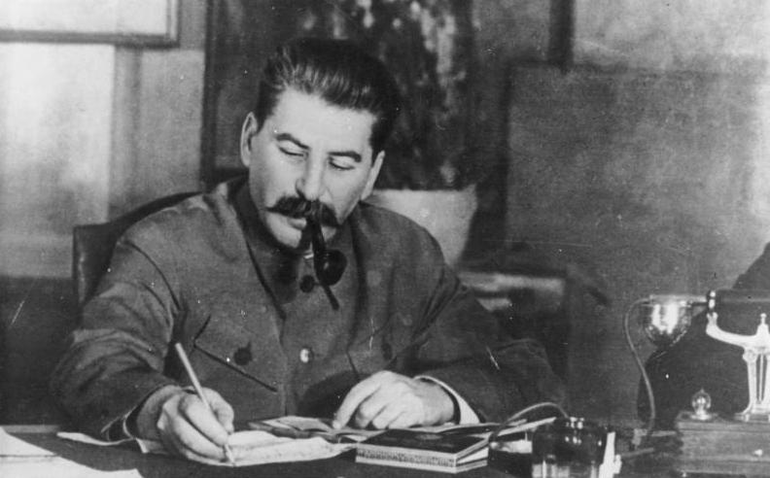
LESSON 3: The creation of Soviet satellite states and Churchill’s ‘Iron Curtain’ speech.
Key Questions:
What and where were the Soviet ‘satellite states’?
What was the reaction to the creation of the satellite states?
What was the impact of Churchill’s ‘Iron Curtain’ speech in 1946?
The Background:
At the end of the Second World War, Russia and its Red Army was able to ‘free’ countries in Eastern Europe from Nazi German control. The Soviet army pushed Germany back and its troops occupied many countries in eastern Europe. When the war ended, Joseph Stalin still had his Red Army in these countries and did not want to give them up. Countries such as Poland, Czechoslovakia and Hungary were in chaos after the war with no government in place. Therefore, Britain and America agreed to allow Stalin to stay as a way of guaranteeing stability in these countries.
Churchill’s Iron Curtain Speech, March 1946
Winston Churchill was no longer Prime Minister but he still had great respect and influence. On a visit to the USA he gave a speech which was remembered for his use of a famous phrase ‘The Iron Curtain’.
Churchill stated that an Iron Curtain had descended across Europe and behind the Iron Curtain there were states controlled by Moscow. In the speech he made it clear that the Soviet Union were a threat to freedom and world peace. He made it clear that he did not like how Communist governments had been set up in Hungary, Poland and Czechoslovakia.
Poland
Why were Russia given control over Eastern European Countries?
E. Germany
Britain and America promised each country in eastern Europe an election to vote for the government they wanted in charge. This was an important part of capitalism and a way of freeing these countries of the dictatorship of Nazi Germany. They believed this would happen under Stalin’s control. (Look under the map – it didn’t!)
Britain was in no position after the war to take care of the countries in eastern Europe. It was in massive war debt and needed to concentrate its energy on rebuilding Britain.
With no organised government in the eastern European countries, it was better to give Stalin the control. This would stop uprisings and even more chaos after the war.
The people of eastern Europe would be happy to live under the control of the country that had rescued them from Nazi control. The Soviet Union seemed to have the money and power to do this.
Czech
Hungary
Romania
The Impact of Churchill’s Speech
Which countries were Satellite States?
East Germany – given to Russia with the Western powers in control of West Germany. No elections.
Poland – taken over by Russia in 1947 who put a Communist government in control after the Warsaw Uprising. No elections
Czechoslovakia – taken over by Russia in 1948 with a Communist government. No elections held.
Hungary – Taken over by Russia in 1949 when the Russians interfered in their elections to guarantee a win.
Romania and Bulgaria – People voted in a Russian Communist government after being intimidated by the Communist Party in 1944
In the same year as the Long and Novikov telegrams and with the same message, it caused even more tension between the USA and Russia. Churchill made it clear that he thought Russia was a threat to world peace & freedom.
Making the speech in the USA showed that the USA believed the same and Churchill was on their side. Russian backed Communist governments had been set up on Hungary and Poland. Churchill saw this as a huge threat to the rest of Europe. It increased tensions even more between the USA and Russia and led to both sides strengthening their forces against each other.
It was an important speech as it made the divide between Communism in the east and capitalism in the west a real idea, with the ‘Iron Curtain’ being the dividing line between the two.
Why did Stalin want to keep control of these ‘satellite states’?
Stalin wanted to create a buffer zone between Russia and Germany. If the Americans used Germany to attack from, they would still have to get through the buffer zone before reaching the Soviet Union.
It would show strength as a ‘super power’ and ‘empire’ against the USA.
It would increase the area of Communist influence in Europe and the Soviet Union would introduce Communist governments into these countries.

Slide 5
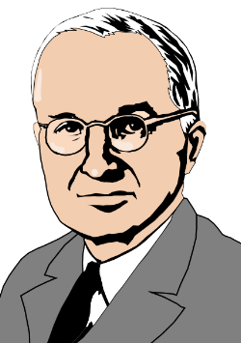
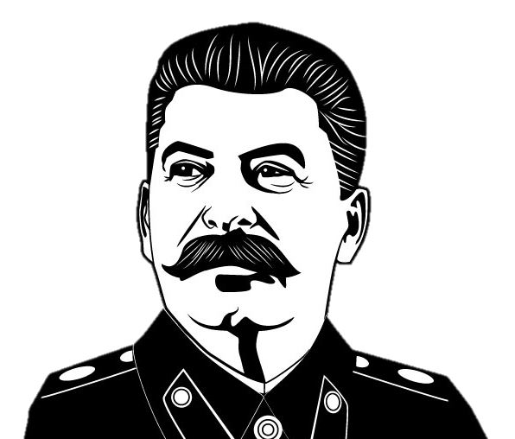
LESSON 4: The Consequences and importance of the Truman Doctrine and Marshall Plan in 1947.
Key Questions:
What was the 1947 Truman Doctrine?
What was the 1947 Marshall Plan?
What were their consequences and why were they important?
The Background: After the war, the Soviet Union had set up communist governments in the eastern European countries it controlled. However, President Truman was worried about the spread of communism and came up with a set of ideas called a ‘doctrine’ to stop the influence of Communism in Europe. His ‘doctrine’ was to give money and send troops to Europe to fight against Communism and was known as the Truman Doctrine. The Marshall Plan, carried out by the US Secretary of State, George Marshall went even further by giving economic aid to Eastern European countries who had fought in the war.
1. Truman was worried about Soviet Influence
2. Truman’s Ideas
3. The Truman Doctrine 1947
4. The Marshall Plan
5. Soviet Response – ‘Dollar Imperialism’
6. The Impact of the Truman Doctrine & Marshall Plan for US-Soviet Relations
President Truman came up with a set of ideas, called a ‘doctrine’, to stop the spread of communism in Europe. These ideas were known as the Truman Doctrine.
It followed the idea of CONTAINMENT – To keep Communism in the Soviet Union and not letting it spread.
Truman’s idea was to give money and military support to any country in Europe that wanted to fight off the influence of Communism.
On 12th March 1947, President Truman announced that he would provide economic help to countries such as Greece and Turkey which were being threatened with Communism by the Soviet Union. He promised them $400 million.
Truman sent American soldiers to Greece and Turkey to prevent them being influenced by Communism.
Truman made a clear statement about the differences between democracy (the ability to vote) and communism, which he believed was a dictatorship. He told the world that democracy offered freedom and choice. He then said that Communism forced ideas onto people.
He compared capitalism and communism to ‘good and evil’.
America was able to afford the economic aid as it had joined the war late. It had not been destroyed like many other countries in Europe such as Britain and France.
The Marshall Plan was named after the US Secretary of State George Marshall. After Truman had set out the Truman Doctrine , George Marshall set out a plan to give money to countries in Europe that were needing help after the destruction of war. If the populations in each country were better off and happier, they would be less likely to support communism.
The Marshall Plan gave economic aid to countries that had been hit by war - Britain, France, West Germany, Belgium, Italy, Austria. The USA gave $12.7 billion dollars between 1948-52.
The British Foreign Secretary called it a ‘Lifeline to sinking men, giving hope where there was none’.
Money was also offered to the Eastern European satellite states controlled by Stalin, but Stalin refused the money so these countries did not gain anything from America.
The Soviet Union’s Red Army still occupied much of Eastern Europe. They were therefore still seen as a threat to peace.
Truman was worried that the people in Stalin’s satellite countries would easily accept the ‘Communist’ way of thinking.
They were living in poverty and destruction and Communism promised to share wealth from the rich to help the poor. Millions of people in eastern Europe would support the idea of communism with the hope of improving their lives.
This would make communism, the Soviet Union and Stalin even stronger. It would also threaten capitalism in the west. Truman wanted a plan to stop this.
Stalin believed that the USA were trying to become even more powerful and create an American empire in Europe by offering ‘free’ money to Eastern European countries.
Stalin criticised the the USA’s actions calling it ‘Dollar Imperialism’. In other words, a way to use money to take control and have influence over other countries.
They saw the USA as an even greater threat as more American troops would be based in Europe.
The idea of a friendly Grand Alliance had now gone completely. There was even more mistrust between the two countries and both believed the other was trying to expand their power and influence in Europe.
The USA was now directly in opposition to the Soviet Union as the two nations had different beliefs in capitalism and communism. They clearly had little in common with each other.
Europe became divided into Western Europe, which was supported by the USA and Eastern Europe which was controlled by the Communist Soviet Union. The ‘Iron Curtain’ seemed real and the map of Europe now looked like two opposing sides.
You just pay people to like you!

Slide 6
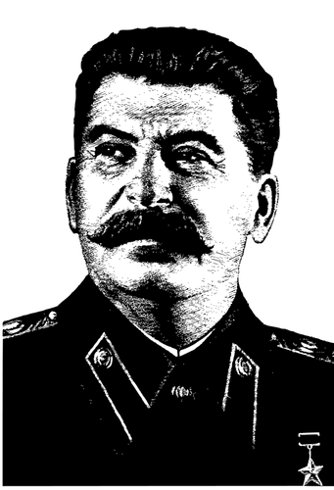
LESSON 5: Stalin’s creation of Cominform (1947) and Comecon (1949)
Key Questions:
What was Cominform (1947)?
What was Comecon (1949)?
What were their consequences and why were they important?
The Background:
Stalin was worried about the impact of the Truman Doctrine and the Marshall Plan. He was worried that the USA were trying to control Europe and potentially take away the support that the Soviet Union already had from its satellite states in eastern Europe. Stalin created two organisations. These organisations were called ‘Cominform’ (which started as a quick response to the Truman Doctrine and Marshall Plan in 1947), and ‘Comecon’, which began running in 1949. Both of these communist organisations were a way to keep control and influence over the states and the people controlled by the Soviet Union after the Second World War.
Cominform (1947)
Comecon (1949)
‘Cominform’ (The Communist Information Bureau) was a political organisation set up by Stalin in September 1947. As an organisation, it had 9 members. These members were expected to follow the rules set out by the Cominform organisation. The members were the Communist Party of the Soviet Union, the Communist Parties of the satellite states of Bulgaria, Czechoslovakia, Hungary, Poland and Romania and Yugoslavia. The Community Party of France and Italy were also members. These two countries were not officially part of the Soviet Union, but Communism was strong enough for them to have an influential Communist Party in each country.
What did Cominform do?
Cominform gave Stalin a way to CONTROL the governments of the satellite states.
Cominform made sure that all of the rules and orders given out by Stalin were carried out in each country. It was a way to make sure that the satellite countries followed communism. This also meant that orders could be given by Stalin in Moscow, and Cominform would make sure they were followed in all of eastern Europe.
Any political communication and contact with non-communist countries was discouraged.
Cominform also began to spread negative, anti-American propaganda.
For example?
Stalin did not want agree with the Truman Doctrine or the Marshall Plan. He ordered that no other eastern European country accepted money from the Marshall Plan. Cominform made sure that each country followed his order.
Overall
Cominform was a way to control the ‘inform’ation given to each eastern European country as a way to make them follow the orders set out by Stalin.
‘Comecon’ (The Council for Mutual Economic Assistance) was another organisation set up by the order of Stalin in 1949. It made sure that all communist states rejected (did not follow) capitalist ideas. It was an alternative to Marshall Aid being offered by America and made everyone in communist countries believe that communism was just as strong and effective as capitalism.
What did Cominform do?
Comecon aimed to help the economies of the Soviet Union’s satellite states. It arranged trade between all of the communist countries.
It also allowed money to be lent/borrowed between all communist countries. It also planned for the growth of industry in the Soviet Union.
Each communist country had a 5 Year Plan which aimed to give all industry and business to the government to control. Any trade with the USA and other capitalist countries in the west was banned. This would mean that any goods and trade would be in the Soviet Union only.
For example?
Bulgaria’s trade with other communist countries increased from 10% in the 1930s to 90% by 1951.
Overall
Com’econ’ was a way for Stalin to control the economy of each communist country. It made people living in communist countries believe that communism was much better than capitalism.
Controlling Information and Money
The Consequences and Importance of Cominform and Comecon
The creation of these two communist organisations was yet another way to highlight the differences between capitalism in the west and communism in the east. This just increased the tension and competition between the two sides.
The propaganda that was published from both sides increased. This made an even greater divide between the USA and the Soviet Union.
The eventual consequence was the USA and Western European countries became even more worried about the threat of communism and created their own military alliance called NATO.

Slide 7
LESSON 6: The Berlin Crisis, the Berlin Blockade and the Berlin Airlift (1948 - 9)
Key Questions:
What was the Berlin Crisis?
What was the Berlin Blockade and how did it lead to the Airlift?
What were the consequences of the end of the Berlin Airlift?
The Background:
When the Grand Alliance met, it was agreed that Germany and its capital Berlin would be divided into 4 zones. One zone would be run by the Soviet Union. The other zones would be run by Britain, France and America. Berlin was significant as it was located in the middle of the Soviet controlled zone. Military checkpoints were put in place to control the movement of people between the zones. There was an informal agreement with the Soviet Union that any supplies needed in West Berlin could be transported in without challenge. However, in 1948, this was about to change. A ‘crisis’ led to Stalin ‘blockading’ goods from coming into West Berlin. The only answer was to transport goods via aircraft into Berlin. This ‘Berlin Airlift’ succeeded with Stalin backing down and taking away the Berlin Blockade.
A narrative of the key events
2. Military checkpoints were placed in each zone to control the movement between the ‘western’ zones and the Soviet ‘eastern’ zones. There was also an informal agreement to allow the transportation of supplies such as food and fuel into the west of Berlin.
3. There were constant disagreements about Berlin and By March 1948, Britain, France and America decided to take two actions:
A) Unite their zones in Germany into one. This united, ‘western’ zone would be called ‘TRIZONIA’.
B) Create a new currency (money) for Trizonia called the DEUTSCHMARK. This meant any trade and business in the western, capitalist zones would be easier with the same currency.
4. The result of the creation of Trizonia and the Deutschmark, was that the divide/difference between capitalism in the west and communism in the east was even more clear.
5. Joseph Stalin was also angry. He believed he had not been spoken to about the changes, that Britain, France and America were uniting against him to show their strength and it went against what was agreed at Potsdam.
6. Stalin therefore responded by using his troops to block the routes used by Britain, America and France to take supplies to West Berlin. This was known as the Berlin Blockade. It began in June 1948. West Berlin was essentially cut off.
1. After WW2, it was agreed at Potsdam by the Grand Alliance that Germany and its capital Berlin, would be split into 4 zones. The Soviet Union would run the eastern sector and Britain, France and the USA would run the other three. The main issue about this agreement was that Berlin, the country’s capital was located deep inside Soviet run Germany. This meant the 3 ‘western zones’ in Berlin were ‘trapped’ deep in Soviet controlled territory.
10. The consequences of the successful Berlin airlift were significant for the development of the Cold War.
The defeat made Stalin look weak. Many of his close communist leaders criticised Stalin for giving into the capitalist, western powers. This was the first time, Stalin had been defeated.
It proved that America and the other western powers could defeat the Soviet Union using peaceful tactics. No troops or civilians were killed in this action and so another war was avoided.
Stalin’s blockade made the western powers worry about the future threat of the Soviet Union. Therefore, 3 days after the end of the blockade in May 1949, they officially united their 3 zones and sectors in Berlin. Trizonia was now officially the Federal Republic of Germany or ‘West Germany’.
Stalin reacted by October 1949 to this by making the Soviet zone the German Democratic Republic or ‘East Germany’ for short. This geographical divide made the difference between east and west even clearer.
Finally, the western powers believed they now needed military protection against the Soviet Union. The formed a military alliance (friendship) with other capitalist countries who promised to help out if each other were attacked. This was called the North Atlantic Treaty Organisation or NATO. It began shortly after in 1949.
9. The Berlin Airlift was successful. Stalin gave in and ordered the blockade to end.
8. President Truman now needed to plan a way to get food, fuel and supplies to the French, British and Americans in western Berlin. The answer was to use aircraft. This was risky as the Soviets may shoot the aircraft down. However, they did not. Between June 1948 and May 1949, 1,000 tonnes of food and supplies were flown in to keep the western Berliners alive. This was known as the Berlin Airlift.
7. Stalin’s reasons for the Berlin Blockade in June 1948 were:
He needed a quick way to respond to the creation of Trizonia and the Deutschmark to show his anger.
He believed that is people in West Berlin started to starve, the ‘western’ powers would give in and allow Stalin to control all of Berlin – essentially pass control of the capital city to the Soviet Union.
It was a clear message to the ‘west’ that Stalin wanted to show his strength.

Slide 8
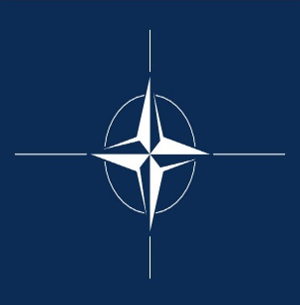
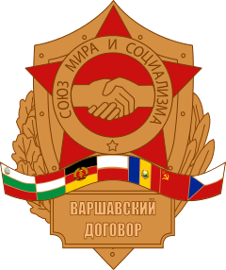
LESSON 7 – The creation of NATO (1949) and the Warsaw Pact (1955)
The Background:
By the end of the Berlin Crisis in 1949, it was clear that the relationship between the USA and the Soviet Union was becoming even more tense. America were concerned about the threatening actions of the Soviet Union, such as the Berlin Blockade. The Soviet Union believed that America were wanting to gain power and influence in Europe. There was a clear divide in the beliefs of the West and East. The political difference was the belief in Capitalism and Communism. On a map, there was now a clear geographical divide between the two sides in Germany with the official creation of West Germany/East Berlin and East Germany/East Berlin. By the end of 1949, there was to be one more divide between the two sides – a military divide. America and its allies (friends) created a military organisation called NATO. The Soviet Union in response created a similar military organisation called the Warsaw Pact by 1955.
NATO (1949) North Atlantic Treaty Organisation
The Warsaw Pact (1955)
Why was NATO created in October 1948?
America and its allies believed that Stalin and communism were becoming an even greater threat. Stalin had attempted to gain control of Berlin with the Berlin Blockade. This was not successful but showed his intention of spreading communism further in Europe.
However, also in 1948, the Soviet Union were successful in taking over Czechoslovakia. They put a communist government in place there. The western powers believed they needed to protect themselves from the communist, Soviet threat.
Why was The Warsaw Pact created in 1955?
The Soviet Union believed by this point that they needed to respond to the creation of NATO and form their own military alliance. In 1955, NATO made the big step of allowing newly created West Germany to be a member.
The Soviet Union were unhappy with this as it would mean American and other European troops being stationed on the border of the Soviet Union – to close for comfort! Within a week of West Germany joining NATO, The Soviet Union created their own version of the military alliance between communist countries. This was known as The Warsaw Pact.
What was NATO?
For this reason, the USA persuaded other western powers that they needed a formal military alliance to protect themselves from the Soviet Union.
In April 1949, the USA, France, Britain and 9 other western countries joined together in the North Atlantic Treaty Organisation – N.A.T.O.. They agreed that if any of the NATO members were attacked, all of the other members would help.
What was The Warsaw Pact?
It was created by the Soviet Union in May 1955. Its members were the Soviet Union, Poland, Czechoslovakia, Hungary, Romania, Bulgaria, Albania and East Germany.
All of these countries became known as the ‘Eastern Bloc’. These countries promised to help each other if another member was attacked.
The Consequences of NATO
The creation of NATO meant that American troops would continue to be present in Europe after the Second World War. American troops could be called upon at short notice to help European countries fight against the communist threat.
A further turning point
By 1955, it was agreed by all members of NATO that West Germany could join the organisation as it was then strong enough to offer help if needed elsewhere. This led to the Soviet Union creating their own military alliance in response.
The Consequences of The Warsaw Pact
It was now clear that Europe was divided into two. One half was part of the NATO military alliance and worked together to stop the spread of communism and strengthen capitalism and democracy. The other half was under the control of the Warsaw Pact and worked to expand the influence of communism.
There was now a real fear that Europe could end up in war so soon after the end of World War Two. Having a political set of differences was one worry, but now each side essentially had an army, it created even more fear of another war.
The perspective of the western powers
Other NATO powers saw the creation of the Warsaw Pact as another threat. Now there were two opposing military alliances in Europe and any small disagreement could lead to war between the two sides.
The Soviet Perspective
Stalin simply saw this as more evidence of America trying to show their strength and influence in Europe. The Soviet Union would see the NATO organisation as a threat towards communism.

Slide 9
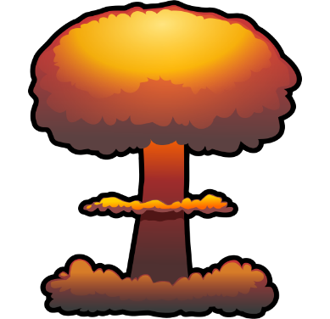
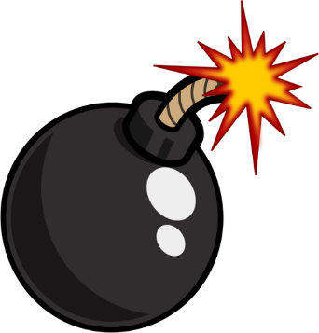
LESSON 8: The importance of the Arms Race during the 1950s on US-Soviet Relations
The Background:
By the 1950s, there was a very clear divide in Europe. Germany had been officially split into East Germany and West Germany after the events of the Berlin Blockade and Berlin Airlift. Berlin itself was split into ‘east’ and ‘west’. As a consequence of the increasing tension between the USA and the Soviet Union, the two sides created their own military alliance with NATO in 1949. Following West Germany’s membership of NATO, the Soviet Union formed their own military alliance, the Warsaw Pact in 1955. There was also build up and competition between the USA and the Soviet Union for nuclear superiority. The 1950s would be the start of the Arms Race, where both sides competes to develop and test more powerful nuclear weapons.
Two New Superpower Leaders
Nuclear Weapons used as a Deterrent
Both sides and the rest of the world could see that there were huge risks with conflict. Rather than developing weapons to win a war, the tactic changed to using nuclear weapons as a deterrent. A deterrent is a force that prevents something from happening. A country would be deterred from using their own weapons as the consequence of a nuclear attack would be even worse. Nuclear
The USA elected a new President in 1953: President Eisenhower.
Stalin died in 1952. Nikita Khrushchev became the next key Soviet leader in 1956.
The Impact of the Arms Race
Was there an opportunity for Peace?
A Timeline of the Arms Race
The Cost
The development of nuclear weapons meant both countries spending huge amounts of money. It was important that they stay ahead of each other to claim a victory in the arms race.
The new Soviet leader from 1956, Khrushchev, openly criticised the policies and ideas of Joseph Stalin in his opening speech. He suggested there would be more peace between the USA and the Soviet Union if either side stopped being so hostile towards each other. He believed that both countries could ‘peacefully coexist’ with each other. This gave hope around the world of peace and an end to the Cold War.
Other reasons to hope for peace
The war in Korea between the North (supported by the Soviet Union) and the South (supported by the USA) had ended.
Both countries were spending so much money on the arms race, they knew this competition had to come to an end at some point.
A meeting of both sides in Austria in 1955 went peacefully and both America and the Soviet Union co-operated with each other, despite not agreeing on a final outcome for how to help Austria.
1945: America were the first to create an atomic bomb which was used on Japan to end the Second World War.
1949: Stalin pushed for the Soviet Union to make their own atomic bomb and this was achieved by 1949.
1952: In response, America then developed a more powerful hydrogen bomb. This was 1,000 more powerful than the atom bomb.
1953: The Soviet Union developed their own hydrogen bomb.
1957: In June, the USA developed ICBM Inter-continental ballistic missiles which could fire a nuclear bomb 4,500km away. This was enough distance to reach the Soviet Union.
1957: The Soviet Union then had their own ICBM by August. This meant they too, could potentially target the USA mainland from the Soviet Union.
Mutually Assured Destruction (MAD)
It was believed that from the early 1950s, both countries had such powerful nuclear weapons that the bombs could have destroyed the world many times over. This meant that the risk of starting a war would have extreme consequences.
Status and Pride
This competition to develop bigger nuclear weapons became known as the arms race. Both countries had huge numbers of ‘conventional’ (normal) weapons which had been used in previous wars. However, the impact of the first atomic bomb on Japan proved that nuclear weapons would give status and power to a country.
Propaganda Opportunity
The USA and the Soviet Union knew that whoever developed the most powerful nuclear weapon, could promote this to their own people and around the world – to prove they were the best. It would also be a way to prove that either capitalism or communism was the most successful way to run a country.
The End of Peace: By the end of 1955, West Germany had been allowed to join NATO and this made the Soviet Union angry with the west. The potential peace between the two sides had gone, when the Soviet Union then formed the Warsaw Pact.

Slide 10
LESSON 9: The events and consequences of the Hungarian Uprising in 1956.
The Background:
One Soviet satellite state was Hungary. By 1949, it had voted in a Communist government. The elections that had been held were not fair. Voters were intimidated on their way to vote and the Soviet Union spent huge amounts of money on propaganda. The Communist Party were the only political party allowed in Hungary. This meant that the Hungarian people were living under a dictatorship. It was no surprise that many Hungarian people wanted to take action to remove the influence of the Soviet Union. By 1956, they had attempted this in an uprising. However, this failed and their actions ultimately led to even greater control and restrictions in every Soviet controlled country in Eastern Europe.
1. Why were the Hungarians unhappy?
They complained about their lack of freedom under a Communist system.
They could not vote. There was no freedom to say what they felt in newspapers/press.
There were fuel and food shortages due to poor harvests and many resources being taken by Russia.
The Hungarian communist leader was brutal and the Hungarian people called him the ‘Bald Butcher’ for how cruel he was to anybody who opposed him.
2. What did they do?
The Hungarian people protested in capital city Budapest.
They tore down a statue of Stalin to show the hatred of Communism.
This worried the Soviet Union as they wanted to control the people in their satellite states.
3. How did the Soviets respond?
The new Soviet leader Khrushchev sent in the Red Army (Soviet troops) with tanks to stop the riots.
Khrushchev tried to please the Hungarians by giving them a new leader called Imre Nagy.
Nagy was still a communist but would allow the Hungarian people more freedom. Khrushchev believed this would keep the Hungarians happy and stop any future protests.
4. Nagy’s role
He wanted voting and democratic elections in Hungary rather than a dictatorship.
He asked for political prisoners to be freed.
He asked Khrushchev to remove Soviet Troops from Hungary.
5. Khrushchev’s reaction
Khrushchev was happy for these changes to happen, as long as the people of Hungary remained calm and did not start to rebel again.
Khrushchev also made sure that Hungary joined the Warsaw Pact. This way, the Soviet Union could take action quickly to stop any rebellions.
6. Change by 1956
In November 1956, Nagy went further and told The Soviet Union that it would leave the Warsaw Pact.
Khrushchev was not pleased. If Hungary left the military alliance, other countries might do the same. This would ruin the power of the Soviet Union.
This threat to leave the Warsaw Pact led to the Soviet invasion of Hungary.
Long term consequences of the Uprising
Short term consequences of the Uprising
8. Why did America and the West not help the Hungarian Uprising?
Despite being offered help with the Marshall Plan, no military help was given to Hungary.
America wanted to stop Communism from spreading with the policy of containment but did not want to interfere too much with those countries already taken over by the Soviet Union.
It was too risky to plan a military attack on a Soviet satellite state as this might start a nuclear war.
7. The Soviet Invasion of Hungary 4th Nov. 1956 and the Hungarian Uprising.
In response to the threat of leaving the Warsaw Pact, Khrushchev sent in the Red Army into Budapest. The Hungarian people fought back in what was known as the Hungarian Uprising. Hungarians, including women and children took up arms against the invading Red Army.
Khrushchev seemed more powerful now he had shown other Soviet satellite states what he was prepared to do if they protested against Communist rule.
A new, stronger and more Communist leader was appointed in Hungary to control the people even more.
It showed other Eastern European states that the USA was not willing to help them. This made Khrushchev even more confident.
The only way America helped was by taking in 80,000 refugees from Hungary and offering medical aid.
Khrushchev could now be even more aggressive in Eastern Europe as he knew the USA would not want to start a war against the Soviet Union.
It made the USA look weak as they had not been prepared to support Hungary by sending in troops.
Overall, it made the Soviet Union look strong and the USA look weak.
The Hungarian Uprising failed. Hungary was taken over again by force by the Soviet Red Army with 200,000 troops.. The Hungarians asked for help from the America but no support came.
The Soviet Red Army were brutal and 3,000 Hungarians were killed in the uprising.
Over 1,000 Russian troops were killed by the Hungarians.
Nagy and several of his supporters were executed.
Khrushchev announced that Nagy’s death was ‘a lesson to the leaders of all Communist countries’. He sent out a threat to other countries who threatened to leave the Warsaw Pact.

Slide 11
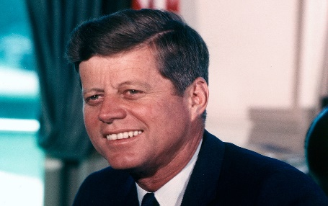
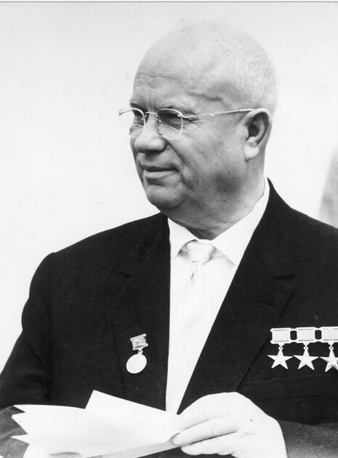
LESSON 10: Khrushchev’s Berlin Ultimatum and the Summit Meetings: 1959-61.
The Background:
By 1958, Germany and its capital city Berlin, had been officially divided into West Germany (capitalist) and East Germany (Soviet Communist). Berlin had already seen the attempted Berlin Blockade by the Soviet Union and the response of the Western countries with the successful Berlin Airlift. Throughout the 1950s, there were further tensions and divisions regarding Berlin which led to the building of the Berlin Wall in 1961.
What was happening in Berlin?
The reaction in the West to Khrushchev’s Berlin Ultimatum
West Germany and West Berlin were much wealthier. They had been able to accept the help from the USA called Marshall Aid. However, East Germany and East Berlin still suffered with food shortages and a lack of basic goods. There were many restrictions on people in the Soviet controlled areas with little freedom of speech and censorship.
This led to 3 million East Germans choosing to leave home and move to West Germany for a better life. This was 1/6th of the population of East Germany.
All they needed to do was travel from East Berlin into West Berlin. Once in West Berlin they could have the freedom to move into West Germany.
The type of people leaving were skilled workers such as engineers, teachers and electricians. It was therefore called the ‘Brain Drain’ of East Germany.
These people knew they would earn more money in West Germany.
The West were annoyed by his demands and saw this as another example of the Soviet aggression and trying to spread the influence of communism.
By the late 1950s, both sides had large numbers of nuclear weapons and both sides believed that if the military was used, it could start a nuclear war. The number of nuclear weapons being built by the Soviet Union and the USA was rapidly growing. One attack by one side could lead to retaliation by the other. It was hoped that by meeting, a solution could be found.
The Summit Meetings of 1959-61
MEETING 1:
MEETING 3:
MEETING 4:
The Geneva Summit May 1959
Both sides met in Switzerland put their ideas forward about what to do with Berlin but no agreements were made.
US President Eisenhower invited Khrushchev to the USA for further talks.
At least they talked.
Paris Summit May 1960
There was little chance of these talks being a success.
The Soviet Union had just shot down an American Spy-Plane as it flew over the Soviet Union. The Americans said it was a ‘weather’ plane that had gone off track. However, the Soviets interrogated the pilot who was shot down called Gary Powers and he admitted it was a spy plane on a secret mission.
Eisenhower refused to apologise for the spy plane and Khrushchev walked out of the meeting with nothing being achieved.
Vienna Summit (Austria) June 1961
F Kennedy was now President of the USA. He wanted to keep building up the military but really wanted to work hard negotiating with the Soviets.
Khrushchev believed that as Kennedy was young and inexperienced, he could get the better of him and get his own way. Therefore, Khrushchev went back to his idea of the Berlin Ultimatum of 1958.
Kennedy refused to give in.
The talks ended with no agreement again.
The personal relationship between Khrushchev and Kennedy was also poor.
Kennedy decided to increase spending on the American military by an extra $2 billion.
This was a strong message to the Soviet Union that the USA was prepared to use the military of it needed to.
Why did Khrushchev not like the high numbers of refugees leaving?
This many people leaving East Germany was an embarrassment for the Soviet Union. People in Europe were obviously choosing capitalism over communism. It made communism look bad.
Khrushchev needed these skilled workers to help East Germany.
Khrushchev needed to stop these people moving to West Germany.
What did Khrushchev want to happen with Berlin?
Khrushchev wanted the whole of Berlin to be controlled by East Germany. To him, this made sense as Berlin was located deep in East German territory. He also wanted to look strong after the Hungarian Uprising.
MEETING 2:
Camp David (USA) Sep. 1959
Eisenhower and Khrushchev met face to face for the first time. The two enjoyed their time together and got on personally.
Khrushchev took away his Berlin Ultimatum terms but no agreement was made about Berlin.
What was Khrushchev’s ‘Berlin Ultimatum’ in November 1958?
Khrushchev made a set of final demands that:
Western Troops should be removed from East Berlin
Berlin should become a free city (controlled by the Soviets).
The West were given 6 weeks to do this. If they did not, he threatened to take over all transport routes in East Germany to stop people traveling to West Germany.

Slide 12
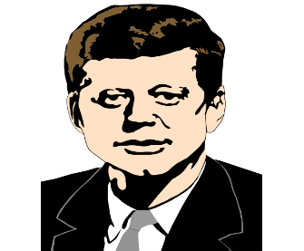
LESSON 11: The consequence of the Berlin Ultimatum – the building of the Berlin Wall in 1961.
The Background:
The summit meetings produced no agreements or compromise. Khrushchev was determined to prove his power over the new, young and inexperienced American President, John F. Kennedy and re-instated his idea of the Berlin Ultimatum. Khrushchev was determined to control all of Berlin, and that way, stop the thousands of East German refugees leaving for the West every month. Kennedy was not prepared to give in to the Berlin Ultimatum and kept Western troops in Berlin. Both sides were keen to avoid a war, as this would likely result in nuclear war. Therefore, Khrushchev took another action which would have lasting consequences – the building of the Berlin Wall.
The Building of the Berlin Wall 1961
 | Negative Consequences of the Berlin Wall | Positive Consequences of the Berlin Wall
Soviet Union | Khrushchev did not get what he wanted in the Berlin Ultimatum. He did not control all of Berlin. The building of the wall looked bad for the Soviet Union as it showed the Soviet Union had to literally ‘lock’ people in East Germany to stop them leaving. The building of the wall proved the people living under communism preferred capitalism. British, French and US troops stayed in Berlin – going against what Khrushchev wanted in his Berlin Ultimatum. | The Berlin Wall successfully stopped East German people from leaving the Soviet Union. The building of the Berlin Wall showed that the Soviet Union was not willing to give up its Communist control of East Berlin or East Germany. Khrushchev believed he had shown his strength by building the wall. He was then confident enough to send Soviet Missiles into Cuba.
USA | The Soviet Union had been able to close the border without permission from the USA. This made John F Kennedy look weak. With the Berlin Wall built, there was nothing Kennedy could do without potentially starting a nuclear war to remove the wall. | The USA poured even more money into West Berlin to make it look even more prosperous for those in the east. West Berlin became a symbol of freedom against Communism. John F Kennedy gained a better reputation when he visited West Berlin in 1963. He was a hero in the West.
THEIR RELATIONSHIP | The two sides had been arguing about Berlin since the Second World War. Nothing had been solved and now the Soviet Union had built a concrete wall dividing Germany. This reminded people of Churchill’s 1946 Iron Curtain speech. The Berlin Wall became a powerful symbol of the differences between East and West for almost 30 years until it came down in 1989. Europe was now completely divided between East and West. This division was literal with the Berlin Wall. | Now the wall was built and there was a definite divide, it was less likely that the two sides would go to war. President Kennedy famously said that a wall was better than a war. It could be argued it reduced the tension as both sides accepted the building of the wall and there was little else they could do apart from fight.
No solution had been made to the Berlin Ultimatum and the relationship between the USA and the Soviet Union had broken down completely, despite Khrushchev and Eisenhower’s friendly, personal relationship in Vienna and Camp David.
More East German refugees decided to leave through West Berlin as they were worried Khrushchev might close the border any day. For example, on just one day in August 1961, 40,000 East Germans crossed into West Germany to escape the East.
In response, Khrushchev ordered soldiers in East Germany to build a barbed wire fence around Berlin. This would stop anyone from the East of the city crossing to the west.
There would only be one, closely controlled checkpoint called ‘Checkpoint Charlie’.
Work was quickly started on a concrete wall which would be 165km long around the city.
By October 1961, no East German could access West Berlin. Soviet tanks guarded the wall and orders were given to shoot any East German attempting the crossing.
The Impact of the Berlin Wall
Anyone trying to escape was shot and over 130 people were killed by East German border guards.
As the wall was erected so quickly, some families were divided between East and West.
The Berlin Wall even cut through streets and even buildings as it divided the city.
There were many escape stories in the first 2 months.
The West Berlin Fire Service helped East Germans escape through windows by providing blankets for them to land on.
The Berlin Wall was made stronger with a double wall containing ‘no man’s land’ where minefields, barbed wire, lookout towers and machine nests would be built.
The Berlin Wall became symbolic of the divide between the Capitalist West and Communist East.
The Importance of Kennedy’s Berlin Visit in 1963
John F Kennedy gained a better reputation when he visited West Berlin in 1963.
He was treated like a rock star and his route was covered in flowers while crowds chanted his name.
He praised the freedom of the West and famously said ‘Ich bin ein Berliner’ (I am a citizen of Berlin).
This speech proved he was not soft on communism.
His visit there was a symbol of how much he wanted West Berlin to remain part of the West

Slide 13
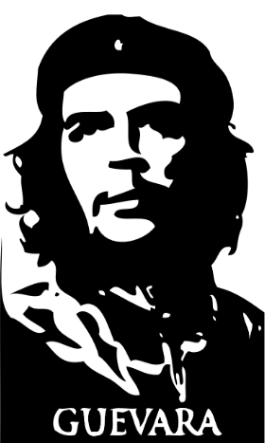
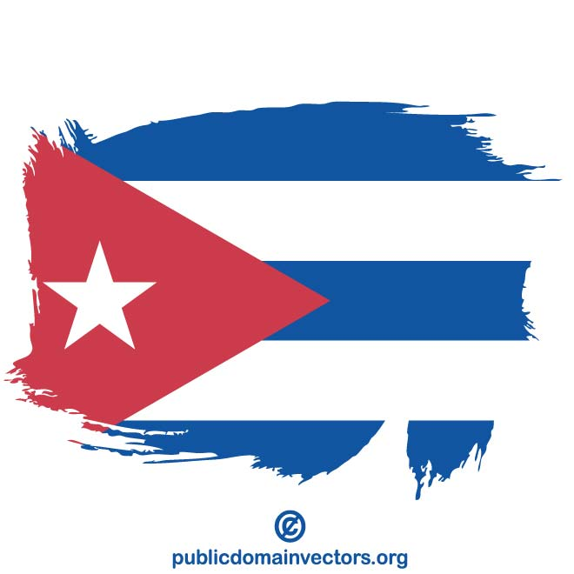
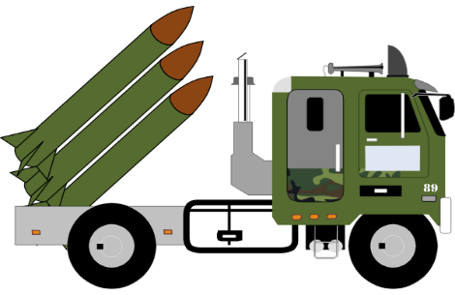
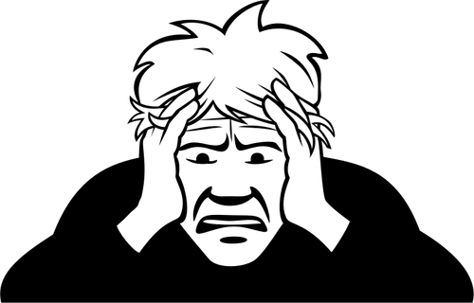
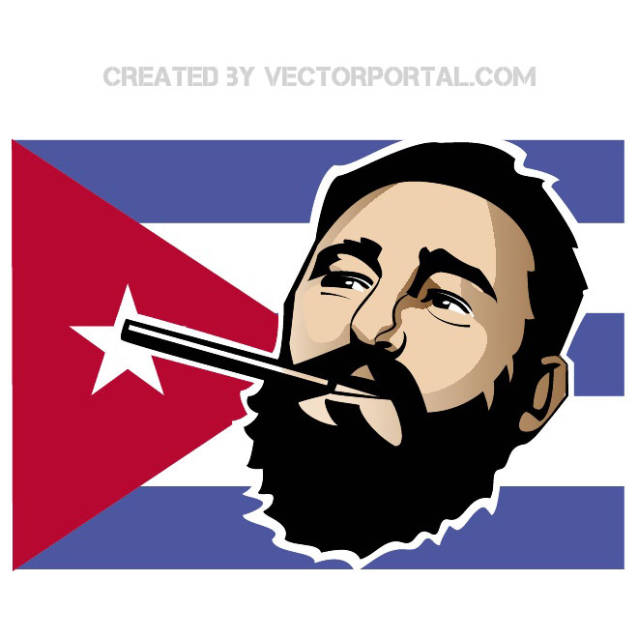
LESSON 12:The Cuban Revolution (1959) The Bay of Pigs (1961) The Cuban Missile Crisis (1962).
The Background:
Cuba is a country located in the Caribbean. Its government was taken over by two ‘revolutionaries’ named Che Guevara and Fidel Castro. Castro decided to support communism and became allies with Khrushchev. In response, US President Kennedy planned to remove Castro from power. He did not want to invade Cuba using the US military, but secretly planned to persuade ex-Cuban citizens to carry out the threat. The attempted revolution took place in a location known as The Bay of Pigs in April 1961. This failed and humiliated the USA and brought even more support for Castro and Communism. By 1962, the USA became more worried about the strong relationship between Cuba and the Soviet Union. American Spy-Planes spotted weaponry which could be used to carry nuclear weapons in Cuba. The American Intelligence Agency also reported a fleet of Soviet ships sailing to Cuba. There was now a crisis as America worried that the Soviets were going to use Cuba as a missile launching site to attack the USA. Kennedy had to deal with this crisis during a ‘The Thirteen Days’ in October 1962. Finally, Kennedy’s tactics of a naval blockade against the Soviet Ships was successful. However, this did not stop the rising tension around the world that a nuclear war would start.
The NARRATIVE of the events that led to the Cuban Missile Crisis in 1962
STEP 1:
The Origins of the Crisis (1959)
STEP 2:
Cuba allies with the USSR
STEP 3:
The US becomes worried
STEP 4:
The Bay of Pigs (1961)
STEP 5:
The Bay of Pigs Failure
Two revolutionary leaders named Che Guevara and Fidel Castro took over Cuba in 1959.
Despite being close to America, the leaders no longer wanted anything to do with America as they hated the power and influence the USA had over Cuba.
Americans in Cuba lost the land they owned which was then given to the Cuban government.
Consequently, America became worried about losing important business links with Cuba. A number of Americans left Cuba as they were worried about Castro.
Any land owned by the Americans in Cuba, was taken away from them and taken under the control of the Cuban government.
Fidel Castro had then started putting communists into his government. Castro then made an agreement with Khrushchev in the Soviet Union in 1960.
The Soviets agreed to buy Cuban sugar in return for giving Cuba economic aid.
There was a secret agreement between Cuba and the Soviet Union that meant Cuba would allow weapons from the Soviet Union to be based in Cuba.
A Communist government was now being created just 145 miles away from the USA.
Eisenhower banned all trade with Cuba in 1960 and then all political relationships with Cuba were ended in 1961. The relationship between the two countries worsened.
America believed they needed to do something to stop the influence of the Soviet Union in Cuba.
Newly elected President Kennedy did not want Cuba being Communist due to how close it was to the USA.
He agreed to a plan by the CIA to launch an invasion into Cuba to overthrow (remove) Castro from power.
They planned to use ex-Cuban citizens to do this so it looked like a Cuban revolution not an attack by the USA. This way, the USA would say they were not involved.
WHAT HAPPENED?
In April 1961, 1,400 ex-Cuban exiles invaded at a location known as ‘The Bay of Pigs’ in Cuba.
They aimed to remove Fidel Castro and put a US friendly government back in charge.
The attempted revolution failed. The ex-Cuban soldiers had little military experience.
The USA were not able to use their own military in support as they needed it to look like a Cuban revolution.
Castro found out about the invasion plans and he had 20,000 Cuban soldiers waiting to fight off the 1,400 Cuban exiles.
Most ordinary Cuban people did not support the USA and so did not help with the invasion.

Slide 14
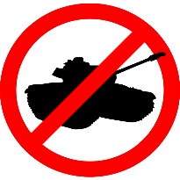
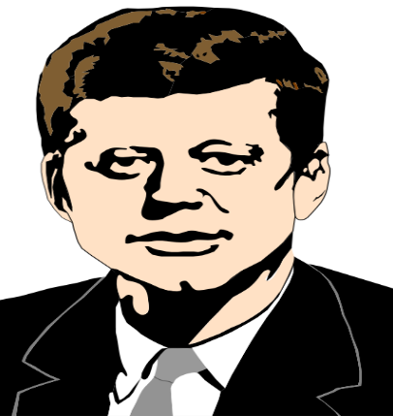
LESSON 12:The Cuban Revolution (1959) The Bay of Pigs (1961) The Cuban Missile Crisis (1962).
The NARRATIVE of the events that led to the Cuban Missile Crisis in 1962
STEP 6:
The Cuban Missile Crisis (1962)
STEP 7:
Kennedy’s Actions
STEP 8:
‘The Thirteen Days’
The Impact of the Cuban Missile Crisis
In 1962, American spy-planes took images of launch pads for medium range ballistic missiles. These types missiles were designed to carry nuclear weapons.
These could clearly cause damage to the USA if they were fired from Cuba.
The CIA also told Kennedy that a fleet of Soviet ships were sailing to Cuba and it was presumed (although not known) that they were carrying the nuclear missiles themselves.
This was the crisis that Kennedy had to deal with. It was thought by the USA that the nuclear missiles could be ready in 2 weeks to be fired on the USA.
Kennedy had to try and deal with what to do with the missiles in Cuba without causing a full blown nuclear war with the Soviet Union.
This was a crisis for America and the rest of the world watched to see how Kennedy would deal with the issue.
His problems were:
1 = TIME: The missiles would be active in 2 weeks – he had little time to decide what to do.
2 = PUBLIC PRESSURE: The American public would be putting Kennedy under pressure to deal with Cuba.
3 = US ELECTIONS: There were elections in the USA coming up. He needed to deal with the missiles or loose votes.
4 = PUBLIC IMAGE: Kennedy needed to stay strong against Khrushchev. He did not want to seem weak.
MEETING: On 16th October, Kennedy called a meeting to discuss what the USA should do. They met every day for 13 days. The world watched as it was believed a nuclear war could start any day.
NO ATTACK: On 22nd October, Kennedy decided NOT to attack or invade Cuba. This was too risky.
NAVAL BLOCKADE PLAN: He set up a naval blockade around Cuba, where no ships would be allowed to pass without permission.
TV APPEARANCE: Kennedy also appeared on TV that evening to announce his plans. It was the first time the public were told of the missiles heading to Cuba.
WORRY OF NUCLEAR WAR: Many of the American public believed the Soviets would ignore the naval blockade, America would have to attack and there would be a nuclear war.
BOMBERS READY: Just in case of this outcome, Kennedy asked for 54 bombers with nuclear missiles in case war broke out. The world held its breath.
SOVIET SHIPS RETREATED: On 24th October, the Soviet ships reached the blockade – AND TURNED AROUND!!! The Soviet Union had backed off and retreated. It seemed Kennedy’s plan had worked.
TELEGRAM FROM KHRUSHCHEV: The Soviet Union agreed to remove the missile sites if the USA promised not to invade Cuba and remove their own missiles from Turkey.
NO WAR: Direct war between both sides was avoided because of the navel blockade.
REDUCTION IN TENSION: War was so close that both sides were frightened into making more agreements which led to reduced tension.
KENNEDY’S POPULARITY: Kennedy became more popular in the USA –People believed he had avoided a nuclear war and defeated the Soviet Union. Both leaders were under pressure from their government and their people to react and start a war but neither leader did.
THE HOTLINE: A direct communication was set up between Moscow (Soviet Union) and Washington (USA) known as the ‘Hotline’. This way, both sides could talk before taking any action.
Agreements
TEST BAN TREATY: In 1963, Test Ban Treaty was signed where both sides promised to stop the testing of nuclear weapons in outer space, under water or in the atmosphere. This controlled the use of nuclear weapons further.
OUTER SPACE TREATY: 1967 Outer Space Treaty – Both sides agreed not to use space for military reasons such as putting nuclear weapons into space.
This could be a nuclear war
NUCLEAR NON PROLIFERATION TREATY 1968: This treaty was signed by both sides to stop the spread of nuclear weapons. Both sides were not allowed to share their nuclear technology with any other country.
FALL OF KHRUSHCHEV: The Soviet Union however believed that Khrushchev had been humiliated with the retreat of the Soviet ships. He was sacked from his leadership in 1964 as a result.

Slide 15
LESSON 13: The Prague Spring (1968) and resulting Brezhnev Doctrine.
The Background: From 1945, countries in Eastern Europe had been part of the Soviet Union’s satellite states. Countries such as Czechoslovakia lived under a Communist government which was ruled from Moscow. Life was strictly controlled by the Soviet Union. However, by the late 1960s, Czechoslovakia had seen some important ‘reforms’ (changes) through a new Communist leader named Alexander Dubcek. He pushed for more freedoms in a time known as the Prague Spring (Prague is the capital city of Czechoslovakia). However, this was too much freedom for the new Soviet leader Leonid Brezhnev. Brezhnev soon reacted to the Prague Spring with a Soviet invasion. He then introduced a policy known as the Brezhnev Doctrine to prevent other Eastern European countries attempting to gain freedom.
Czechoslovakia Basic Facts:
Czechoslovakia was an Eastern European country in the Soviet Union’s ‘Eastern Bloc’. It was a satellite country under Communist control.
2. A time for change
In January 1968, a new communist leader of Czechoslovakia came to power - Alexander Dubcek
He was still a communist but had a more ‘liberal’ (free) idea of what Communism should be like.
He called his more liberal version of Communism ‘Socialism with a Human Face’. He still believed in communism but cared about his people.
He wanted people to enjoy their lives and be able to express their views without the fear of being punished.
The Soviet Union liked and trusted Dubcek and wanted him to make Communism more popular.
Dubcek also strongly wanted to stay in the Warsaw Pact and had no intention of leaving.
Dubcek made reforms (changes to the law) that gave more freedom to the Czech people.
This time of freedom in Czechoslovakia was known as The Prague Spring as the reforms started in April (Springtime). Prague was the capital of Czechoslovakia and where the changes started to take place.
4. The Consequences
Most people in Czechoslovakia welcomed the changes and liked their new freedom.
The Soviet Union had a new leader in 1968 called Brezhnev. He disliked the Prague Spring and the new freedoms given to the Czech people.
Brezhnev worried that other Eastern European countries would want to gain more freedom and this would damage the powerful image of the Soviet Union.
The Soviet Union needed to make
message clear that no other Eastern European country should attempt to make the same reforms.
5. How did Brezhnev React?
Brezhnev warned Dubcek not to weaken communism and to stay strict.
Brezhnev ordered his Warsaw Pact troops to carry out military practice just outside the border of Czechoslovakia as a warning. Brezhnev decided then to take military action and invaded.
20th August 1968, 500,000 Warsaw Pact troops invaded Czechoslovakia and stop the Prague Spring.
How did Dubcek React to the Soviet Invasion?
Rather than fight back, Dubcek ordered his army and the people to remain peaceful – a peaceful resistance.
Some individuals attacked Warsaw Pact soldiers and blocked roads but it remained a peaceful.
Dubcek was arrested and ordered by Brezhnev to change his reforms.
He was replaced with a hardliner (strict/tough) communist leader.
For the next 20 years, Czechoslovakia was under strict Soviet control again to prevent another ‘Prague Spring’.
1. Why was there opposition towards the Soviet Union in Czechoslovakia?
ECONOMIC
All goods made the country were taken to the Soviet Union. This meant people had little to buy.
Poor economy. Czech people had very few goods, fuel and food.
POLITICAL
There was no freedom of speech.
No democracy (voting) as the Communist Party were the only party allowed.
TV, radio and newspapers were censored.
Stalin had ordered ‘purges’ (violent attacks and executions) on anyone opposed to Communism. This included politicians and members of the military.
SOCIAL
Czech people complained about their poor standard of living.
Czech people were banned from travelling to the West.
The Main Consequence of the Prague Spring - The Brezhnev Doctrine 1968
A doctrine is a ‘belief’. Brezhnev said that if any communist country attempted freedom, Warsaw Pact troops would be sent in. This was a way to stop any other countries from attempting their own Prague Spring. He did this in Sept. 1968.
The importance of the Prague Spring and the invasion of the Soviet Union
The impact in Czechoslovakia
The Soviet invasion ended the time of the Prague Spring. The Soviet invasion led back to strict Soviet control again.
The impact on the relationship with other communist countries:
Other countries such as Yugoslavia and Romania spoke out against the Soviet invasion which made their relationship with the Soviet Union worse. Communist political parties in Italy and France cut their links to the Soviet Union.
The massive invasion of the Soviet Union led to a very tight control over other Eastern European countries to prevent others trying to gain more freedom. The invasion showed the massive power of the Warsaw Pact troops.
The impact on the relationship between the USA and the Soviet Union:
The USA were outraged by the invasion of Czechoslovakia and made public protests.
The Soviet Union realised that nobody could really do anything about their invasion apart from use words against it.
It showed that the USA was keen to criticise the Soviet Union but was very unlikely to actually carry out any action against it. The USA had started a war in Vietnam and so this made action against the Soviet Union more unlikely.
3. The Events of the Prague Spring
There was less censorship so people could openly criticise Communism and the Czech government.
Trade Unions (that helped workers with pay and conditions) were allowed.
The government control of land and industry was relaxed. Trade with countries outside the Eastern Bloc was allowed.
Czech people were given the freedom to travel to countries outside the Eastern Bloc.
There was open discussion about allowing political parties other than the Communist Party.

Slide 16
LESSON 14: The 1970s Détente – SALT 1 (1972), Helsinki Accords (1975) and SALT 2 (1979).
The Background: The tension between the two sides of the Cold War reached a climax during the 1960s. Both sides knew the risk of a nuclear war was too great. Therefore, there was a period of ‘peace’ known as DÉTENTE throughout the 1970s. This however, ended when the Soviet Union invaded Afghanistan in 1979.
Why did both sides follow the policy of Détente in the 1970s?
A threat of Mutually Assured Destruction M.A.D. During the 1960s, events had brought the two sides close to war. Both sides had developed enough nuclear weapons to destroy each other. It was a worry that if war did break out, the results would be complete destruction. This was known as Mutually Assured Destruction or MAD. Both sides agreed that a nuclear war was too risky and tried their best to avoid this by the 1970s. | Public Pressure for Peace in the USA The USA had been involved in the Vietnam War. It was expensive and caused the death of 60,000 US soldiers. There were mass protests against war all over America and the West. President Nixon gave in to public pressure. He knew the public feared a nuclear war which risked more lives. | More money and time to solve social issues America had social problems such as inequality between blacks and whites. Black Civil Rights leader, Martin Luther King was assassinated in 1968. A policy of détente would give the US more money and time to help people in their own country. The Soviet Union had poor living standards. There was pressure from the people living there to improve this rather than spend money on weapons. | Pressure from West Germany There was pressure for Détente from the leader of West Germany, Willy Brandt. He called for a better relationship between East and West Germany. This pressure from Willy Brandt was called ‘Ostpolitik’. Willy Brandt had huge influence over the decisions made by the USA and the USSR
SALT 1 (1972) Strategic Arms Limitation Treaty
HELSINKI ACCORDS 1975
SALT 2 (1979)
Who signed the SALT 1 agreement? - President Nixon & Brezhnev 1. The Anti-Ballistic Missile Treaty stated that ballistic missiles were only allowed on two military sites and a maximum of 100 missiles were allowed. 2. The Interim (short term) Treaty put a restriction on the number of long range missiles called ICBMs (Inter-Continental Ballistic Missiles) that each side was allowed. 3. The Basic Principles Agreement Was a set of rules about where missiles could be placed. E.g., no nuclear missiles were allowed on submarines or on the seabed. The negative consequences of SALT 1: In reality, if war broke out, it was unlikely that both sides would stick to the agreement just because they had signed a piece of paper. Both sides still owned enough nuclear weapons to destroy each other anyway. The SALT treaty did not include even newer nuclear technology such as missiles which could carry more than one nuclear warhead on a single missile. The positive consequence and importance of SALT 1: It showed that both sides were willing to negotiate and seek détente. It showed that both sides wanted to reduce the likelihood of war. It was a major symbolic importance and publically demonstrated that both sides wanted peace. After signing SALT 1, President Nixon visited the Soviet leader Brezhnev in Moscow in 1972. In 1973, Brezhnev then visited the USA. In 1974 negotiations started for SALT 2.
Helsinki is in Finland where the 33 nations from the Warsaw Pact and NATO all met to build on the idea of détente and co-operation. It was announced 1975 that all nations at the agreed on what they called 3 main ‘baskets’. BASKET 1: EUROPEAN BORDERS The borders between East and West Germany and the Soviet Controlled areas were formally agreed. It was now illegal for either side to force a change in these borders and ‘invade’ the other side’s territory. BASKET 2: INTERNATIONAL CO-OPERATION The agreement that both sides would continue to work for a better relationship. This included a trading agreement, an exchange of technology and a joint space mission. BASKET 3: HUMAN RIGHTS The agreement that both sides would respect human rights and freedom of speech, religion and free movement of people across Europe. The soviets were worried however that they were going to be spied on for the USA to check they were respecting human rights.
Both sides wanted détente to continue worked towards a second SALT agreement. This time, President Carter negotiated with Brezhnev. What was first agreed in SALT 2? Further restrictions on missiles and a ban on testing a new type of ICBM (Inter-continental ballistic missile) Why did détente fail by the late 1970s? LACK OF TRUST - There was a growing believe in the USA that the Soviets could not be trusted to keep their side of the agreements. FURTHER COMMUNIST SUPPORT - The USA were not happy that the Soviet Union had given more support to other communist countries around the world. A STRONG IMAGE - American workers were captured by Islamist fighter in Iran (Middle East). The American public demanded a more aggressive approach rather than détente to make America look strong again. POLITICAL PRESSURE - American politicians were beginning to demand a stronger attack on Communism and the Soviet Union due to ongoing Soviet aggression. NEW US PRESIDENT CARTER – Wanted to be tougher against Communism. A TURNING POINT IN SALT 2…… THE SOVIET INVASION OF AFGHANISTAN 1979 In December 1979, the Soviet Union invaded a nearby country called Afghanistan and once again showed its aggression and force. As a consequence of this aggression, President Carter refused to fully sign and agree to SALT 2. Therefore, it was never formally agreed. This symbolised the end of a period of détente between the two sides.

Slide 17
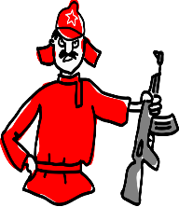
LESSON 15 – The Soviet Invasion of Afghanistan in 1979 & consequences.
The Background: Throughout the 1970s, there had been a period of relaxed tension between the two sides known as Détente. However, when the Soviet Union decided to invade Afghanistan in 1979, the invasion had many consequences. Importantly, one of the main consequences was the certain end of Détente and a period often referred to as the ‘Second Cold War’. The relationship between the USA (President Carter) and the Soviet Union (Brezhnev) would become more strained.
Why did the Soviet Union invade Afghanistan in 1979?
Afghanistan is located below the Soviet Union. It was important to the USSR as the Soviet Union wanted to use Afghanistan as a ‘barrier’ to protect it from Muslim Fundamentalism. Iran, another neighbour of the Soviet Union had already been taken over by a Muslim Fundamentalist government. The Soviet Union were worried that the same could happen in Afghanistan. If this happened, they feared that extreme Muslim beliefs would spread into the Soviet Union.
The Short term cause of the Soviet Invasion.
In 1979, the Soviet Union put a pro-Soviet government in control of Afghanistan to stop the spread of Muslim ‘threats’. They also gave Afghanistan economic help to keep them on side. However, this only lasted until September when a pro-Muslim leader called Amin took over. Brezhnev was willing to work with Amin until he heard that the USA might offer Amin even more support to keep out the Soviet Union.
Key Terms
Muslim Fundamentalism – Extreme believers in the Islamic faith.
Mujahedeen – the Islamic fighters/army.
Pro-Soviet Government – a government which supports Communism.
Amin – the Afghan leader who took over in 1979.
Kamal – the Afghan leader put in power by the Soviet Union to work in a pro-Soviet government.
Economic Sanctions – a series of trade bans to halt the economy of a country.
Boycott – The refusal to take part in an event.
The key events of the invasion
In December 1979, Soviet troops invaded Afghanistan. They ‘claimed’ that Amin had wanted them to invade to protect his government from Islamic terrorists. However, Amin was then assassinated (almost certainly by Soviet troops). The Soviets replaced Amin with a Pro-Soviet leader called Kamal. Soviet troops stayed in Afghanistan for 10 years. They kept their pro-Soviet leader, Kamal in charge & fought off any opposition. The Soviet Union argued that they were trying to protect their border from foreign invasion and stop the influence of Muslim Fundamentalism..
The American Reaction to the invasion
The Americans saw the Soviet invasion differently. They believed it was an example of Soviet aggression and another attempt to spread communism elsewhere in the world. This would go against the agreements made at Helsinki in 1975.
President Carter even claimed that the Soviet invasion was the biggest threat to world peace since the end of the Second World War.
Carter then refused to sign the SALT II treaty.
He increased the American spending on weapons.
Carter then said in public in January 1980, that America would use force in the Middle East if any American interests were threatened.
Carter imposed economic sanctions on the Soviet Union.
Carter send weapons and money to help the Islamic Fundamentalist fighters known as the Mujahedeen fight against the Soviet Union. One individual to gain from this was Osama Bin Laden.
The impact of the invasion on USA-Soviet Relations
Détente was certainly now finished.
Some believed that the American government deliberately over-reacted to the invasion as an excuse to become more aggressive against the USSR.
In the 1980 Presidential Election, a new candidate Ronald Reagan argued that President Carter was too weak against the Soviet Union in the era of Détente and believed America should become stronger.
Reagan won a landslide victory as the American public too, wanted America to become more powerful and reduce the spread of communism.
The US Olympic Boycotts
The USA led a boycott of the 1980 Olympic Games which was being held in Moscow. Over 60 countries supported the USA and refused to send their athletes to compete.
The boycott proved how influential the USA were.
American athletes were told that if they travelled to Moscow to compete that their passports would be taken away from them and they would not be able to return.
The Soviet Union were hoping that the Olympic games would promote communism. However, they were not able to showcase the country as many of the best known athletes did not turn up.
The boycott made the Soviet Union more angry with America. 4 years later, when it was the USA’s turn to host the games, the Soviet Union refused to send its athletes and athletes from the other 15 communist countries.

Slide 18
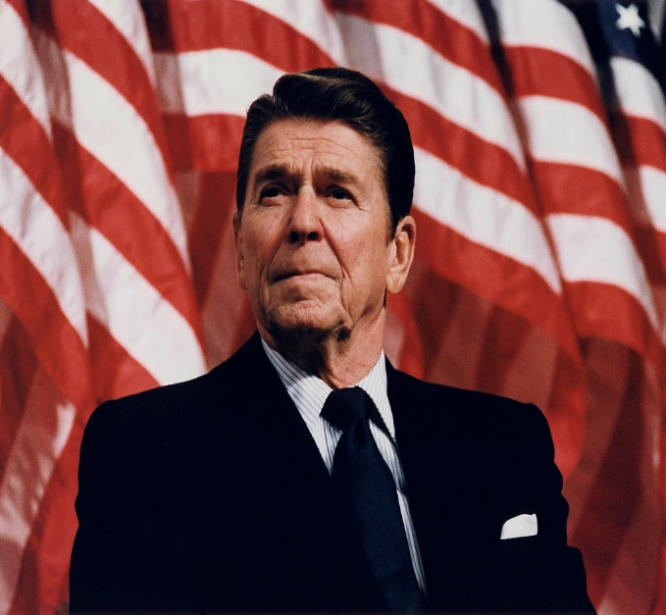
LESSON 16: President Reagan, the ‘Second Cold War’ and the Strategic Defence Initiative (‘Star Wars’).
US President Reagan was hugely influenced by the Soviet invasion of Afghanistan and as a consequence, he became far tougher on the Soviet Union. The American public voted for Reagan on the promise that he would get even tougher on Communism. This led to a period of tense and hostile relations and was referred to as the Second Cold War. Reagan made it very clear in public that he wanted to confront Communism where possible. He wanted to massively increase spending on weapons and to make the position of the USA in the world even stronger.
President Reagan’s Policies
Reagan’s Defence Policies
Reagan’s Strategic Defence Initiative – ‘Star Wars’ (1983)
Communism is ‘Evil’.
In 1983, he described the Soviet Union as an ‘Evil Empire’ and said that the USA represented the forces of ‘good’. The Soviet leader, Yuri Andropov responded by calling Reagan a ‘liar’ and ‘insane’.
Reagan announced that the USA would spend 1 trillion dollars improving its weapons to ‘defend’ the country against Communism. He was willing to do this as he knew that the Soviet Union were running out of money and they would not be able to keep up with this ‘arms race’ by the 1980s.
President Reagan announced an even bigger plan to defeat communism. It was so high tech and expensive that there would be no way the Soviet Union could afford to challenge it. It was the Strategic Defence Initiative. The American and Western media nicknamed it the ‘Star Wars’ Programme after the popular movie of the time.
What was the SDI?
The USA would place a number of satellites into orbit. These satellites would carry powerful lasers which would be able to detect and shoot down missiles launched by the Soviet Union. It was against the terms of the 1967 Outer Space Treaty.
Was the Strategic Defence Initiative real?
President Reagan spoke about the Strategic Defence Initiative as if it already existed. However, he did not admit to the rest of the world that the technology for it was years from actually being ready.
Increased spending:
Reagan increased spending on the military. In 1982 , 13% extra was spent on new weapons such as Trident Nuclear Submarines and Stealth Bombers.
NEW DEFENCE TECHNOLOGY
A ‘Stealth Bomber’ which could remain undetected by radar systems.
B-1 Supersonic bombers
The development of a ‘neutron bomb’ which would kill people but leave little damage to buildings’.
The placement of ‘cruise missiles’ which were invisible to radar in countries in Western Europe.
NUTS: Nuclear Utilization Target Selection. US missiles would openly target the Soviet Union’s military bases rather than popular cities. This would mean the USA could easily destroy any Soviet nuclear weapons quickly before they became a threat to the USA.
What were the consequences of the S D I Programme on the development of the Cold War?
Helping Anti-Communist groups:
He announced his ‘Reagan Doctrine’. This would show America’s support for any group wanting to fight against Communism around the world.
EXAMPLES OF REAGAN DOCTRINE:
The US Army supported an island called Grenada in the Caribbean to defeat the Communist government there.
The USA also helped support a Trade Union called ‘Solidarity’ in Poland which wanted fairer working rights and democracy in Poland.
The Soviet Union were in shock. They had spent huge sums of money developing their own missiles. However, they now believed that the Strategic Defence Initiative would mean their missiles would simply be destroyed if they were ever launched. | The Soviet Union accused the USA of preparing for an attack on the Soviet Union first, even though the USA claimed that the Strategic Defence Initiative was to ‘protect’ and ‘defend’ America. It led to even more tension in the Cold War. |  | The Soviet Union realised that they would either have to spend more money developing their own weapons or fail in the arms race against America for good. |  | It proved to the Soviet Union that they had not been able to keep up with the technological advances of the USA and the Capitalist West. Its economy was poor and the Soviet people would no longer accept living in even more poverty for the sake of developing even better weapons.
Reagan hoped that the Soviet Union would want to spend even more money on the arms race and in which case it would destroy the Soviet economy completely and show the failure of Communism. |  | The USA had already won the space race with the first man on the moon in 1969 and the creation of space shuttles in the 1980s. This would mean the Soviet Union loosing the Space Race and the Arms race against the USA. |  | Computer technology was far more advanced in the West. It was this technology that was now needed to develop weapons, space technology, communication, the media and even more. The Soviet Union felt could no longer compete against the US.

Slide 19
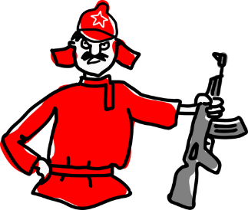
LESSON 17: The actions of Mikhail Gorbachev and the collapse of Soviet control in Eastern Europe.
The Background: The leadership of Mikhail Gorbachev was a key turning point in the history of the Cold War. He came to power in 1985. This was a time when the Soviet Union was facing huge economic, social, political and military problems. Many historians have argued that the actions of Mikhail Gorbachev led to the end of the Cold War and the break up of the Soviet Union. It was Gorbachev’s new approach and ‘new thinking’ about Communism that caused such a turning point. Gorbachev stated - ‘We can’t go on living like this’. He wanted to ‘reform’ Communism to be more in line with the needs of the people of the Soviet Union. In this lesson, we will investigate the events that led to the break up of the Soviet Union and the end of the period known as the Cold War.
Problems in the Soviet Union by 1985
Gorbachev’s New Policies
Consequences
Summit Meetings between the two sides
ECONOMIC PROBLEM: ARMS RACE
Brezhnev had spent huge sums of money on weapons to keep up with the USA in the arms race. The Soviet economy struggled.
Perestroika
Perestroika is a Russian word for ‘reconstruction’. He wanted to re-organise the economy. He wanted to improve the Soviet economy. He controversially wanted to make communism more like capitalism in order to make money.
Perestroika proved how Communism did not work. This was bad for the reputation of the Soviet Union.
Geneva Summit 1985:
Gorbachev and Reagan met for the first time and had a positive relationship with a hope to bring an end to the Cold War.
Reykjavik Summit 1986
This meeting was held just after the Chernobyl nuclear disaster. Gorbachev was worried about the danger of nuclear power and nuclear weapons. No formal agreements were made but again, both sides were willing to work together.
SOCIAL PROBLEM 1: POVERTY
People living in the Soviet Union were living in poverty. There was little food, fuel or goods available. Living conditions were poor.
Glasnost
Glasnost is a Russian for ‘openness’. He wanted the Soviet Government to be more honest with the people and allow its people to speak more openly about their opinions without the fear of the secret police. He hoped glasnost would make the Soviet people trust their government and stop protests.
Glasnost gave the Soviet people a chance to see how much better life in the West was compared to the East.
Washington Summit 1987
Gorbachev agreed to disarm nuclear weapons and reducing spending on arms. He wanted a better relationship with the West.
AGREEMENT: The signing of the Intermediate Range Nuclear Force Treaty (INF). It was agreed that both countries would remove and destroy all land based missiles with a range of up to 5,500km.
SOCIAL PROBLEM 2: HUMAN RIGHTS
There was little freedom of speech and high amounts of censorship. This led to protests in some states such as Poland. Here, a trade union called Solidarity with 10 million members challenged the Soviet Union.
Moscow Summit 1988
Gorbachev announced a reduction in the number of Warsaw Pact troops and that the Soviet Union would leave Afghanistan.
Ending the Brezhnev Doctrine
The Brezhnev Doctrine stated that any country which wanted to leave the Soviet Union would be threatened by military action by Warsaw Pact troops. Gorbachev now dropped this idea and stated that the Soviet Union would no longer get involved with the desires of other Soviet countries.
Ending the Brezhnev Doctrine allowed other Eastern European states to form their own non communist governments without the fear of being invaded by the Soviet Union.
It allowed these countries more freedom to live a western lifestyle and so travel to the west.
SOCIAL PROBLEM 3: USE OF SECRET POLICE
The Soviet Union were worried about protests. They tightened their control by using the secret police, interrogating protestors and imprisoning without trials.
Malta Summit 1989
Gorbachev met with new US President George Bush & marked an end to the Cold War.
POLITICAL PROBLEM: POOR LEADERSHIP
The Soviet Union had suffered from poor leadership. The leaders wanted to compete with America and not look after their own people. Many had poor health. 1982-1985 there were 3 leaders and little was achieved.
Reduce Spending
Gorbachev promised to reduce spending on nuclear weapons, arms and defence.
How did the US respond to Gorbachev’s new thinking?
Ronald Reagan had been elected by the American public in 1981 as he wanted to be even tougher on Communism. It was known as a period called the Second Cold War. However, once Gorbachev became Soviet leader in 1985, the relationship between the two sides improved. Reagan changed his tactic to work with the Soviet Union to possibly bring an end to the Cold War. Both sides were willing to discuss and negotiate change.
REPUTATION: CHERNOBYL NUCLEAR DISASTER 1986
In 1986, there was an explosion at a nuclear power plant called Chernobyl. It released 100x more radiation than in the atom bombs used at the end of the war. The Soviet Union tried to cover up the nuclear disaster. It proved how bad nuclear technology was in Russia
Remove Troops from Afghanistan
The Soviet Union had invaded in 1979 and lost millions of men fighting for over 10 years. He decided to withdraw.

Slide 20
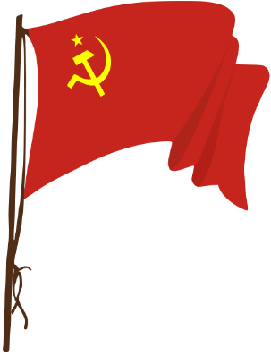
LESSON 18: The significance & consequences of the fall of the Berlin Wall (1989).
The Background: The Berlin Wall had been ordered by Soviet leader Khrushchev in 1961 to prevent thousands of skilled workers were leaving the poor living conditions of the Soviet Union to live in the West. The Berlin Wall was the strongest visible symbol of the Cold War divide between the East and West, Capitalism and Communism and the USA and the Soviet Union. Soviet leader Mikhail Gorbachev finally allowed the border at the Berlin Wall to be opened on the 9th November, 1989. It signified the end of Communist control in the Soviet Union and even brought the end to Gorbachev’s leadership of the Soviet Union.
Why did the Berlin Wall Fall?
The Immediate Consequence
CONSEQUENCES & IMPORTANCE OF THE FALL OF THE BERLIN WALL
Due to Gorbachev’s new way of thinking, East Germans had begun travelling to the ‘West’ through Austria. Other Eastern European countries were starting to give more freedom to their people such as Poland, Hungary and Czechoslovakia. Citizens started to cross the border to the West unchallenged by the Soviet Army.
This influenced the citizens of East Berlin to do the same if they protested enough.
Mikhail Gorbachev visited East Germany in October 1989 and told people that he would not get in the way if people wanted change.
In October 1989, East German citizens started to protest about the wall and demanded that the border ‘Checkpoint Charlie’ was opened. Thousands gathered at the checkpoint.
By 4th November one million demonstrators took to the streets of East Berlin to demand democracy and the end of the Berlin Wall.
By 9th November 1989, Gorbachev refused to challenge the demonstrations and told the East German government that they could open the border ‘indefinitely’.
Many citizens had been split up from their family and friends when the wall was built. The fall of the wall meant that they could be reunited after 28 years.
There were scenes of great emotion and anger at the wall when they realised that the border crossing was open without the restriction of the East German and Soviet troops.
For days after, people travelled through to the ‘other side’ and even brought pick axes and hammers to break down the wall themselves.
The fall of the Berlin Wall was broadcast live on TV around the world. TV images showed thousands of East Germans crossing over the West for the first time in 28 years.
The fall of the wall proved that Gorbachev was not willing to stop of challenge demonstrations/protests by the East German people.
Gorbachev fell from power
Despite being seen as a hero in the West for wanting to ‘reform’ and bring changes to Communism, other, more extreme Communist leaders in the Soviet Union believed that Gorbachev had been too soft and a weak Communist leader. They pushed him out of power by December 1991.
IMPORTANCE:
There was so much disagreement and a lack of leadership in the Communist Party, that the Soviet Union formally broke up (stopped existing) after 1991.
Eastern European Countries re-gained their freedom.
Many countries in Eastern Europe gained independence from the Soviet union. They held their own free elections and voted out Communism. They no longer had to follow the rules set out in Moscow or be under threat if they did not follow them.
IMPORTANCE:
It showed the end of control by the Soviet Union and the lack of support that Communism had. No Eastern European country wanted to stay Communist after 1989.
Reunification of Germany 1990
Germany was formally united into one country in less than a year by October 1990.
IMPORTANCE:
After Germany was united, it was mainly controlled by the West. This showed how successful capitalism was. Russia no longer had control over Germany.
The end of the Warsaw Pact (1991)
The Warsaw Pact had been set up by the Soviet Union in 1955 after the creation of NATO by the West. It meant Europe was divided into two armed camps. It was the Warsaw Pact troops who stopped Hungary and Czechoslovakia from escaping Communist control in 1956 and 1968.
Now Gorbachev had said he would not challenge the actions and decisions of other Eastern European countries, there was no need for the Warsaw Pact.
IMPORTANCE:
It showed an end to the possible military fight between the two sides. The Soviet Union would no longer be a threat to the West in Europe.
A Symbolic Event
The fall of the wall, symbolised the end of the divide between the two sides. It also symbolised an end to Churchill’s idea of an ‘Iron Curtain’ that divided Europe.
IMPORTANCE: To many it proved the victory of the West over the East and of capitalism over communism.

