Slide 1
Component 1 Knowledge Organiser
Name: _________________________
Target Grade: __________
Media Studies
AWE05 – Mr Williams

Slide 2
How to Research
a. Primary Research
Primary Research is research that YOU do yourself.
Examples of Primary Research:
Survey – Used to gather information from a group of people. Could be used to find opinions on a certain topic, or to get feedback on a product.
Interviews – Conducted by yourself, often used to find out how certain aspects of a media product has been created, or to get opinions of a topic.
Consuming the Media Product – By viewing a media product and making notes is a form of primary research.
b. Secondary Research
Secondary Research is conducted by someone else and presented in an analytical or formal way.
Examples of Secondary Research:
Essays – academic writings that other people have published can be a great way to find quotes or information needed to back up your points.
Books – Theory, non-fiction and academic books are often used to help find information that helps prove your point in your written paper.
Documentaries – documentaries can offer a wide range of information presented in an accessible way. Producers would have already researched the information and then will have presented it in a different way. This means that you can take information and quote it to support your points.
Websites – these are built to deliver information. Looking at various online articles can help build your research and essay.
References - Don’t forget to add a reference page at the bottom of each task.
This should be done as follows:
Websites – Link
Books – Title, Author, Year
Articles – Title, Author, Year, how you accessed it
Media Products – Title, Director/Author/Creator, Production Company, Year
BANNED SITES
You cannot use the following websites as part of your research:
Wikipedia
Chat GPT or any other A.I.

Slide 3
Vocational Context
Vocational Context to be copied from Brief released in Sept 2024
Pictures of products that support the theme will be added to.
The Brief: Use research techniques to select examples of media products that have approached the topic in different ways.
You must select at least one media product from each of these sectors:
audio/moving image
print
interactive media products.
Based on these examples, you should undertake research that covers:
forms of media products
the purposes of media products
types of audience and how they interpret and respond to media products
the relationship between media products, their purpose and audience

Slide 4
Formats of Media Products
Publishing | Audio/Moving Image | Interactive
Newspapers Magazines Film Posters Advertising Album artwork | Radio Podcasts Music Music Videos Film Television Advertising | Websites Video Games Applications Social Media
Example products will be added once theme of brief is given.

Slide 5
Media Industry: The companies making the products and distributing them to the audiences.
Key Term | Definition | Example
Conglomerate | A very large organisation that owns different types of media companies. These organisations have huge financial resources and a lot of power. They can control the messages in many areas of the media. | Comcast or Newscorp.
Diversification | Where a media company moves from producing one type of product to creating different media forms to increase their chances of success | A TV company moving into film production
Horizontal Integration | is where an organisation develops by buying up competitors in the same section of the market | A music publisher buys out other smaller music publishers and they end up owning more than one company at the ‘production’ stage.
Vertical Integration | Where one organisation owns more than one stage of the industrial process (production, distribution and circulation) of media product creation. | These companies can control every stage and ensure that their products reach the audience.
Convergence | Making a product available across different platforms, in order to reach different audiences. This enable organisations to construct/reinforce a brand identity and maximise audience reach | A film marketing campaign including posters, trailers, social media/ viral content and a website, where all of the different elements converge (e.g. James Bond)
Government Funded | A product that is financed by government money | A public health campaign, for example This Girl Can and all the Covid-19 information adverts
Non-profit | Products that are made for a reason other than to make money | The BBC is funded by the licence fee and its programmes need to fulfil a public service remit.
Commercial Model | Companies producing products in order to make a profit, often funded by advertising. | ITV, Channel 4, Sky (almost everything except the BBC)
Regulation | Monitoring / control of media industries by independent organisations. | Ofcom (TV), IPSO (News), BBFC (Film) and PEGI (Games)

Slide 6
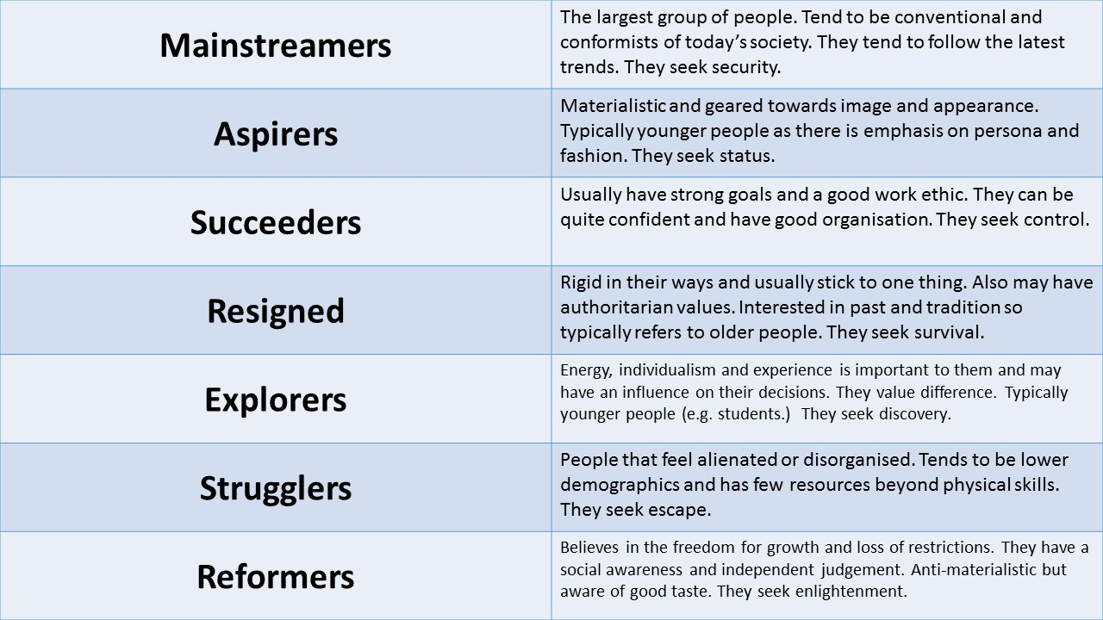
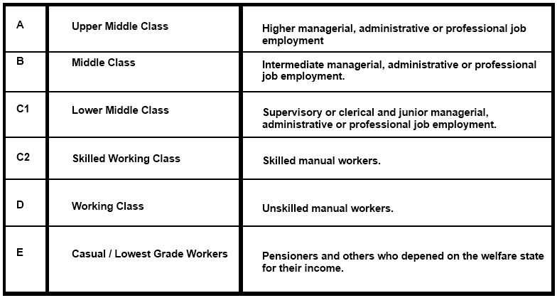
Audiences
a. Mass Audience = A larger broad group of people that will consume a media product. E.g. Eastenders, Marvel Films, charity adverts and the NHS website are all products that will target a mass audience. There is always something that will appeal to all.
Niche Audience = A smaller specific group of people who will consume a media product. E.g. Horror Films, Crime Documentaries, protein adverts and Call of Duty, are products that target a smaller group of people. They are made for people with interests.
b. Demographics
Age – What is the age range of the Target Audience? (e.g. 18-25, 35-50, etc.)
Gender/Sexuality – How would the stereotypical target audience identify? (A straight female is more likely to watch something about fashion compared to a straight male. However, a gay male might enjoy a show about fashion.)
Location – Where is the person based? Someone in the US will be more likely to consume news about US politics compared to someone in the UK.
Class – What is their occupation and income? Which class category do they fit into?
c. Psychographics
Interests
Values
Beliefs
Lifestyle
Personality Traits
By considering the above it helps target products to a particular type of person. We use the acronym MASTERS to help remember the groups.
d. Primary Audiences - The intended audience for a media product. All media producers will tailor their products to target a certain group of people to make sure the product gains profit and views from the intended group.
e. Secondary Audiences – People who may watch a product but aren’t the intended audience. These people may have an interest in the type, style, actors, or may watch it with people around them.
Audience Response
Media products are polysemic (communicate multiple meanings), so different people are likely to find different meanings in the same text.
Media producers make assumptions about a target audience that people in a certain age group and income bracket might share similar values/beliefs. This is now not always the case due to the wider availability of information.
Example: depending on the time / place in which a product is consumed, and a person’s age, upbringing, education, where they live, their values and beliefs, audiences might respond very differently to the confrontation between two characters in a soap opera.

Slide 7
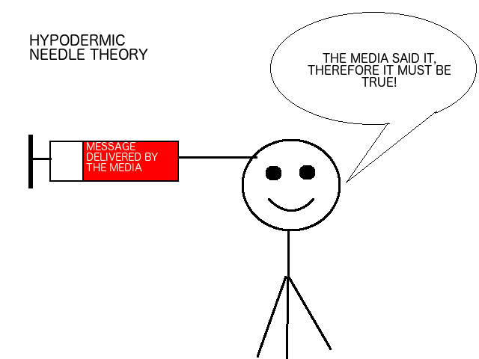
Audience Theories
a. Hypodermic Needle Theory – Lasswell
Theory argues that all audience members are passive (laidback and unresponsive) when consuming media, allowing the media to “inject” ideas and messages to the audience.
An example would be propaganda in the war. They pushed messages to audiences to make them believe certain things about the opposition.
The media today still works like that. Advertising, the news, magazines, social media, etc. Imagine you are thinking you want Pizza Hut for dinner, you then see an advert for a Domino’s deal, you then proceed to order Domino’s because the media told you to.
Newspapers and new broadcasting does this quite often, they try to persuade the audience to take a certain viewpoint. For example, The Sun wants to convince you that the conservatives are the better political party, and that you should vote for them, whereas The Guardian is a left-wing paper (supports Labour or Liberal Democratics)
b. Uses and Gratifications Theory – Bulmer and Katz
Theory to explain the idea of audiences consuming media to satisfy a need or want.
Personal Identity:
Testing yourself and comparing yourself to people in the films, wondering how would you react to the same situation, if you could would you make the same decisions or complete the challenges that character's face.
Social Interaction:
Getting familiar to the characters as if they are friends; getting involved with their lives and wanting to find out what happens to them; having something
to talk about with
other people.
Inform and Educate:
It may teach you or inform you about things you didn’t know. These things could be from around the world, your local town or subject based like history or sciences.
Entertainment and Diversion:
Can also be known as escapism. This takes you away from any problems. It brings excitement and drama to your life.
c. Reception Theory – Stuart Hall
Stuart Hall suggested that media texts contain a variety of messages that are encoded (made/inserted) by producers and then decoded (understood) by audiences. Therefore, what we see is simply a ‘re-presentation’ of what producers want us to see.
Hall suggested that there are three different ways audiences can decode/view the media messages put forward by the producer:
Dominant/Preferred Reading - The audience accept and agree with the messages put forward in the media text
Negotiated Reading - The audience agree with some part but reject or are opposed to other parts
Oppositional Reading - The audience reject the messages that are trying to be conveyed and do not accept/agree with them
For example, when watching a political speech, audiences will either agree with the messages, partly agree or disagree completely depending on their political persuasion and stance.

Slide 8
Task 1 Structure
Pick three products. One audio/visual, one print and one interactive. These must be all relate to the THEME given. One of these products must have been released pre-2000. Include research, both PRIMARY and SECONDARY within your report. Screenshots from shots must be included.
1. Theme Introduction and Research
What is the theme and why have you chosen these three products?
How do you your products link to the theme?
Research Findings on the genre/theme – Primary and Secondary. Include tables and graphics.
Questionnaire Results. Explain your research results and how this links to your chosen products.
Complete the following for each of your chosen products.
2. History/Context (A section for each product)
What was it about?
When did it come out?
Who starred in it?
Facts and Statistics
Research Findings – Primary and Secondary
How well did it do/Audience Viewing Figures
3. Audience (A section for each product)
Primary and Secondary audience – How do you know? Examples.
Individual or Group audience – How do you know?
Mainstream or Niche audience – How do you know?
Demographics (Age, Gender, Location, Race) – How do you know?
Psychographics MASTERS – How do you know?
Uses and Gratifications Theory -– How do you know?
Active or Passive Audience – How do you know?
Hypodermic Needle Theory – What influence -How do you know?
Audience Reading (Preferred/Negotiated/Oppositional)?
Audience statistics + Research – YouGov/Online
Why? Include examples.
Embed your Primary/Secondary Research
How successful was the product in targeting the audience? Why?

Slide 9
Task 1 Structure
4. Purpose (A section for each product)
Type and Ethos of the Media Producer – How do you know?
Type of Production Values? – How do you know?
Marketing used? – How do you know?
What aims and purposes for producer? – How do you know?
How successful was the product in fulfilling its purpose?
5. Relationship between product, audience and purpose (A section for each product)
How does the purpose affect the target audience?
How does the target audience affect the purpose?
6. Similarities and Differences between the products
What is similar and different between all three products in terms of target audience and purpose? Why?
Final Checks:
Name and title on document
Arial Font, Size 12.
Spelling and grammar check.
Screenshots of specific point are added. (not too big, not too small, fitted with text around images)
You have read through your work and included all points for Task 1.
You have clearly met the brief.
Run one more spelling and grammar check.
Submit on Google Classroom.

Slide 10
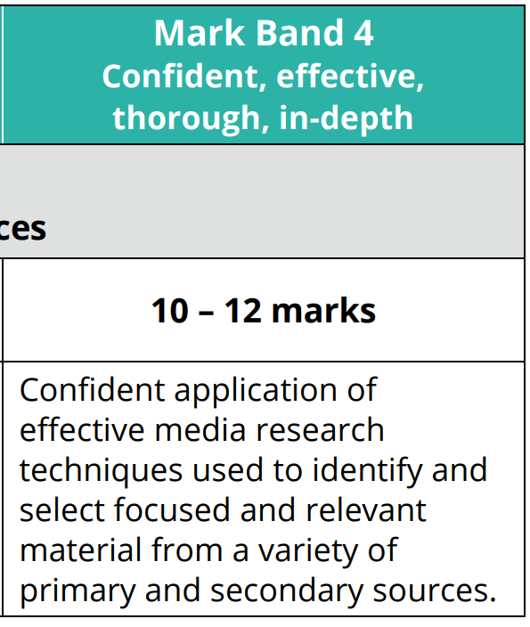
Task 1 Marking Criteria
Everyone is aiming for the top mark band.
In-depth = Covering most, or all, important points of a subject.
Effective = Applies relevant knowledge and understanding and/or skills appropriately to a task and achieves the desired outcome; successful in producing a desired or intended result.
Thorough = Comprehensive and extremely attentive to accuracy and detail.
Confident = Exhibit certainty, having command over information/ argument, etc. Demonstrate secure application of skills or processes.

Slide 11
Notes

Slide 12
Task 2: The Brief
Based on your research relating to the the theme of INSERT THEME, explore how different media products combine media codes and conventions to communicate meaning to audiences. You may chose to focus on products from one sector or products from different sectors.
You should undertake an analysis of media products and provide examples of:
how genre, narrative and representation are used
how media production techniques are used
how genre, narrative, representation and media production techniques combine to create meaning and engage audiences.

Slide 13
Genre
a. GENRE IS…
the word is used to describe a particular style which has certain characteristics or ‘Ingredients’, which we call genre CONVENTIONS
Sub-Genre | Within most genres we can find sub genres, for example within Comedy we can find RomCom
Hybrid Genre | A hybrid genre is a genre which blends themes and elements from two or more different genres, for example The Office is a documentary/comedy
b. Main Film Genres
Listed below are some of the most common and identifiable film genre categories, with descriptions of each type or category.
c. Genre Iconography – What do you expect to see/hear?
Iconography can be defined as those particular signs we associate with particular genres. For example, blood, dark lighting and monsters are associated with the Horror genre, whereas, roses, chocolates and pinks are connected to the Romance genre.
d. What are codes? Codes are systems of signs, which create meaning. Codes can be divided into two categories – technical and symbolic. Technical codes are all the ways in which equipment is used to tell the story in a media text, for example the camera work in a film. Symbolic codes show what is beneath the surface of what we see. For example, a character's actions show you how the character is feeling.
What are conventions? Conventions are the generally accepted ways of doing something. There are general conventions in any medium, such as the use of interviewee quotes in a print article, but conventions are also genre specific.
How codes and conventions apply in media studies Codes and conventions are used together in any study of genre. It is a convention of the horror genre that side and back lighting is used to create mystery and suspense – an integral part of any horror movie.

Slide 14
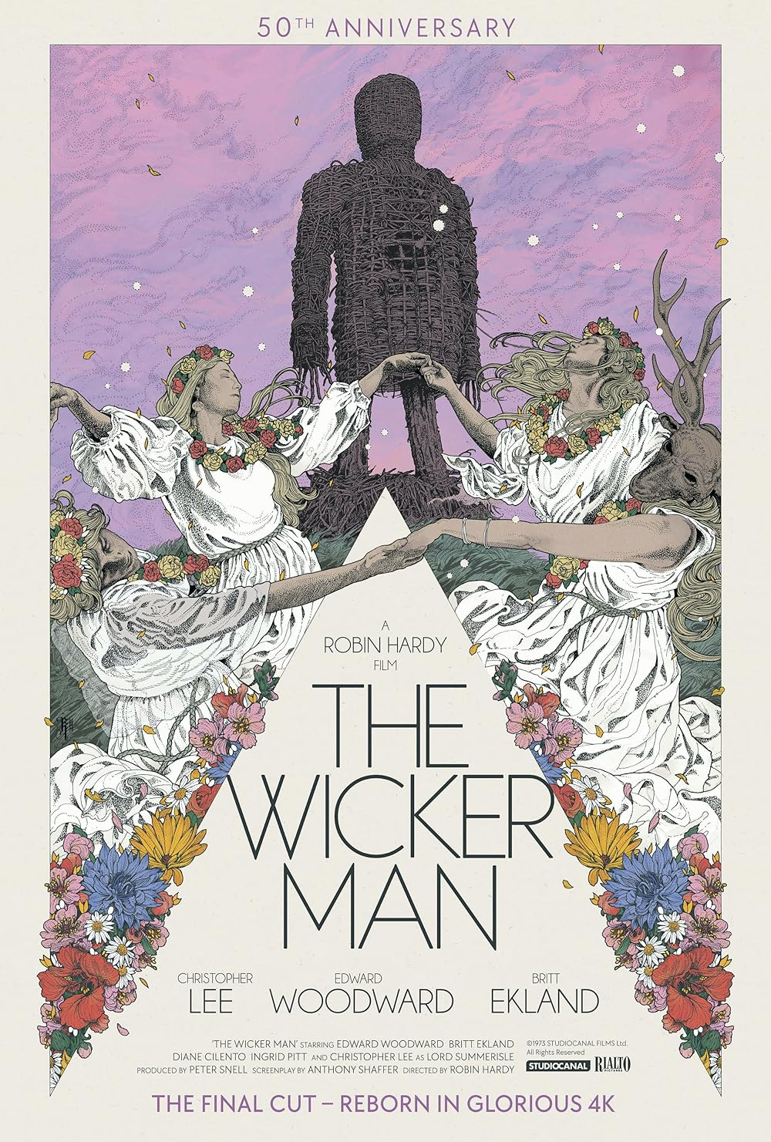
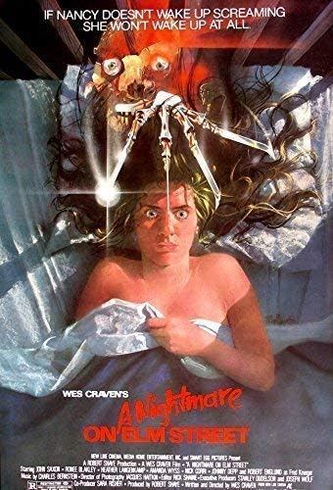
Genre Theory – Steve Neale
Steve Neale developed his Genre Theory to explain why audiences choose different types of media.
We already know that genre is made up of specific conventions and iconography allowing the audience to identify a film they may enjoy based on their interests.
Neale states, that ‘genres are instances of repetition and difference’ and ‘genres are not systems, they are processes of systemisation’. (systemisation = system for organising ideas or plans)
Repetition
Steve Neale argues that audiences like repetition when choosing a film. They like to know what to expect from a certain genre, style and choice.
Example –
Slasher Horrors:
Villain with some form of flaw, could be physical or character based
Chase scenes
Manual weapons – knives, chainsaws, axes, etc.
Final girl – the pretty blonde is always the final victim remaining who may get away.
Tense and synthesised music that peaks at moments of killing
Films that conform:
Difference
Neale then challenges this idea by arguing that audiences will stray from their interested to find something exciting and new to consume. They look for films that will break the expected horror conventions.
Example –
Films set in daylight
Films that are filmed in a different way – e.g. through technology, cinematically
Varied mise-en-scene – pastel colours, new environments, etc
Breaking character archetypes
Films that challenge the genre:

Slide 15
Narratives
Key term | Definition
Narrative | The 'story' that is told by the media text. All media texts, not just fictional texts, have a narrative. For example, magazines have a clear beginning, middle and end. Most narratives are linear and follow a specific structure (see Todorov).
Narrative trope | A recurring motif, theme, or narrative device that is commonly used and recognized across various genres and forms of storytelling. Example would be romance films where boy meets girl, and they fall in love.
Character archetype | Archetypal characters are people who fulfil specific roles within the plot or conflict and help develop the products theme, meaning, or purpose.
Enigma codes | A narrative device which increases tension and audience interest by only releasing bits of information, for example teasers in a film trailer or narrative strands that are set up at the beginning of a drama/film that make the audience ask questions; part of a restricted narrative.
Action codes | Something that happens in the narrative that tells the audience that some action will follow, for example in a scene from a Casualty, a character forgetting to switch the iron off might lead to an accident which results in them attending the casualty department.
Propp’s Character Theory
Hero | The hero reacts and responds to the donor and gets married to the Princess. This is Harry Potter himself
Villain | The villain is the antagonist who plots against the main character. In the Harry Potter films this function is served by Voldemort
The Prize/Princess | The princess is the hero’s love interest but they cannot be married until the villain is defeated. In Harry Potter and The Half Blood Prince (2009), this role is fulfilled by Ginny Weasley
The Helper | The helper, often literally magical, helps the main character during their quest. In the Harry Potter universe, Ron and Hermione fulfill this role
The Dispatcher | The dispatcher is a character who informs the hero or heroine of some emergency or need and sends them on their quest. This role is carried out by Dumbledore
The Princess’ Father | The princess’ father gives the hero his task and exposes the False Hero. Ginny’s father Arthur fulfils this role
The False Hero | The false hero is jealous of the hero, plots against them and takes false credit for the hero’s achievements. Draco Malfoy is the False Hero in the Harry Potter stories
The Donor | The donor prepares the Hero for the challenges ahead. In the Harry Potter stories this role is fulfilled by Hagrid

Slide 16
Narrative Structures
Narrative Structures | Definition
Linear | The story follows a clear story in one straight line of time.
Non-linear | The story will jump around in time, often features flashforwards and flashbacks to help tell the story.
Open | The plot has been left on a cliffhanger, often happens in a series of films, or at the end of a TV episode to make the audience want to watch more.
Closed | There is a clear solution to the narrative. The story has ended, the characters have finished their quest, and the film has a clear ending.
Three-Act Structure | A form of Linear Narrative. The story has three acts. A beginning, middle and end. The beginning is used to set up the characters, the location, and their motives. The middle is where the main bulk of action happens with an exciting peak. The ending is then used to resolve the issues and show the audience the solution to the narrative.
Cause and Effect | A linear structure that follows the line of time. One thing happens so that means something else will too. For example, in Harry Potter, Harry receives a letter telling him he needs to go to wizard school, he then goes with Hagrid to buy supplies for school where he finds out Voldemort is after him, therefore he then embarks on a quest to defeat him, etc. Harry is in the only spare cabin, and he then meets Ron and Hermoine who then become his friends. Everything happens for a reason meaning something else will in turn.
Circular Structure | This is a form on non-linear narrative. The film begins at the end and then explains how they got to the conclusion. Media products with a circular narrative often features a narrator and have a closed ending.
Single stranded | One storyline for the audience to follow throughout.
Multi-stranded | Multiple storylines for the audience to follow throughout. Often used in TV series, soap operas or film.

Slide 17
Todorov’s Narrative Theory
Traditionally, narrative structures followed a formula which was identified by the theorist Tzvetan Todorov.
Todorov studied classic fairy tales and stories.
He discovered that narratives moved forward in a chronological order with one action following another. In other words, they have a clear beginning, middle and end.
Todorov also suggested that the characters in the narrative would be changed in some way through the course of the story and that this would be evident by the resolution.
Equilibrium - The balance of life is equal and even. ​
New Equilibrium – The balance is restored but something has changed, could be a character’s morals or a situation.
Disturbance - The balance is broken by an incident.
Repair - Characters of the story will begin to try and repair the situation.
Recognition - One of the characters will recognise that a disruption has happened.

Slide 18
Representation: the description or portrayal of someone or something in a particular way
Key Terminology | Definition | Example
Representation | The way in which people, issues and events are depicted in media products. How aspects of reality and versions and perspectives of events are presented to the audience | Brexit was presented as a good thing or a bad thing depending on the media presenting it – e.g. The Sun vs The Guardian. The editors of these papers “re-presenting” news from their own viewpoint.
Selection | The action of carefully choosing something as being the best or most suitable of the message. This includes what is, and isn’t, included | The Sun chose to omit any benefits of being in the EU so that the emphasis in its Brexit position of the need to save our British culture had more impact
Mediation | How the maker/producer draws on all possible ideas and resources to present their version of reality to you | The Sun newspaper uses populistic images, large bold text and sensational quotes from well-known figures and celebrities.
Construction | Representations are ‘built’ by producers, using elements of media language. i.e. how things have been designed, laid out, edited, put together | Magazines will often build representations using a person with star quality on the front and align headlines and other images to present the side of this persona that they want to promote
Stereotype | A widely held and over simplified image or idea of a person or thing | Grumpy older people or flat cap wearing northerners.
Archetype | A very typical example of a certain person or thing | a male archetype = muscly, strong, powerful with short hair and tall.
Feminism | Supporting equal rights for women (society was traditionally male dominated but from the 1960s onwards there has been a move towards more equality) | Media industries have traditionally been male-dominated, with fewer opportunities for women. Women have often been underrepresented in the media; they also tend to be ‘passive’ in the narrative, and portrayed as ‘objects’ (Mulvey’s Male Gaze theory )
Dominant | 1) The main idea or message. 2) The person considered to be in charge or who has the power | A dominant message is that adults must work and pay their taxes. Traditionally, men have been portrayed as more dominant than women. This stems from the concept of a patriarchal society
Inferior | Lower in rank, status, or quality | This could be a product, a style, a genre or a person

Slide 19
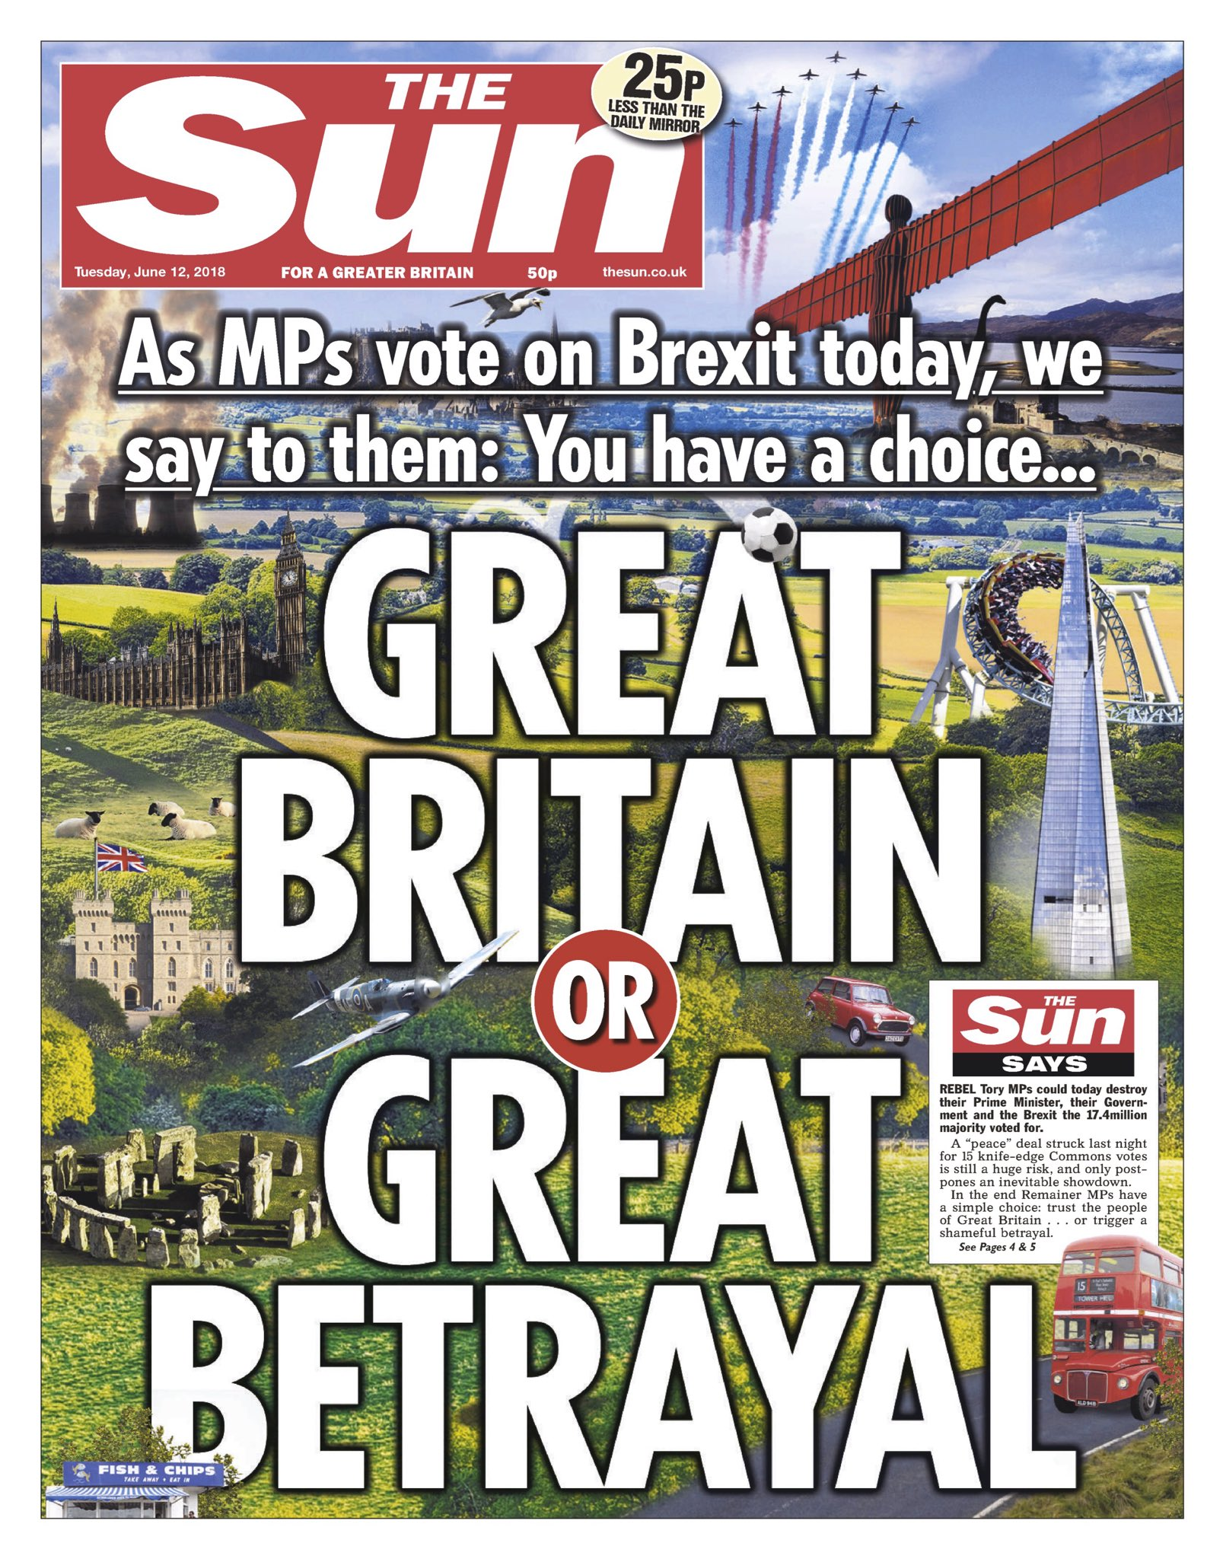
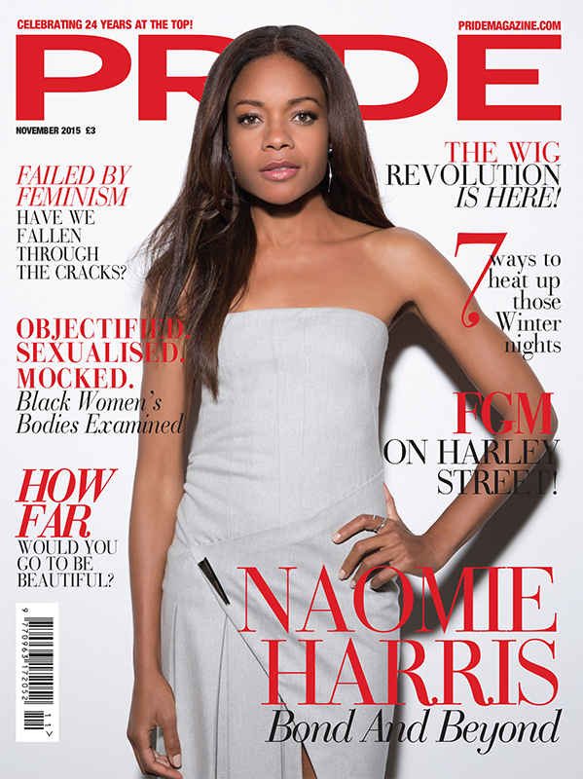
Representation is not a ‘window to the world’ – it is how the media producers want you to see the world
a. Representation often includes stereotypes:
Stereotypes are a widely held, often negative and over simplified image or idea of a type of person or thing. They are used to communicate meanings Unruly, rude, lazy, disrespectful, defiant, unmannered…that audiences will easily recognise.
Stereotypes become established when a social group (often a minority group) has been categorised repeatedly in the media and becomes recognised by a set of attributes.
Stereotypes may alter and develop over time, mainly due to changes in culture and society.
b. Media producers make choices about how to represent:
Events | Newspaper front pages combine images and text to convey information about the issues and events in the main splash (story).
Social Groups | Are often categorised by age, gender and ethnicity. e.g. how some magazine front covers communicate ideas about gender/ identity in the use of media language. Media products often feature representations of powerful social groups (who have traditionally controlled the media). Certain groups (e.g. minority ethnic or LGBTQ+ people) may be absent, or under/misrepresented (e.g. stereotyped). The choices about how to represent a social group will communicate a point of view, e.g. Pride Magazine cover conveys positive messages about black female empowerment.
Aspects of Reality | These may be represented differently depending on the purposes of the producers. Newspapers are informative and need to include factual detail, a sitcom might exaggerate/ subvert reality to entertain
Values and Beliefs | Examples of these are diversity and human rights, e.g. the multi-ethnic representation in a music video like Uptown Funk.
Group | Stereotype
Women | Motherly, cooking, cleaning, feminine, weaker gender, emotional, concerned about appearance…
Men | Masculine, strong, powerful, dominant gender, sports, gadgets, emotionally strong, cars…
Teenagers | Unruly, rude, lazy, disrespectful, defiant, unmannered…
Remember: the representation in a media product will reflect the contexts in which it was produced:
Social: reflecting society at the time/place of production e.g. in terms of issues such as gender or racial equality, or economic prosperity.
Historical: the time/period in which a product is created or set, does this impact the outcome?
Cultural influences on a product, e.g. current trends or direct references to popular and/or classic culture.

Slide 20
Representation Gender Theories
The Beauty Myth – Naomi Wolf
Naomi Wolf’s concept of the beauty myth refers to the unrealistic beauty standards imposed on women and the relentless pressure to conform to those narrow representations. She argued advertisers and women’s magazines were reinforcing gender inequalities by deliberately undermining women’s self-esteem and potential.
Wolf argues that all women in the media should be “slim, young, blonde and overwhelmingly white”. Think of your typical female protagonists, they often fit these requirements, however some media products are beginning to challenge these ideas.
Psycho Femme - Producers of media often represent women in a delicate and inferior manner. Some producers will challenge this representation by making the female protagonist strong, dominant and powerful. This often happens in horror, action or action-adventure films, but the media today is starting to challenge the ideas around women in the media. Can this theory be applied to any of your chosen products? Does the female character have the control, power or appear stronger than the traditional ideologies?
The Male Gaze – Laura Mulvey
Women are presented as sexual objects to be enjoyed by men in films, games and other media content. Laura Mulvey (1991) argues that in film, women are objects to be gazed on as the camera acts as the masculine eye from a male viewpoint. For example, when the camera pans up/down the female body, this is done for the male viewer’s pleasure.
The Male Gaze presents women through a lens of male objectification, making females seem an object there for the use of a male. This is common in films like James Bond. Bond will meet many women whilst on his missions, they aren’t there for anything other than Bond’s pleasure, and in turn the pleasure of the male audience.
Tough Guise- At times, the media represents the male gender as being strong, powerful, violent, dominating and highly sexual. Whilst in some cases some of these stereotypes could be seen as positive it can have a negative effect on the younger male audiences.
The Tough Guise Theory looks at how men are made to feel that they need to be strong and violent to be considered masculine. Examples of this are films that feature actors like Sylvester Stallone, Arnold Schwarzenegger, Dwayne ”The Rock” Johnson, etc. Typical action films feature the overly “masculine” stereotypes. Take James Bond, he is constantly in conflict, he blows things up, he has a string of women wanting him, but he isn’t a positive male role model as such.
This can have a huge impact on the younger audiences as they will try to mimic the behaviours of the stars in films and TV shows, meaning they gain negative ideas and expectations of reality.
Patriarchal - A society dominated by males in power is known as a patriarchal society. The inequality within society can be reflected in representations, often resorting to stereotypical representations of gender as the media industry is heavily dominated by men. This is why women can seem inferior in media products as it has been created by men.

Slide 21
Task 2 Structure
Pick two films/film posters that link to the given THEME. Ensure they both show the THEME in a different way.
Complete the following steps continually, comparing Product 1 and Product 2.
1. Introduction
Introduce both products
When released?
Target Audience?
Genre?
Film company created by?
How do they depict the theme? How does the theme link?
Research – Primary and Secondary – What does this tell you about your products and how does this link to the theme?
The following needs to be done for each product.
2. Genre (A section for each product)
Can you identify generic characteristics of the genre? What is typical for the genre? Is there any iconography in the film? Connotations? What conventions are there?
How does it relate to audience expectations of genre? Does it fulfil or subvert expectations of the genre? Why?
What makes this film fit the genre and therefore audience expectation?
Are there any deliberate attempts to subvert the genre?
Does this film help with development of the genre?
What examples of repetition and difference are in your trailer?
COMPARE WITH YOUR OTHER PRODUCT (Similarly/ In contrast to/On the other hand)
3. Narrative (A section for each product)
What kind of Narrative structures does it use? Linear/Non-Linear? Open/Closed? Explain.
What is TODOROVs narrative theory? Does the film follow the structure or not? Why?
What PROPPS character types can you identify? Give examples to prove this.
What characterisations can you identify?
What is its Unique Selling Point?
COMPARE WITH YOUR OTHER PRODUCT (Similarly/ In contrast to/On the other hand)
4. Representation (A section for each product)
How does it represent the Settings, characters, gender, situations?
Is there a use of stereotyping? Or anti-stereotyping?
What positive and negative representations do you notice from the characters?
COMPARE WITH YOUR OTHER PRODUCT (Similarly/ In contrast to/On the other hand)
5. Camera Work (2 paragraphs each product)
Shot types and movements
COMPARE WITH YOUR OTHER PRODUCT (Similarly/ In contrast to/On the other hand)

Slide 22
Task 2 Structure
6. Mise-En-Scene (2 paragraphs each product)
Props
Locations
Colour
Lighting
Proxemics
Costumes
COMPARE WITH YOUR OTHER PRODUCT (Similarly/ In contrast to/On the other hand)
7. Copy/Text (2 paragraphs each product)
Typography
Language Techniques
What the text says/infers
Mode of Address
COMPARE WITH YOUR OTHER PRODUCT (Similarly/ In contrast to/On the other hand)
8. Layout and Design (2 paragraphs each product)
Balance
Contrast
Proxemics
Alignment
Size of elements in comparison to other
COMPARE WITH YOUR OTHER PRODUCT (Similarly/ In contrast to/On the other hand)
9. Comparison
Key similarities and differences between your products in terms of characters, narratives, representations.
REFERENCE LIST Properly reference all information, videos and research that you have included in the report.
Final Checks:
Name and title on document
Arial Font, Size 12.
Spelling and grammar check.
Screenshots of specific point are added. (not too big, not too small, fitted with text around images)
You have read through your work and included all points for Task 1.
You have clearly met the brief.
Run one more spelling and grammar check.
Submit on Google Classroom.

Slide 23
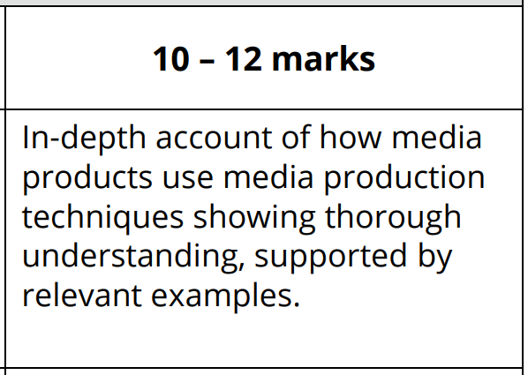
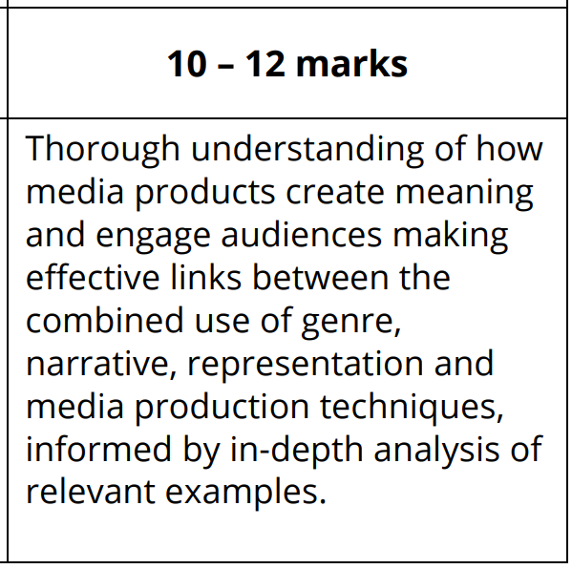
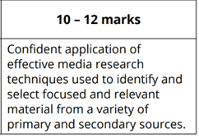
Task 1 Marking Criteria
Everyone is aiming for the top mark band.
In-depth = Covering most, or all, important points of a subject.
Effective = Applies relevant knowledge and understanding and/or skills appropriately to a task and achieves the desired outcome; successful in producing a desired or intended result.
Thorough = Comprehensive and extremely attentive to accuracy and detail.
Confident = Exhibit certainty, having command over information/ argument, etc. Demonstrate secure application of skills or processes.

Slide 24
Notes

