Slide 1
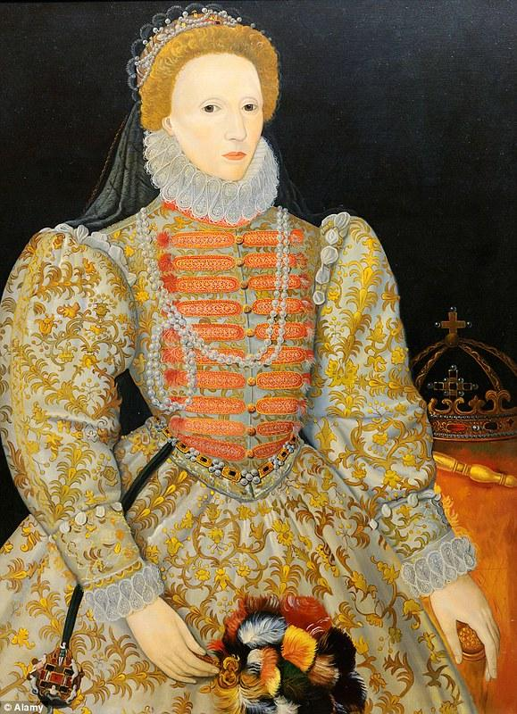
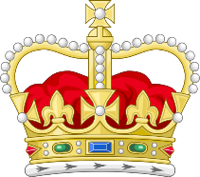

LESSON 1: How was Society and Government organised when Elizabeth came to the throne in 1558?
Introduction to the lesson:
Life in 1558 was very different from today.
Life expectancy (the length of time a person lived for): was only between 28 and 41.
Religion: People were expected to follow the Christian religion of the monarch or else be punished for committing the crimes of treason and heresy. 90% of Where did people live? 90% of the population lived in the countryside.
Rich and poor: There were clear boundaries between rich and poor with most people being poor. It would be impossible to be born poor and become rich.
Features of Elizabeth Society
Features of Elizabethan Government
Elizabethan people had a very clear idea of where everyone belonged in society. This is called a hierarchy. Starting with the most important, this is the hierarchy for Elizabethan England.
1. The monarch (the King or Queen) was at the top.
2. The nobility - other members of the royal family with important titles.
3. The gentry. - land owners. The more land a person had, the more powerful they were.
4. The Yeomen - men who owned smaller amounts of land or an estate where farmers worked.
5. Tenant farmers - rented land from the Yeomen.
6. The labouring poor – worked for other people.
7. The Vagrants - those without work and the homeless.
In Elizabeth’s government, there were different jobs to make sure the country ran smoothly. Elizabeth believed she had the Divine Right from God to rule. For this reason, Elizabeth could make decisions on her own such as starting a war. Elizabeth also had the right to stop her government discussing any issue she wanted.
The most important person in Elizabeth’s government was the Secretary of State. The name of Elizabeth’s first Secretary of State was Sir William Cecil. He was the closest person to Elizabeth. Elizabeth trusted him to give her advice.
FEATURE | PURPOSE/JOB
The Court | They were close friends and advisors to Elizabeth who lived with her. They could help her make decisions.
The Privy Council | This was an important group of advisors who were chosen by Elizabeth. There were 19 members of the Privy Council. They met 3 times a week. They too, helped Elizabeth make decisions.
Parliament | This group were like a government. They would vote on laws. Like today, they were divided into The House of Commons and the House of Lords.
Justices of the Peace | These were members of the rich gentry or Yeomen who kept law and order (like the police) in their area. They were unpaid and reported to the Privy Council. They made sure all laws were followed and taxes were paid.
LESSON KEY TERMS
Hierarchy
Monarch
Nobility
Gentry
Yeomen
Vagrants
Court
Privy Council
Parliament
Justices of the Peace
Secretary of State
William Cecil
The Elizabethan Family
Being male, the husband and father was the head of the home and the wife and children were expected to be obedient (do what they said) to him at all times.
Whoever you were, it was expected that you fully respected your place in society and did not challenge the group above.
In the towns, merchants (people who traded goods from abroad) were at the top, followed by educated people such as lawyers and doctors.

Slide 2
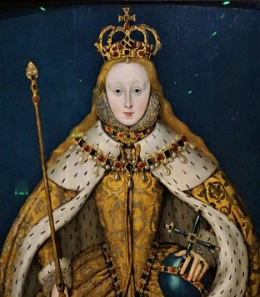
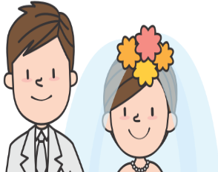

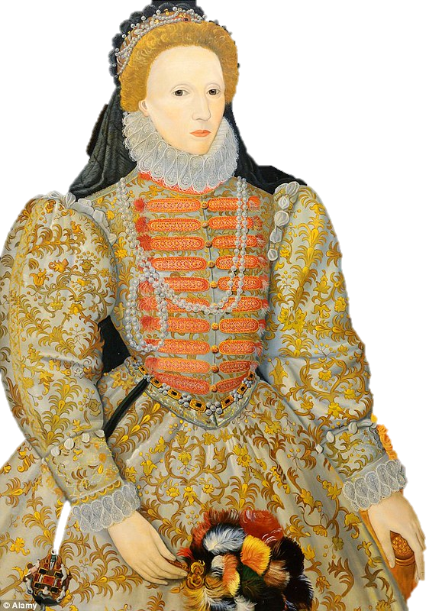



LESSON 2
What were the challenges faced by Elizabeth ‘at home’ when she became Queen in 1558?
Introduction to the lesson:
The people of Tudor England expected their monarch to have certain strengths and qualities. For some, Elizabeth posed a number of problems as the new monarch of England in 1558. Below are the challenges that were faced by Elizabeth when she became Queen of England in 1558.
You should aim to EXPLAIN why each of these issues would have challenged the power and control of Elizabeth when she first became Queen in 1558.
Then, aim to justify which of the challenges would be the most significant for her and how the various factors all relate to each other.
Her Legitimacy to the thrown.
Being legitimate means being legally able to become a monarch.
Catholics in England and abroad did not support her Father’s (Henry VIII) divorce from Catherine of Aragon. This meant they did not see his marriage to his second wife (Anne Boleyn) and Elizabeth’s mother as legal.
In their eyes Elizabeth was a ‘bastard child’ (a child born to parents who are not married).
This meant that Elizabeth had no legal right to become Queen as her mother and father were not legally married when she was born.
Marriage
It was expected in society that as Queen, Elizabeth should marry.
Elizabeth could only marry a man from an equal status which would mean a man who was a prince or king of another country.
Elizabeth however, worried that this would put her under the control of another country and be a threat to her power in England.
Elizabeth even turned down the offer of marriage from Philip II of Spain. She had the belief that she wanted to be ‘married to her country’.
She was under constant pressure from her Privy Council and Parliament to marry. They worried that if she did not marry, England was lack stability and face threats from abroad.
The Economy
Elizabeth was able to raise money by taxing her people but this was always unpopular. She did not want to do this as it would bring even more challenges towards her reign.
She did not have a lot of money because of the costly wars fought before her time.
When she became Queen, England was £300,000 in debt. The yearly total she would gain in a year was lower than this.
To be strong, Elizabeth needed to be wealthy and show her wealth.
Her Personality
Elizabeth was confident, well educated, intelligent and charismatic, able to make great speeches and win people over.
However, she faced a challenge from those who also knew she took too long to make decisions. Her hesitation with decision making frustrated many in her court , Privy Council and Parliament.
It also supported beliefs
about women not being
able to rule.
Religion
Catholics in England were already angry with her father Henry VIII for starting his own ‘Protestant’ Church of England and the following ‘Reformation’ which led to England becoming a Protestant country not Catholic.
This brought a challenge from the Pope in particular as Elizabeth wanted to continue her father’s Protestant faith in England.
The Pope strongly influenced many English Catholics to challenge Elizabeth’s religious views.
Gender
For a Queen to rule rather than a King was something very unusual in English history. Women were seen as inferior to men in all areas of society. Many had the same attitude towards Elizabeth.
It was believed that women should still be under the full control of men. Some did not trust Elizabeth if she was expected to lead an army into battle during war.
Women were not seen as strong enough, either mentally or physically in order to rule and make decisions about a country.
Children
Elizabeth also faced a challenge from those who wished her to have children.
Many believed that if she did not have children, there would be no heir to the throne for the Tudor family and it would also mean she would be more vulnerable to attack and assassination.
With a child, if anything happened to Elizabeth, the child would continue to reign of the Tudor monarchy. Without one, the country was very unstable.
Her Privy Council constantly pressured her to have children at the start of her reign.
Previous Tudor Women
People were worried that Elizabeth would be just as evil and strict as a ruler as her half sister, Mary I.
Mary I had executed over 300 Protestants for going against the Catholic Church.
Mary had caused hunger and poverty, lost a war against France and brought England into debt. It was a worry that Elizabeth, being a woman, would do the same.

Slide 3
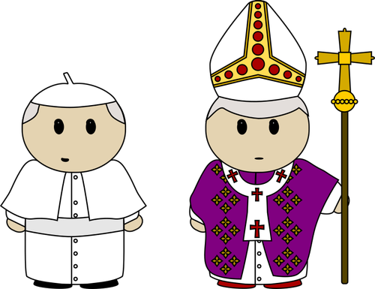
LESSON 3: What were the challenges to Elizabeth from ABROAD?
Introduction to the lesson:
As well as a number of challenges facing Elizabeth from within England, she also faced some key threats from abroad (other countries). The main threats towards Elizabeth at the start of her reign in 1588 were from France, Scotland and Spain. Some of these threats were based on religion now that Elizabeth wanted England to be a Protestant country. Other threats were linked to politics and power. Some threats from abroad were to do with the economy (money) while other threats were related to land. Read the threats from each of the countries below and decide for yourself whether each country from abroad was threatening Elizabeth’s religion, her power, the economy or England’s England.
THE THREAT FROM FRANCE
THE THREAT FROM SCOTLAND
THE THREAT FROM THE POPE
FRENCH THREAT 1:
By 1558, France was wealthier than England. It also had a bigger population. France had long been the traditional enemy of England as the two countries had fought against each other throughout history. Elizabeth’s government worried that France would be more likely to win another war if the two countries fought.
FRENCH THREAT 2:
France also had a very strong friendship with Scotland. This long term relationship with Scotland was called the Auld Alliance. Scotland too, had long been another enemy of England. This threatened the power of Elizabeth even more as Scotland was to the north of England with France to the south.
FRENCH THREAT 3:
The countries in the Auld Alliance were strict Catholic countries. They sided against Elizabeth who was showing further support for the Protestant Church. Many Catholics wanted to return England back to the Catholic faith and the way to do this would be to threaten Elizabeth and remove her from the throne.
FRENCH THREAT 4:
The Catholic French King, Francis II was engaged to the Catholic Scottish monarch, Mary, Queen of Scots. This would bring the two countries even closer together in their fight against Protestant England. It was also a problem as Mary, Queen of Scots had a very strong claim to the English throne and had a huge amount of support from many Catholics all across Europe.
FRENCH THREAT 5:
England had taken control of an area of land in France called Calais. This land was important for Elizabeth’s pride and for her trade with the rest of Europe. However, it was always under the threat of being taken back by the French.
SCOTTISH THREAT 1:
The Scottish monarch, Mary, Queen of Scots believed that she was the legitimate (legal) heir to the English throne. She and her supporters accused Elizabeth of being a ‘bastard’ child of Henry VIII. She was heavily supported by Catholics in England, Scotland, France and Spain. It was possible that the Queen of Scotland could attempt to become the Queen of England.
SCOTTISH THREAT 2:
The border between Scotland and England was difficult for the English to defend. as It was a very long distance away from London and Elizabeth’s English troops found it difficult to travel there. There were constant Scottish raids into England over the border which the English found difficult to defend.
SCOTTISH THREAT 3:
Mary, Queen of Scots mother (called Mary of Guise) who was French, also spent time in Scotland but brought over French troops to help the fighting against England on the border. This meant that the Scottish army also had the help of the French army against England on the border.
ROME THREAT 1:
Despite the poor communication methods and modes of travel between European countries, the head of the Catholic Church, the Pope, still had huge control and influence over the beliefs and actions of Catholics all over Europe. The Pope used his power and influence to his advantage to ask Catholics to challenge Elizabeth. He spoke about his dislike for the Reformation (the change to the Protestant Church) and had already argued with Elizabeth’s father, Henry VIII about religion.
ROME THREAT 2:
The Pope wanted a ‘Counter-Reformation’ – this meant he wanted to make all Europe Catholic again and stop the spread of the Protestant Church. Elizabeth was worried that the Pope could influence Catholics all over Europe to challenge her as Queen of England.
ROME THREAT 3:
The Pope was even willing to offer support to countries such as Spain and France in their fight against Protestant England. Not only did he promise money, but promised anyone who fought against the Protestant faith in England a place in Heaven.
THE THREAT FROM SPAIN
SPANISH THREAT 1:
Spain was a strict, powerful and wealthy Catholic country. It also supported the claim that Mary, Queen of Scots had to be the rightful Queen of England. Elizabeth was worried that Spain might join forces with France and Scotland to become an even bigger threat against her. The Catholic King of Spain, Philip II had even been married to Elizabeth’s extremely Catholic sister Mary I. Spain had all the right power and support to defeat Elizabeth.

Slide 4
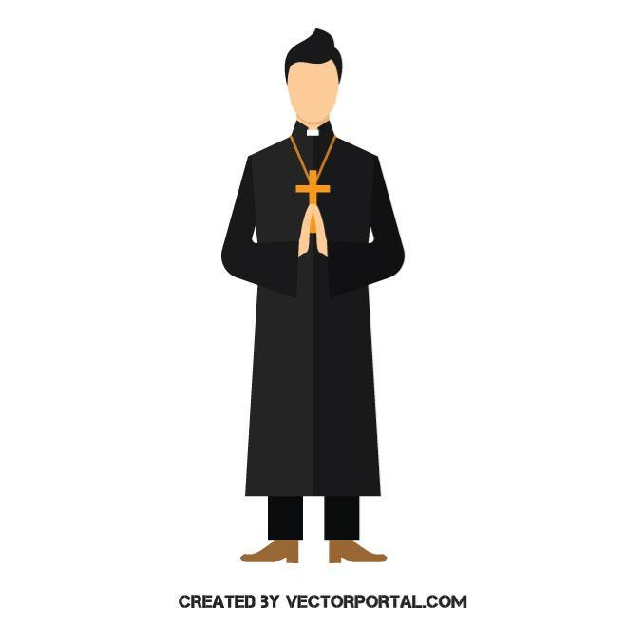
LESSON 4: What were the RELIGIOUS DIVISIONS in England when Elizabeth became Queen in 1558?
KEY TERMS
Reformation
Mass
Protestant
Catholic
Puritan
Latin
Clergy
Act of Parliament
Vestments
Sacraments
Introduction to the lesson:
Before we look at the changes that Elizabeth I made to religion, it is vital that we know what religious life was like in England at this time. There had been significant changes in the belief of the Christian church in Europe in the 1500s. Some Christians had started to question the greed, wealth and power of the Catholic Church. Some then ‘protested’ against the Catholic Church and set out to change or REFORM in the way Christians worshipped. These changes were known as the Reformation and the people who followed this new Christian religion were called ‘PROTESTANTS’. This meant that by the time Elizabeth became Queen of England, there was a divide between the traditional Catholic Church and the Protestant Church. Elizabeth also came to power after her strict Catholic sister Mary I had ruled the country and punished Protestants.
Catholics Versus Protestants
THEIR BELIEFS | CATHOLICS | PROTESTANTS
 | The Pope in Rome is the leader of the Church across England. | No Pope. The monarch (King or Queen) is the head of the Church.
 | Many clergy such as cardinals, bishops and priests are needed and have huge power. | Fewer clergy are needed and they are seen as more equal to ordinary people.
 | During the religious ceremony of Mass, bread and wine become the actual blood and body of Christ. This is seen as a miracle. | There is no belief in miracles. The bread and wine are just symbolic of Christ and Mass is banned.
 | There are 7 main religious ceremonies called sacraments | There are only 2 religious sacraments
 | Priests cannot marry or have any sexual relationships. | Priests can marry and have children.
 | Catholics believe in the existence in saints who can cause miracles. | There is no belief in miracles and so no belief in saints.
THEIR CHURCHES | Church services are in Latin | Church services are in English
 | Priests wear special and highly decorated religious clothing called ‘vestments’. | Priests wear simple vestments to show they are like ‘the people’.
 | Churches are highly decorated to show the glory and power of God. | Churches are plain and simple. This way people are not distracted from their worship.
SUPPORT | Catholics were still the majority in the north of England | Protestants were mainly found in the south-east near London.
 | Support from the Pope in Rome, Spain, France, Scotland and the Spanish who have taken over the Netherlands. | Support from Germany and the Protestants in the Netherlands.
The main features of the religious divisions/differences when Elizabeth became Queen in 1558
Countries such as Spain and France where the Catholic Church remained the official Church, persecuted (or punished) Protestants. Many protestants fled to England and influenced more Protestant changes here.
Some Protestants took their new religion seriously and became more extreme. They were known as Puritans. They wanted to ‘purify’ the Christian religion by removing ANY Catholic influence.
In the north of England, in places such as Yorkshire, Lancashire and Durham, religion stayed very Catholic. People were influenced more from Catholic Scotland which was nearer to them and the monarchy in London were less influential in the north. In the south of England however, people tended to be more Protestant as they were closer to the Queen in London.
Religion in England was now divided between the traditional Catholic Church the newer Protestant Church. Many people were used to worshipping in a Catholic way after having Mary I in charge.
Elizabeth’s Christian Beliefs
The Clergy in England
Elizabeth believed more in the Protestant faith. However, she wanted to be fair to both faiths. When she became Queen of England she did not want to punish the Catholics for following their faith. Elizabeth could see the increasing tension between the Catholics and the Protestants and so she wanted to seek a ‘Middle Way’ or compromise. Her Catholic sister, Mary I, had persecuted over 300 Protestants before Elizabeth became Queen. Elizabeth was not interested in doing the same against Catholics simply to seek revenge.
When we talk about the clergy, we mean anyone who works for the Church such as bishops, vicars and priests. When Elizabeth became Queen, most clergy were still Catholic. Elizabeth used a new law called an Act of Parliament to officially change the religion of the country back to the Protestant faith. Many priests agreed to follow Protestant religion just to keep their jobs. However, more powerful members of the clergy such as the bishops remained Catholic and were more willing to challenge Elizabeth. Many Catholic clergy wanted Mary, Queen of Scots to become the Queen of England and remove Elizabeth.

Slide 5

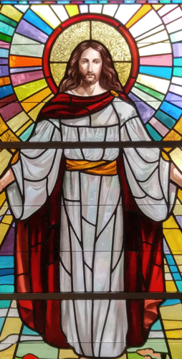


LESSON 5: KEY LESSON – What were the features of Elizabeth’s Religious Settlement in 1559?
Introduction to the lesson:
After only a year as Queen, Elizabeth wanted to try and find a solution to the religious differences between the Catholics and the Protestants. Elizabeth wanted a Protestant church that the Catholics would accept. Instead of forcefully challenging the Catholics, she hoped that her new religious laws would eventually mean the Catholic faith in England would just fade away. A very strict Protestant group called the Puritans wanted Elizabeth to go even further and ban ALL Catholic aspects of religion. However, she could not risk upsetting the Catholics too much as at the start of her reign she needed the support of her people. Remember, that most people were still Catholic after the reign of her sister Mary I. It was therefore Elizabeth’s aim to bring about a COMPROMISE. This compromise was known as Elizabeth’s MIDDLE WAY. Elizabeth’s official changes to religion in England were called the RELIGIOUS SETTLEMENT. There were three main parts to it. As you read through, ask yourself which parts of the religious settlement the Catholics would like or dislike and which parts the Protestants and Puritans would like and dislike? Who would be happiest with her Religious Settlement?
THE ACT OF SUPREMACY
THE ACT OF UNIFORMITY
ROYAL INJUNCTIONS
The Act of Supremacy made Elizabeth the ‘supreme’ leader of the Church of England instead of the Pope.
The Act of Uniformity set out rules for how a church should look and what the church services should be like. Being ‘uniform’ meant everyone being the ‘same’.
The Royal Injunctions were a written set of instructions issued to to the clergy about how to follow the Religious Settlement.
The instructions included rules such as:
The clergy were ordered to teach their congregations about the Religious Settlement to make sure people understood it and followed it.
Each church was to have a copy of the Common Prayer Book in English NOT Latin.
Pilgrimages to holy places, worshipping saints and believing in ‘fake’ miracles were banned as this was more of a Catholic practice.
Elizabeth did allow some images of Christ in the church such as stained glass windows and statues.
Oath Of Allegiance
All clergy (people who belonged to the church) had to swear an oath of allegiance to her as their supreme leader and promise to obey her Religious Settlement.
The Bible or ‘Book of Common Prayer’
A Book of Common Prayer was to be used in ALL churches and by all clergy and written in English. The wording of the Book of Common Prayer was deliberately vague/unclear so Catholics and Protestants could read their own meaning to it.
Ecclesiastical High Commission
An Ecclesiastical High Commission was created. This was a group of people who made sure that all clergy did as they were told and followed the Religious Settlement.
Clothing for Priests – Vestments.
Priests had to wear special, decorative clothing called vestments. This was a more traditional Catholic tradition and Elizabeth personally liked priests to look ‘special’.
IMPACT OF THE RELIGIOUS SETTLEMENT
Church on a Sunday
It ordered everyone to go to church on a Sunday and other holy days - otherwise they would be fined. The fine was a lot for ordinary people and it was a way to make sure they heard the message of the Protestant Church. Some Catholic nobles refused to go to church as they could easily afford to pay the fine. Those who refused to attend church were known as ‘recusants’.
8,000 clergy out of 10,000 (80%) accepted the Religious Settlement. Most ordinary people accepted the Religious Settlement as they were simply used to doing what they were told.
However, many Catholic bishops (bishops were higher powered) opposed the Religious Settlement. These bishops increasingly supported opposition against Elizabeth however, Elizabeth sacked them and appointed 27 new Protestant bishops. Many Catholic nobles refused to go to the new church services and became recusants.
Puritans believed the Religious Settlement was still too Catholic. Some in London even destroyed church statues and stained glass windows.
Punishment
Any members of the clergy who did not follow the Religious Settlement could be punished with a fine by the High Commission.

Slide 6
LESSON 6:
What was the role of the Church of England in Enforcing the Religious Settlement of 1559?
What was the overall reaction to the Religious Settlement?
The Clergy (men who worked for the Church)
All members of the Church had to take the oath of supremacy - if they refused they would be dismissed. Around 8,000 priests out of roughly 10,000 parishes took the oath. This means that the Religious Settlement was largely successful. However, more traditional Catholic Bishops were different. Only one agreed to take the oath. The others had to step down. This meant however, that Elizabeth could appoint 27 new bishops of her choosing. Elizabeth used this opportunity to place 27 loyal, Protestant bishops in place.
The Ordinary People
Most people accepted Elizabeth’s Religious Settlement and attended the new Church of England services. They did this, even though many of them still held on to some of the older Catholic beliefs they had grown up with. The wording of the new prayer book helped as it could be understood to mean different things by both faiths. Parishes in places nearer to the north of England had more Catholics and they were slower to change to the new church services. Some Catholic families would avoid punishment if one person from a household attended the new Protestant Church service in their local church, but other family members would then stay at home to say their prayers following traditional Catholic methods. Those people who refused to attend the new church services were called recusants. However, Elizabeth stated that she did not want recusants to be investigated too deeply. However, in the southern parts of England, especially close to London, people welcomed the Protestant religion. People even took it upon themselves to violently remove and destroy the old Catholic statues of saints.
How the Church of England helped to Enforce the rules of the Religious Settlement
The Threat of Punishment
The church had a responsibility to make sure the rules of the Religious Settlement were carried out by all clergymen. Any that did not could be punished with a fine or dismissal.
A Licence Essential
Priests needed a license to preach from the government. This meant that priests would have to follow the ideas of the government or not be allowed their license.
Loyalty to Elizabeth
Licenses helped Elizabeth increase the belief and following of the Religious Settlement as the Priests would speak positively about it to their congregations (people who visited their church).
Visitations
Churches were inspected by powerful bishops to make sure that everyone in the clergy was following the rules of the Act of Supremacy and Act of Uniformity. 400 clergymen were dismissed in 1559 - the same year as the Religious Settlement for not following the rules. Visitations would be carried out every 3 to 4 years.
Checking other Professions
Church visitations also made sure that other professions had the correct licence. For example, teachers, lawyers and surgeons all needed permission to practice from Elizabeth’s government.
Powerful and Educated
Priests were the most powerful figure in a local village with significant influence on people’s beliefs.
The Role and Influence of the Church in Everyday Life
To deal with crime and punishment
The church had a responsibility to deal with crime and decide on punishments. Church Courts were used in each village to deal with issues such as marriage (if people marrying because of the right reasons), sexual offenses (such as bigamy – having more than one wife), wills and inheritance. This gave the local churches a lot of power and influence over people.
Influence
With poor transport and communication, the village priest was the only person able to influence and make sure people followed the rules of the monarch.
Religious Ceremonies
The village church took control of weekly services, weddings, funerals, births, baptisms. It also ran schools, summer fetes and celebrations during holy days. It had a huge amount of influence on local life in general.
Tithes
The local church collected money from the local people called a ‘tithe’. This was often 10% of a person’s income or their goods produced.
Provided help in times of need.
The Church was at the centre of all towns and villages. The Priests were the first person people would go to in a time of need. Any difficulties such as with money, deaths, poor harvests or disease could be made better by visiting the local church.
To deal with social issues.
A bigger population in towns led to issues such as poverty, vagrancy (begging) and disease. Priests had a role in helping people deal with these issues.
To Influence different beliefs
Towns were growing and with increased trade from around the world, some coastal port towns such as London had people with a wider range of religious beliefs.

Slide 7
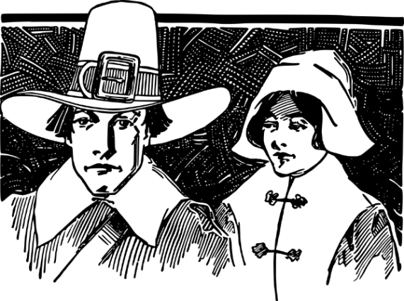
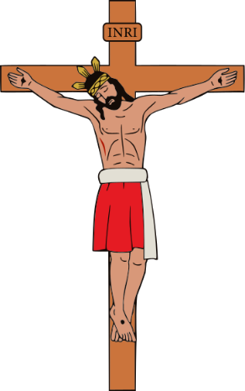
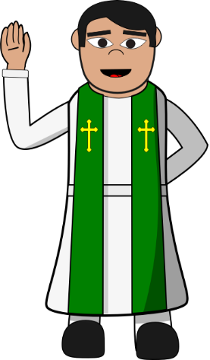
LESSON 7: To explain why the PURITANS challenged Elizabeth’s Religious Settlement.
Introduction to the lesson:
The Puritans were a group of extreme and radical Protestants. They wanted to take the Protestant religion one step further by removing ALL aspects of Catholic worship. Despite Elizabeth making England officially Protestant, the Puritans were not happy with how she compromised with her Religious Settlement in 1559 to make the Catholics in England happy. As a result, some Puritans challenged Elizabeth.
How far were the Puritans a threat to Elizabeth after 1559?
Puritan Facts
The Puritans wanted to remove any and all aspects of the Catholic religion in England.
The Puritans wanted religion to be controlled by the monarch without the need for more powerful bishops and cardinals who they believed were too rich, corrupt and greedy.
The Puritans wanted a simpler style of worship with no decorative and expensive Catholic clothing.
The Puritans wanted plain, whitewashed churches where people could pray without the distraction of extravagant ornaments, stained glass or statues. This represented the ‘purity’ of the Christian religion that the Puritans believed in.
The Puritans hated the idea of the Pope and believed he was the ‘Anti-Christ’.
Elizabeth couldn’t just remove or attack the Puritans. In fact, because of their belief in the Protestant faith, she needed them on her side to keep the Protestant faith strong and to try and outnumber the Catholics.
Few Puritans actively challenged Elizabeth’s Religious Settlement. If they did, they might risk losing their job and they were worried about the punishments they may be given.
The sacking of the 37 clergymen after the vestment challenge proved that Elizabeth would act strongly against the Puritans if they challenged her.
Puritans were only active and threatened Elizabeth's power in the South-East of England in places such as London and Oxford. Even here, their only actions were to damage or destroy Catholic church buildings or decorations. The rest of the country remained mainly Catholic.
Elizabeth and her government mainly ignored the Puritan challenges as the threat from the Catholics was far more significant.
Puritan Challenge 1: The use of the Crucifix
What did the Puritans want?
The Puritans did not like fancy, highly decorative Catholic style ornaments in churches and wanted the image of Christ on the cross removed. Some Puritans threatened to resign if this was not done at a time when Elizabeth needed their support the most.
What did Elizabeth do?
Elizabeth actually liked the image of the crucifix and at first wanted them to remain in churches. However, after the threat of the Puritans to resign, she GAVE IN and said that there was no way to enforce every church having a crucifix. The Puritans were therefore happy with her decision. However, this did not stop Elizabeth having a crucifix in her own church and some other churches continued to display it in areas further north where the Puritans were not popular.
Puritan Challenge 2: The use of Vestments (Religious Clothing)
What did Elizabeth want?
Elizabeth wanted the clergy to wear special religious clothing called vestments. She liked the imagery and how it made the clergy look important. Vestments were more decorative and many people liked how it symbolised the importance of the clergy.
What did the Puritans want?
Puritans challenged this and believed that the clergy should not try to look more important. They believed that member of the clergy were equal to ordinary people and that it was God who was important and not the clergy. They wanted the clergy to wear plain, black and white, simple clothing.
What did Elizabeth do?
This time, Elizabeth did NOT GIVE IN and ordered the clergy to wear the vestments. She even had the Archbishop of Canterbury put on a exhibition in London to show off the vestments the clergy had to wear. Of 110 invited, 37 Puritan clergy refused to attend. Elizabeth punished them by dismissing them from their role in the church - they lost their job.

Slide 8
LESSON 8a: To explain the extent of the CATHOLIC challenge to Elizabeth’s Religious Settlement from within England.
Introduction to the lesson:
As well as from the Puritans (the extreme group of Protestants), another challenge to Elizabeth’s Religious Settlement was from the Catholics who lived within England. The Catholics knew that Elizabeth had tried to compromise and seek a ‘Middle Way’ between the two Christian religions. However, they still saw the official Protestant religion as a threat to their much loved, traditional Church and way of worshipping. Due to Mary I’s strict Catholic rule, by 1559 there will still many powerful Catholics living within England who wanted to threaten Elizabeth. These Catholics were also hugely influenced by the Pope in Rome and other powerful Catholics from Spain, France and Scotland who all gave the promise of military, political and economic support.
The influence of the Pope and the Counter Reformation.
The threat of the English Nobles, Gentry and Earls
How far were the English Catholics a threat to Elizabeth?
The Pope could only influence English Catholics so much as he was so far away living in Rome. His messages still took time to reach the English Catholics, although once received they would be very influential.
Elizabeth did not react in a strict and harsh way against the Catholics who refused to attend Church of England services. She worried that if she punished these recusants too much they would be further angered and rebel against her. Therefore, by ignoring the Catholic nobles she helped avoid a rebellion.
The Pope was and is the leader of the Catholic Church. Most Catholics believe that he has been chosen by God and see the Pope as an extraordinary. Many will worship the Pope as they would God.
At the time, he influenced other Catholics all over Europe, including England and called for them to stop the spread of the Protestant Faith. He called for something called a ‘Counter-Reformation’. This meant a reversal back to the Catholic faith and to end the influence Protestantism. In particular, he wanted Elizabeth to make England officially Catholic again.
The Pope may have spoken from Rome (Italy) but had a massive influence on the Catholics within England. For example, in 1566, the Pope issued an official instruction to English Catholics which ordered them not attend Elizabeth’s Church of England services. The people who followed this order and refused to attend Protestant Church services were called ‘Recusants’. These recusants were often powerful and wealthy people and this made them a threat to Elizabeth’s religious settlement.
The Pope also supported Catholic communities all over Europe persecuting (punishing) Protestants who they saw as ‘Heretics’ and encouraged the waging of war against Protestants and their faith.
The nobility, the gentry and the earls were at the very top of Elizabethan society. They owned huge areas of land and held great power.
A large number of nobles and members of the gentry in the north of England remained Catholic and they were heavily influenced by the instructions from the Pope.
Roughly 1/3 of English Catholic nobles became recusants after the Pope’s instructions in 1566. Despite facing a fine for not attending the Protestant Church services, their wealth meant that they could easily afford the punishment.
Before Elizabeth’s reign, the Catholic nobles had gained a huge amount of land, power and influence during the Catholic reign of Mary I. However, once Elizabeth became Queen of England, they lost some of this power. They wanted to challenge the Religious Settlement as a way to show their dislike towards Elizabeth for this. Many Catholic nobles also hated how much power Elizabeth was giving to important Protestants such as her Secretary of State William Cecil and a close advisor of her called Robert Dudley. Their challenge was just as much a way to get back their power and influence as much as a complained about the new Protestant religion.
Most ordinary English Catholics (those who were not rich earls and nobles) adapted to Elizabeth’s Religious Settlement. Ordinary people simply did not question what they were told to do. In this way, Elizabeth never faced a threat from the majority of her people.
Around 1/3 of the Catholic nobility and gentry were recusants, especially in the north of England but far fewer in the south such as London. Elizabeth did not feel threatened by the Catholics living in the north because they were so far away from her.
However, as you will discover, by 1569, a number of important earls from the north became organised enough to attempt a revolt against Elizabeth!

Slide 9
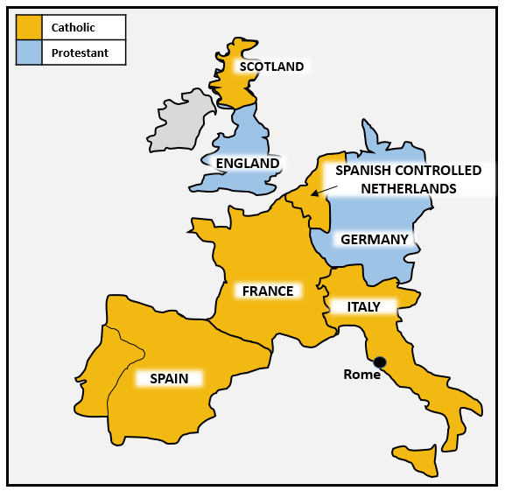





LESSON 8b: To explain the nature and extent of the CATHOLIC challenge from abroad to the Religious Settlement.
Introduction to the lesson:
Despite a number of countries having more Protestant believers, most of Europe was still officially controlled by the Catholic Church by the Pope in Rome, Italy. Because of the power of the Catholic Church it was no coincidence that these Catholic countries were highly powerful, wealthy and influential. Elizabeth understood that religion was so powerful, that if these Catholic countries united, they could easily threaten and defeat her as Queen of England. The Pope pushed Catholics across Europe to take part in the Counter Reformation to remove Protestantism from Europe. As you study each country, try to decide which one had the most significant threat to Elizabeth and her Religious Settlement as well as how they link to each other.
Scotland
The Netherlands
Scotland had a long tradition of following the Catholic faith. This was especially true during the rule of Elizabeth’s cousin, Mary, Queen of Scots.
Mary, Queen of Scots had strong family links to Catholic France after she had married the King of France, Francis II and Elizabeth worried that the French may help Mary, Queen of Scots claim the English throne.
There were also many Catholic Scottish nobles who would be willing to support Mary in gaining control of Protestant England.
As a country, the Netherlands had officially been a Protestant country. However, by this time it was controlled by Catholic Spain.
The people living in the Netherlands, called the Dutch, were threatened by the Spanish Inquisition . This meant that any Protestants in the Netherlands could be arrested, punished, tortured or even burned alive in public – just as a warning to others not to follow the Protestant faith.
In 1566. Dutch Protestants rebelled against the Spanish. However, Spain sent 100,000 troops led by the harsh Duke of Alba and defeated the Protestants quickly.
The Duke of Alba stopped more Protestant rebellions by setting up a Catholic style court known as the Council of Blood. This executed more Protestants and sent a strong message to other Protestants in Europe, including Elizabeth, about what Spain were capable of.
In 1567, some Protestant Dutch Rebels fled to England. These men were known as the ‘Sea Beggars’. Elizabeth made the decision to take care of them. This showed Spain that Elizabeth had taken sides against them to support the Protestants.
In 1568, Spain was angered even more when Elizabeth decided to capture and keep Spanish money on its way to the Netherlands. took money called the Genoese Loan. The Italian city of Genoa had offered money to help Spain in the Netherlands but they made the error of stopping on the south coast of England with the Genoese Loan before heading to the Netherlands. Elizabeth ordered the money to be seized. King Philip II of Philip was furious.
Why was Elizabeth worried about the Spanish in the Netherlands?
Elizabeth was worried about the harsh actions of the strict Duke of Alba and the Council of Blood. She was worried that being so close to England’s shore, the Duke of Alba could easily send his men to England. As Elizabeth had helped to shelter the Protestant ‘Sea Beggars’ this sent a clear message to Spain and King Philip that she was taking sides against the Catholics. This made tensions grow between England and Spain and risked a religious war. Spain’s control in the Netherlands was so secure by 1570 that it would have been easy them to invade England due to how close they were.
Spain
Spain was the wealthiest country in Europe and strictly Catholic. It had already made vast amount of money from its trade and exploration abroad, especially in the New World (America).
Spain’s leader, King Philip II once had strong Catholic links with England as he was married to Mary I (Elizabeth’s sister – also known as Bloody Mary). He even offered to marry Elizabeth to make allies with England but she refused his proposal.
Spain began to challenge England after the Religious Settlement and became even more angry with Elizabeth’s after her support for other Protestants in Europe.
Rome (Italy)
The Pope’s influence spread across all of Europe from Italy’s capital city, Rome. He wanted a Counter Reformation to remove the Protestant Faith.
In 1566, the Pope had instructed Catholics in England to avoid Church of England services (become recusants) and start a ‘war’ against the Protestant Faith.
In 1570, the Pope excommunicated Elizabeth a year after her Religious Settlement. This meant she was no longer a part of the Catholic Church and should be seen as an enemy to all Catholics.
France
There was also conflict between Catholics and Protestants in France.
In fact, in 1562, Elizabeth had promised to help the French Protestants. She hoped the French would reward her by returning the important port of Calais back to English control but this did not happen. Catholic, Philip II of Spain was angered by Elizabeth for her support of the Protestants in France.
To make matters worse, the Catholics came to power in France and Elizabeth was forced to sign an agreement called the Treaty of Troyes. This agreement officially gave Calais back to the French for good. This made Elizabeth look weak and a poor decision maker.

Slide 10
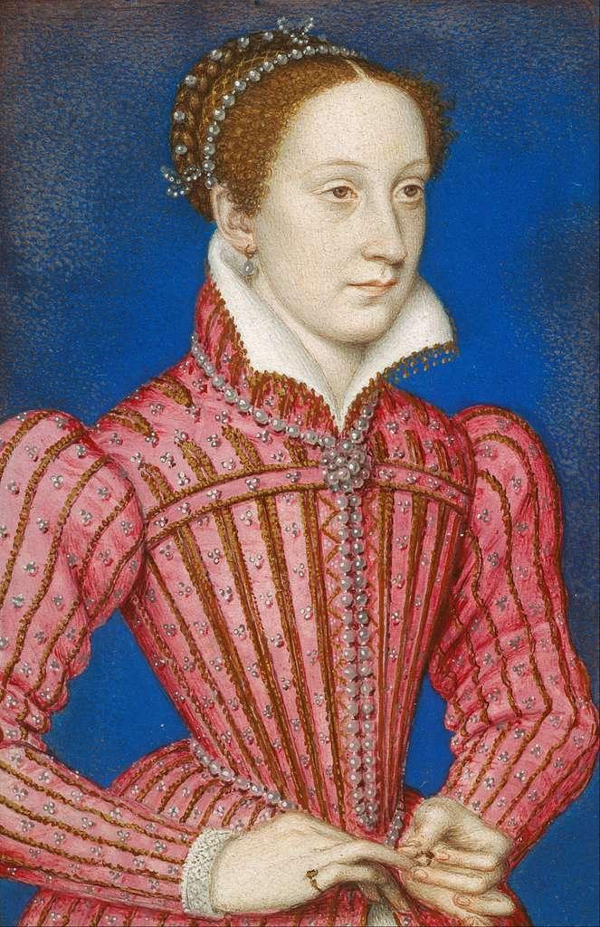
LESSON 9: To explain why Mary, Queen of Scots was a threat to Elizabeth.
Background:
Mary, Queen of Scots was a strict Catholic. She was also Elizabeth’s cousin. Most Catholics believed that it was Mary, who had the legitimate right to the English throne. This was because the Catholics did not believe Elizabeth’s parents, Henry VIII and Anne Boleyn were legally married when Elizabeth was born as the Pope had refused to divorce Henry and his first wife. Mary, Queen of Scots seemed to always be at the centre of many Catholic plots against Elizabeth. Here are some of reasons why Elizabeth was so worried about Mary.
1: Mary’s Legitimate Claim
All Catholics believed that Mary, Queen of Scots was the legal heir to the English throne. She gained support from Catholics not just in England but from all over. They supported the idea to overthrow Elizabeth to return England back to the traditional Catholic faith with Mary as England’s Queen.
2: Elizabeth had no heir
Elizabeth was not married and therefore had no children. This left England without an heir and many people believed it also left Elizabeth vulnerable to attack. However, because of Mary’s religion, Elizabeth refused to name Mary, Queen of Scots as her heir. This simply angered and motivated the Catholics even more.
3: Catholic Support for Mary
With support from the Pope, English Catholic nobles, France and Spain; it was highly likely that Mary would attempt to challenge Elizabeth as Queen of England. For Elizabeth, this meant that Mary was one of her biggest challenges. If Elizabeth sat back and did nothing about Mary, she would look too weak. However, if Elizabeth acted too harshly against Mary, it would anger the Catholics even more.
What did Elizabeth do about Mary, Queen of Scots?
Elizabeth secretly sent money and troops to help Protestants in Scotland fight against any Catholic influences that would help Mary.
In 1560. Elizabeth made Mary, Queen of Scots sign an agreement called The Treaty of Edinburgh. Here, Mary agreed she would give up her claim to the English throne. Of course, she would never stick to this agreement but it was enough to keep Elizabeth happy for the time being.
When Mary came to England ask Elizabeth for help in 1568, Elizabeth placed Mary under house arrest so she was guarded at all times. By this point in time, Elizabeth had lost all trust in her cousin.
Elizabeth did not yet execute Mary as this may have started a conflict with the Catholics and Elizabeth did not have the resources or money to fight a war yet.
6: Mary’s Ruthless Relationships!
After the death of her husband King Francis II, Mary married her second husband, Lord Darnley in Scotland in 1565.
However, this was a violent relationship and some people suspected that Mary was involved in Darnley’s murder in 1567.
Mary then married again, to a Earl Bothwell – again, this relationship did not go well.
Eventually, the Protestant Lords in Scotland became fed up with Mary and she was forced to step down as queen.
Protestants put Mary in prison on an island in the middle of a lake. However, she escaped with the help of Catholic lords and fled to England to get help from Elizabeth in 1568. This proved how ruthless Mary was and how much support from Catholics she could get if needed.
Why was Mary, Queen of Scots a threat to Elizabeth?
4: Mary’s French links
Mary, married the French monarch, King Francis II and her mother, Mary of Guise was also French.
While Mary was living in France with her husband, her mother controlled Scotland for her and had great respect and control there.
This made her a threat because she could easily gain support from France against England if needed.
5: Mary’s return to Scotland
After the death of her husband King Francis II in 1560, Mary returned to Scotland. It was believed that in Scotland, Mary was planning to challenge Elizabeth with the support of the French and the Scottish Catholics.
The death of Francis II and her move back to Scotland made Mary unstable. This made Mary even more of a risk for Elizabeth.
Scotland was traditionally more Catholic and it was likely that Mary would gain support to overthrow Elizabeth.
INTERESTING FACT
Elizabeth I and her cousin Mary, Queen of Scots never actually met. They communicated with each other via letters and often, Mary, Queen of Scots would sent Elizabeth gifts as a way to try and gain her trust.

Slide 11
LESSON 10: To explain the causes, features and failure of the Revolt of the Northern Earls in 1569/70.
Elizabeth was crowned Queen in 1558. Her Religious Settlement came a year later in 1559. She had already faced a number of threat from home (within England) and abroad. Many of these threats linked back to the Catholics and their wish to place Elizabeth’s Catholic Cousin; Mary, Queen of Scots on the throne. 10 Years after her Religious Settlement came one of the biggest threats from within England. This threat was known as the Revolt of the Northern Earls in 1569. Unsurprisingly it was a Catholic plan to put Mary, Queen of Scots on the English throne. It failed but stirred up even more tension between protestants and Catholics..
The causes of the Revolt of the Northern Earls.
Causes are linked to the categories of: Religion, wealth, politics, geography, social and foreign influences.
The features of the revolt.
1. For Mary, Queen of Scots to marry the Duke of Norfolk and then forcefully remove Elizabeth as Queen. | 2. Mary event told the Spanish that she ‘shall be Queen of England in 3 months and mass shall be said all over the country’. | 3. Elizabeth found out about the plan and Norfolk was arrested and sent to the Tower of London.
4. The Earl of Northumberland and Westmoreland reacted to this by starting the revolt in the north. | 5. The two earls gained support and took over Durham Cathedral. The Protestant Archbishop fled and the earls celebrated Catholic Mass in northern churches for 2 weeks. | 6. The Catholic rebels carried on south with the aim of rescuing Mary, Queen of Scots from prison and putting her on the throne. Elizabeth ordered Mary to be moved.
7. Elizabeth raised an army of 14,000 men and the revolting army of 5,400 fled back north. | 8. The earls went to meet the Spanish troops but they never arrived as promised in the letter to Mary, | 9. 450 rebels were executed and Northumberland was executed in York. His head was put on a spike above the city gates.
10. Elizabeth was under pressure from her Privy Council to execute Mary, Queen of Scots and the Duke of Norfolk but refused | 11. In 1570, the Pope issued a Papal Bull (Religious order) to all Catholics to remove Elizabeth from the throne. Elizabeth then passed a law to make any attempt on her life treason and heresy. | 12. Elizabeth also set up a ‘Council of the North’ which organised even harsher treatment of Catholics who refused to follow orders.
The rebellion happened in the north as most people here remained Catholic and more motivated to challenge Elizabeth.
Elizabeth refused to name Mary, Queen of Scots as her heir. The earls wanted Mary as the next monarch.
The earls simply wanted to restore the Catholic faith in England. The northern earls were influenced by the Pope’s orders for a Counter Reformation.
The group who started the revolt were Catholic nobles and earls. They had a lot of influence to start a rebellion and gain Catholic support from ordinary people in the north.
Mary, Queen of Scots was under house arrest in England. The earls believed they had an opportunity to free her and easily have a legitimate Catholic monarch as Queen of England.
Another rebel, The Duke of Norfolk, had planned to marry Mary, Queen of Scots and then aim to take the throne. This would provide Mary with even more power to bring back the Catholic faith and help the rebellion.
Key Catholic earls, The Earl of Northumberland and The Earl of Westmorland, both lost influence and power under Elizabeth. They were jealous of Elizabeth’s new Protestant ‘favourites’ William Cecil and Robert Dudley.
Many Catholic earls and nobles had become recusants as a protest against Elizabeth, but soon saw that this did not bring about a change back to Catholicism. They needed a more extreme tactic.
The wives of the Catholic northern earls called Jane Neville and Ann Percy also hated how much power and wealth they lad lost. They hugely influenced their husbands to start a rebellion against Elizabeth.
The Northern Earls believed they had the support of Spain who also wanted Mary, Queen of Scots as a new Catholic Queen. It was believed that Mary had received a letter from Spain promising troops to help with the rebellion.
Elizabeth had chosen a Protestant as the Archbishop of Durham in 1561. Durham was a traditional Catholic town and James Pilkington’s appointment angered many Catholics in the north.
The Catholic earls lost power and wealth when Elizabeth became Queen. They wanted revenge and removing her to make way for another Catholic monarch would help restore their power.
Key Terms
Revolt | Northern Earls | Mary, Queen of Scots | Earl of Northumberland | Earl of Westmorland | Duke of Norfolk | William Cecil | Robert Dudley | Jane Neville and Ann Percy | Archbishop James Pilkington | Durham Cathedral | Mass | Council of the North | Papal Bull

Slide 12
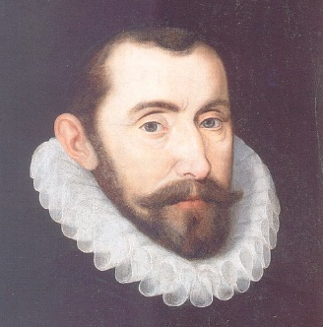
LESSON 11: To explain the failure of the Ridolfi (1571), Throckmorton (1583) & Babington (1586) Plots against Elizabeth.
Background:
The failure of the Revolt of the Northern Earls, did not stop other Catholics from trying to plot against Elizabeth and bring Mary, Queen of Scots to power. Elizabeth put her Secretary of State, Francis Walsingham in charge of finding out who was plotting against her. His network of spies allowed him to collect enough evidence to stop 3 further attempt to remove Elizabeth. See if you can recall the features of each plot and explain why they failed.
The Ridolfi Plot 1571
The Throckmorton Plot 1583
The Babington Plot 1586
The causes of the plot:
Elizabeth had made laws against Catholics even tougher after the Revolt of the Northern Earls. Catholics felt punished.
The Papal Bull (Orders from the Pope) had ordered Catholics to rebel against Elizabeth to make England Catholic again.
This caused Italian banker, Roberto Ridolfi to plot a murder against Elizabeth.
The causes of the plot:
Elizabeth had made laws against Catholics even tougher after the failure of Ridolfi.
The Papal Bull (Orders from the Pope) had ordered Catholics to rebel against Elizabeth to make England Catholic again.
The causes of the plot:
Elizabeth had made laws against Catholics even tougher after Throckmorton.
The Papal Bull (Orders from the Pope) had ordered Catholics to rebel against Elizabeth to make England Catholic again.
Elizabeth’s Spy Master
Francis Walsingham.
The features of the plot:
The plan was for the French Duke of Guise (a cousin of Mary) to come to England, free Mary, Queen of Scots and make her Queen.
Philip II of Spain offered to pay for the revolt.
The Pope knew of and approved the plans.
A Catholic Englishman, Francis Throckmorton agreed to pass letters between Mary, Queen of Scots and the plotters.
The features of the plot:
To murder Elizabeth.
The French Duke of Guise to invade England with 60,000 men and put Mary, Queen of Scots on the throne.
Philip II and the Pope supported the plot.
Catholic, Antony Babington, wrote to Mary, Queen of Scots while she was under house arrest. However, her letters were closely monitored after the previous plots involving her.
Walsingham’s tactics to uncover the plots.
The features of the plot:
Ridolfi was a spy for the Pope & worked as a banker in England
Ridolfi planned to murder Elizabeth, start a Spanish invasion and put Mary, Queen of Scots in power.
Ridolfi travelled to the Spanish controlled Netherlands to discuss his plans with the Pope, the Duke of Alba and Spanish King Philip II.
Ridolfi was given support by the Catholic Duke of Norfolk who promised to marry Mary, Queen of Scots (exactly as he had done in the plan for the Northern Earls).
Philip II ordered 10,000 Spanish troops to prepare an invasion.
He used a network of spies in every town.
He sent spies abroad.
He paid Catholic informers.
He used codes called ciphers for his letters.
He could work out the codes other letters were written in.
He was willing to use torture against Catholic priests to gain information.
Why did the plot fail?
Sir Francis Walsingham discovered the plot.
He found letters in Throckmorton’s house.
Throckmorton was arrested and tortured for information.
Throckmorton was then executed.
Why did the plot fail?
Sir Francis Walsingham discovered the plot when looking through the letters sent to Mary, Queen of Scots.
Why did the plot fail?
Sir William Cecil discovered the plot and was able to prove that the Duke of Norfolk was guilty of treason.
Consequences:
Antony Babington was executed.
31 Catholic Priests were executed across England in 1586.
Elizabeth finally signed Mary’s Death Warrant in 1587. This would remove any more plots involving her taking Elizabeth’s throne.
Consequences:
Elizabeth had the Duke of Norfolk executed but refused to execute Mary, Queen of Scots as this would further anger Catholics.
The plot proved that the Catholics were still a threat and support could be brought in from Spain.
There were even tougher laws and monitoring of Catholics to discover any further plots.
Consequences:
Throckmorton’s letters proved how much Catholic hatred there was for Elizabeth.
Showed the threat from France not just Spain.
11,000 Catholics were imprisoned.
A new law made sheltering Catholic priests punishable with death.

Slide 13

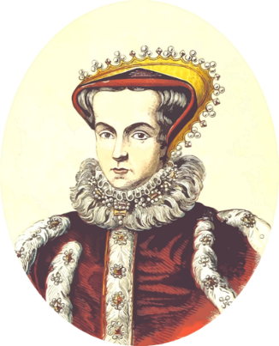
Lesson 12: The importance of Francis Walsingham as Elizabeth’s ‘Spymaster General’.
Francis Walsingham was a strict Protestant. In fact, during the reign of Elizabeth’s Catholic sister Mary I, Francis Walsingham decided to escape England in fear of his life. However, after Mary I’s death, he and other Protestants returned to England to support the Protestant Queen Elizabeth I. He began to work closely with Elizabeth’s Secretary of State, William Cecil and helped him to discover plots against her. He became so trusted as well as talented at his job, that in 1573, Elizabeth asked Francis Walsingham to be her new Secretary of State. During his time working with William Cecil, Walsingham had already started to build up relationships with people abroad, who he believed could spy for him. He made sure that he had spies and informers working for him in France, Spain and Scotland in particular. Walsingham was also keen to travel to these countries himself in order to gain the trust of even more people. Walsingham was also known for his bluntness and the way he would directly talk to the Queen. He was so effective at his job, that he has become known as Elizabeth’s ‘Spymaster’.
Francis Walsingham’s Spy Network and Spy Methods
Walsingham’s Importance in the Execution of Mary, Queen of Scots
Walsingham supported Francis Drake’s circumnavigation of the world. He correctly judged that the Catholic Spanish were vulnerable to attack at sea by Francis Drake. The Catholics were certainly humiliated when Drake attacked and looted Spanish ships on the voyage in the 1570s.
Walsingham was so ruthless, that he was even willing to spy on members of the nobility and even members of Elizabeth’s close Privy Council.
Throughout England and Europe Walsingham had an impressive range of spies and informers in every country and important town. Some were specially trained agents but others were simply ordinary people who Walsingham had recruited.
Walsingham played a key role in collecting the evidence that was presented to Elizabeth to prove that her cousin, Mary, Queen of Scots was plotting against her.
While Mary, Queen of Scots was under house arrest in England, Walsingham instructed the guards there to open any letters which had been sent to her or which Mary wanted to send.
It was important that Mary still believed these letters were being secretly sent to her. This way, Walsingham was able to discover the plans of the Babington Plot.
A letter was found in which Babington planned to assassinate Elizabeth and bring Mary to the throne of England.
Mary’s reply was then discovered in a beer barrel and it fully supported the plan.
This evidence is what Walsingham needed to bring Mary, Queen of Scots to trial.
Walsingham began to train his own spies on the use of ciphers (secret written messages) and even found individuals such as Arthur Gregory who could lift the red wax seal from a letter to make it look like the letter had been unread.
Not all priests who were arrested were executed as Walsingham wanted to avoid the Catholic priests in getting too much sympathy and support. A special prison was built for the priests and the conditions were not that harsh. However, 130 priests and 60 of their supporters were executed by Walsingham.
Walsingham gathered a vast number of spies and informers abroad in countries such as Scotland, Spain, France, Italy and even in North Africa.
Walsingham was willing to use torture as a way to gain information. For example, he tortured Edmund Campion in 1581. Campion was then hung, drawn and quartered at Tyburn as a deterrent to other Catholic plotters.
Walsingham became involved in many aspects of trade and exploration. He believed that one way to remove the Catholic faith from England was to simply remove the Catholics from England all together and send them to the ‘New World’ of America.
Walsingham also gained information from some of the Catholic priests who he had captured. For example, John Hart was a Catholic priest who had been smuggled into England but then found by Walsingham. He was held by Walsingham in the Tower of London in 1581. However, he was promised a ‘pardon’ for his time in the tower if he promised to spy for Walsingham. Given that in 1580, at least 6 Catholic priests had been taken to the Tower of London, tortured and executed, Hart’s decision to spy for Walsingham was not a surprise.
He was given £2,000 a year by Elizabeth’s government to carry out his secret activities and bribe anyone who he believed could give him useful information about any plots against Elizabeth. This could be from prisoners to Catholic priests. If money didn’t work to get the support he needed then Walsingham was also willing to use the threat of violence.

Slide 14
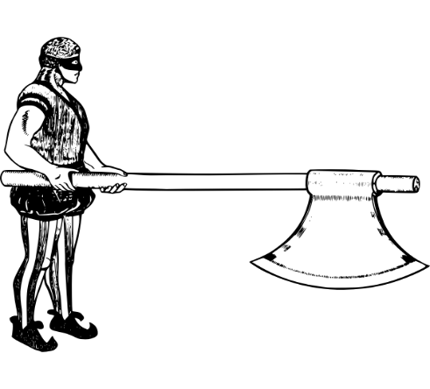
LESSON 13: To explain why Mary, Queen of Scots was executed by Elizabeth in 1587.
Background:
Elizabeth had not been willing to execute her cousin, Mary, Queen of Scots before 1587. She was worried that killing her would anger the Catholics even more and bring about further attempts on her own life. Until 1586, Elizabeth did not have concrete evidence against Mary, Queen of Scots for the role that she had played in the many plots against her. As the Queen of England, Elizabeth had to make sure that any execution of another monarch was fully legal and supported with evidence. Furthermore, Mary still had to go on trial and a jury had to find Mary guilty of treason before any punishment could be decided. However, Elizabeth signed the death warrant for Mary, Queen of Scots in 1587. As quickly as this was signed, Elizabeth’s parliament called for the execution before Elizabeth could change her mind.
REASON: PLOTS
Mary had been involved in too many plots against Elizabeth such as the Revolt of the Northern Earls, Ridolfi, Throckmorton and Babington plots. Enough was enough and as much as Elizabeth had been trying to hold off executing her own cousin, Elizabeth was left without any choice.
REASON: CLEAR MESSAGE
The execution of Mary, Queen of Scots would send a powerful message to other Catholics about how they might be dealt with. With Mary dead, the threat from the Pope and other Catholics would drastically reduce and the Protestant faith would survive in England.
REASON: FRANCIS WALSINGHAM
In 1586, Francis Walsingham discovered the letters which had been written between Mary and Babington. In the letters it was clear that Mary had agreed to sending six men to execute Elizabeth. Now, Walsingham had written evidence against Mary to use in a trial. Walsingham used his skills to de-code the ciphers in the letters sent between Mary and the plotters involved in the Throckmorton and Babington plots. It was this evidence that uncovered the plots and was then used against Mary to accuse her of treason during her trial.
REASON: PRESSURE
Elizabeth had pressure to execute Mary from most of her Protestant government, Francis Walsingham and her Privy Council. Knowing how indecisive Elizabeth was with her decision making, once Elizabeth had agreed to the execution, parliament arranged the execution quickly. This gave Elizabeth no opportunity to change her mind. In this way, Elizabeth’s own government were responsible for the execution.
Why was executing Mary a risk?
The execution of Mary, Queen of Scots left England without an heir as Elizabeth had no children. This might make England more likely to be invaded.
The execution further angered Spain. The Spanish were already angry with Elizabeth for helping the Protestants in the Netherlands.
Catholics in England would be more determined to support a plot against Elizabeth.
Mary’s execution clearly showed that Elizabeth wanted to remove the Catholic faith from England. This would make her even more of an enemy to the Pope.
REASON: EVIDENCE
Mary was officially found guilty of being involved with the plotters using evidence collected by Francis Walsingham. She was put on trial and found guilty of the crime of high treason (the attempt to murder a monarch). In law, execution was the only punishment that could be given – anything less would again make Elizabeth look weak.
REASON: NO ALTERNATIVE
Mary, Queen of Scots was the only real legitimate alternative for the throne of England after Elizabeth. Executing Mary would make sure she could not have chance to be a Catholic Queen. Elizabeth would then not be under pressure to name her as the heir to the throne.
REASON: ELIZABETH’S PERSONALITY
Elizabeth had been sympathetic towards Mary for a long time and hesitated to have her executed. After the Babington Plot Elizabeth’s sympathy ran out when Walsingham was able to show her clear evidence against Mary.
REASON: ELIZABETH’S PARLIAMENT
Elizabeth’s close advisors and parliament were so keen to execute Mary, that one of them wrongly informed Elizabeth that the Spanish Armada was on its way to invade England and put Mary on the throne. This prompted Elizabeth even more to sign Mary’s death warrant.
REASON: MARY’S POPULARITY
As long as Mary, Queen of Scots was alive, angry Catholics in England would be more likely to plot against Elizabeth. Her death would stop her being a figurehead of the counter-reformation and leader for the Catholics.
REASON: PERSONALITY
The ongoing letters between Mary and the plotters showed just how determined she was to take the throne of England. Mary also had nothing to lose after being forced out of Scotland. Executing Mary was the only way to stop this.
REASON: THE LAW
In 1584, Elizabeth’s parliament persuaded her to create a law called The Act for the Preservation of the Queen’s Safety. This made any attempt to threaten Elizabeth an act of ‘treason’ and would result in an execution for anyone found guilty.
This has really annoyed me now
REASON: MARY’S IMPRISONMENT
Elizabeth had put Mary under house arrest in several castles in England to reduce the chances of Mary attempting a revolt. However, she always found a way to make contact with the plotters.
REASON: SPANISH LINKS
Elizabeth had been making enemies with Philip II and it was clear that Spain were becoming more likely to invade England. Removing Mary would take away the most obvious Catholic monarch Spain could put in control after their invasion.

Slide 15

LESSON 14: The tension between England and Spain - The events in the Netherlands
We should already know that the Spanish had taken control of the Netherlands before Elizabeth became Queen of England. It’s also worth remembering how close the Netherlands was (and is) to Protestant England. As the Netherlands was now controlled by Spain, it meant it was also Catholic. However, there were still many people from the Netherlands who were Protestant and Elizabeth offered to ‘indirectly’ help these Protestants fight against the Spanish. At no point however, did Elizabeth officially send an English army into the Netherlands to fight against the Spanish as she wanted to avoid a war as much as possible.
The Events in the Netherlands 1558 - 1570
Tension between England and Spain in the Netherlands 1570s and 1580s
Elizabeth continued to indirectly and unofficially help the Protestants in the Netherlands by sending them money. She could not afford to send a full English army to the Netherlands and she did not want to risk a full on war with the Spanish at this time. Most of the time, she tried to indirectly help the Protestants against the Catholic Spanish.
We know that in 1560, Spain had brought in the idea of the Spanish Inquisition to the Netherlands. The Spanish Inquisition was a religious group who set about finding anyone who was not Catholic and then arresting, torturing or burning them alive.
We know that by 1566 and in response to the Spanish Inquisition, there was a ‘Dutch Revolt’ against the Spanish.
We know that by 1567, to stop the Dutch Revolt, King Philip II of Spain sent over the strict Catholic Duke of Alba with 10,000 men to stop the Revolt. The Dutch Revolt had been defeated by 1568.
In 1568, The Duke of Alba set up another organisation nicknamed the ‘Council of Blood’ which made sure that people were fully obedient to the Catholic faith. This put thousands of Protestants to death and many to flee to England.
One group who decided to flee to England were called the Sea Beggars. Elizabeth promised to keep them safe in England. This made it clear that Elizabeth was taking sides with the Protestants.
Also in 1568, a large sum of money called the Genoese Loan was on its way from Italy to the Netherlands to help pay for the Spanish soldiers there. However, while the Italian ships stayed on English shores, Elizabeth ordered her men to take the Genoese Loan from Spanish ships.
In 1570, Elizabeth offered the promise of a marriage to the future king of France, the French Duke of Alencon. By doing this, she was hoping that she could gain another ally – France and this would worry Spain. The Duke of Alencon was keen to fight against the Spanish and so Elizabeth was able to take advantage of this.
However, the Duke of Alencon was not needed as by 1576, the Spanish government in the Netherlands were running out of money. Despite all the riches being brought back from the New World, they could not cope with the constant fighting in the Netherlands. In fact, the Spanish troops there were not being paid. As a result, they refused to and went on a violent rampage through the Netherlands. This was known as the Spanish Fury. The violence by the Spanish troops, especially in a city called Antwerp meant that both Protestants and Catholics came together against Spanish rule.
In the same year (1576) The Spanish soldiers were that angered that an agreement was even drawn up called the Pacification of Ghent. The Pacification of Ghent demanded that the Spanish troops should be expelled from the Netherlands, that Protestants should no longer to attacked and that Spain should no longer have control of the Netherlands. This was amazing news for Elizabeth who sent £100,000 to help the Protestant troops in the Netherlands keep their power. Not only this but the Spanish actually agreed to withdraw troops from the Netherlands.
However, just six months after agreeing to the Pacification of Ghent, in 1577, Spain sent troops back to the Netherlands. Elizabeth responded by sending an experienced soldier called Jon Casimir enough money to pay for an army of 6,000 English volunteer soldiers to ‘unofficially’ help the Dutch Protestants fight the Spanish. However, this was not enough to stop Spain taking control of the Netherlands again. Most historians agree that if Elizabeth had sent more money and a fully trained, official English army to the Netherlands, the Spanish would not have re-gained control of the Netherlands.
In 1581, and now that the Spanish were back in the Netherlands, Elizabeth asked the French Duke of Alencon for help. Again, she sent money (£70,000) to help him but did not send any English troops. This attempt to remove the Spanish failed. Not only that it just angered the Spanish even more that Elizabeth had involved France in her attacks against them.
The Duke of Alencon tried to remove the Spanish from the Netherlands again in 1582 but again failed.
Things became worse for Elizabeth when in June 1584, the Duke of Alencon died. Not only that, but the leader of the Protestants in the Netherlands, William of Orange was assassinated in the same year. This removed the two best hopes Elizabeth had to remove the Spanish.
In 1584, things got even worse for Elizabeth. Spain officially formed an alliance with the French called the Treaty of Joinville. It made Spain more powerful and it meant two powerful Catholic countries were now allied against Protestant England. It also meant that France were helping the Spanish in the Netherlands rather than England.
Finally, in 1585, as the Spanish had their own alliance with the French, Elizabeth signed her own alliance with the Protestants in the Netherlands. This alliance between England and the Netherlands was called the Treaty of Nonsuch.
It seemed that the tension was even greater between England and Spain and that events in the Netherlands would continue.

Slide 16

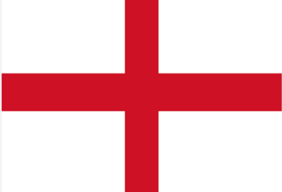

LESSON 15: To explain why there was a growing tension between England and Spain in the 1570s and 1580s?
Background:
The relationship between England and Spain had been getting worse since Elizabeth’s Religious Settlement as well as her helping the Protestant Dutch rebels fight against the Spanish in the Netherlands. Throughout the 1570s and 1580s, the King of Spain, Philip II was increasingly angered by the actions of Elizabeth. Apart from the events in the Netherlands (which we will examine next lesson), let’s have a look at exactly why tension grew between England and Spain in these years.
Rivals in Trade & Exploration
The Actions of ‘Sir’ Francis Drake
Religious Rivalry
Throughout the 1500s England and Spain found new countries around the world to trade with and explore further for goods and resources. In particular, European explorers had discovered new lands in modern day South and North America. They called this land the ‘The New World’. The money which could be made there from trade was enormous. The New World offered goods such as tobacco, sugar cane, and it had Vast amounts of silver.
Spain had already claimed much of the New World as their own and controlled important sea ports there. This meant that any other country who wanted to explore and trade in the New World needed a special license from Spain to do this. However, Spain were not willing to give their rival England a licence.
Tension increased as English merchants (traders) ignored Spain’s rules and traded goods illegally without a license. At no point did Elizabeth criticise the English sailors who did this but encouraged it.
Some English merchants even attacked Spanish ports and ships in the New World to try and gain the upper hand. Some merchants simply stole from the Spanish as acts of piracy. Philip II could not sit back and ignore this challenge to his wealth in the New World.
Also, in 1582, The Spanish had managed to conquer the land next to it - Portugal. This sent a very strong message to England that Spain’s empire was becoming more powerful and wealthier. Portugal was a key country as it offered Spain even more access to the sea as much of its land was next to the coast of the Atlantic Ocean.
Francis Drake was a famous Elizabethan explorer, privateer and merchant (a person who traded goods from abroad). He was keen to find goods in the New World to bring back to England and eager to impress Elizabeth.
Drake was very popular with Elizabeth as his goods made huge sums of money for her and anyone else who invested in his voyages. She saw him as a grand ‘Privateer’ - a sailor who was given permission from the government to trade and make money for England.
However, the Spanish had little respect for Drake and a very different opinion of him. They saw him as a simple ‘pirate’ who stole from their ships.
In 1570 he captured Spanish ships in the New World and stole their goods. He returned to England with a cargo of Spanish treasures.
In 1572, he captured £40,000 worth of Spanish silver. The simple fact that Elizabeth had supported Drake with this caused even more tension with Spain.
In 1577, Elizabeth then gave Drake secret orders to attack Spanish ships and ports and gave him 100,000 crowns to support this. The Spanish were made to feel weak and humiliated by Drake’s actions as well as angered.
This 1577 voyage also became a famous as Drake became the first sailor to circumnavigate the world (travel all the way around). This further humiliated Spain who also saw themselves as a great sea fairing nation. Drake became a national hero and showed England’s strength. From this voyage, it is estimated that Drake returned to England in 1580 with around 400,000 of Spanish treasure.
The Spanish were angered even more when Elizabeth rewarded Drake for his raiding expeditions by knighting him on board his famous ship The Golden Hind in 1580. This was a very public stunt to show Drake’s power and Philip II was outraged by Elizabeth giving him the title Sir Francis Drake in a public ceremony intended to annoy the Spanish.
Since the Religious Settlement in 1559, Catholic countries in Europe had demanded a Counter-Reformation - England to return to the Catholic faith.
Elizabeth had imprisoned her cousin and Catholic figurehead Mary, Queen of Scots in England. Spain saw this as a direct threat to the Catholic religion.
Elizabeth increased her attacks against Catholics in England as a result of the many Catholic plots against her – all of which were supported by Spain.
Spain showed constant support for all of the major plots against Elizabeth. Philip II offered money and troops to help the plots such as the Revolt of the Northern Earls, the Ridolfi Plot, the Throckmorton Plot and the Babington Plot.
She also introduced new anti-Catholic Laws.
Spain strongly believed the Protestant faith should be stamped out and tension grew as Philip gained support from Pope Pius V. Pius V publicly supported any Spanish plans to attack England. He issued an official religious order called a Papal Bull which formally ‘excommunicated’ Elizabeth from the Catholic Church. This meant that the Catholics in England no longer had to obey her.
In 1570, Pope Pius gave a public statement about Elizabeth which said: ‘Elizabeth, Queen of England... is the servant of wickedness... This woman, having seized the kingdom of England has reduced it into a miserable and ruinous condition.’
The Pope now gave full backing to Spain for any attack they planned on England which resulted in angering Elizabeth further.
Drake raided Spanish ships throughout the 1570s. The Spanish labelled him a pirate and gave him the nickname of ‘El Draque’ meaning ‘The Dragon’. Philip offered a reward of 20,000 ducats (the Spanish currency) for Drake’s head!

Slide 17
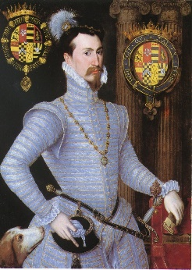
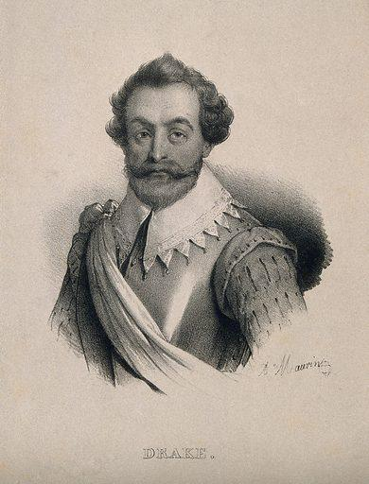
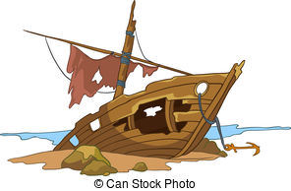
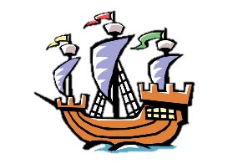
LESSONS 16: To explain why Elizabeth’s involvement in the Netherlands caused tension with Spain after 1585.
Until 1585, Elizabeth had been only indirectly supporting the Protestant rebels in the Netherlands who were trying to defeat the Spanish. She had provided support with money, protected Protestant fighters called the ‘Sea Beggars’ in English ports. Elizabeth had also supported privateers such as Francis Drake to capture Spanish silver and gold in the New World in the hope it would weaken Spain and encourage them to leave the Netherlands. However, in 1585, Elizabeth decided to directly support the Protestants in the Netherlands by sending in her own English troops. This now put England and Spain directly at war with each other. The aim was to push the Spanish out of the Netherlands to restore the Protestant faith there. However, this proved very difficult for the man she put in charge - Robert Dudley.
Elizabeth takes action!
In 1585, Protestants from the Netherlands came to England to offer Elizabeth the chance to become Queen of the Netherlands.
However, it was too risky to accept this offer. it would mean removing the King of Spain, Philip II from his control of the Netherlands. Elizabeth did not want to risk a war.
England’s Time in the Netherlands was a Failure – WHY?
Elizabeth did not want to take charge as she still hoped to negotiate (talk) with Spain.
Elizabeth did not give Robert Dudley enough money, men or supplies to fight effectively against the Spanish.
Elizabeth could not control Robert Dudley once he was in the Netherlands. Dudley made a foolish mistake by accepting the title of ‘Governor General of the Netherlands’ without getting Elizabeth’s permission first. This also angered Philip II who was meant to be in charge of the Netherlands – not Dudley.
One English sea captain, even changed sides and gave a captured port in the Netherlands back to the Spanish.
Dudley did not defeat the Spanish in the Netherlands or stand up to the strong Spanish leader, the Duke of Parma.
Elizabeth had to call Robert Dudley back from the Netherlands in 1587 because of his poor actions.
Robert Dudley’s main success
Dudley did managed to stop the Spanish Duke of Parma from taking a key deep water port in the Netherlands called Ostend. It was important as the large ships used for the Spanish invasion of England depended on this deep water port to help re-supply. Not being able to use Ostend, was a key factor in the defeating the Armada.
The Treaty of Nonsuch 1585
Instead, Elizabeth decided to sign an agreement with the Netherlands called the Treaty of Nonsuch. This made the Netherlands and England allies.
It was a response to Spain and France signing a similar treaty, the Treaty of Joinville a year earlier.
Drake’s attack on Cadiz ‘The singeing of the King of Spain’s beard’ in 1587.
Spain was already preparing its invasion of England with an armada (an invasion fleet of ships).
In March 1587, Elizabeth ordered Francis Drake to attack Spain’s navy.
In April 1587, he sailed into Cadiz harbour in southern Spain. This was Spain’s most important port.
Over 3 days, he destroyed 30 ships and most of the ships supplies.
He then spent the next few weeks attacking the Spanish coast of Portugal.
Drake’s attack was known as the ‘Singeing of the King of Spain’s beard’ because of how humiliating it was for the Spanish and their king.
The Consequences of Drake’s attack on Cadiz
Spain were not able to build the invading armada while the attack was in progress.
The disruption to Cadiz put the Spanish invasion back a year to give Elizabeth time to plan.
It meant that Spain did not attempt an invasion until 1588, by which time Elizabeth had prepared.
It was a humiliation for Spain and showed the strength of the English navy.
Drake still active in the New World
Elizabeth also sent Sir Francis Drake to raid more Spanish ships in the New World. The aim was to disrupt Spanish wealth and trade.
This angered Philip so much that he told the Pope in 1585 that he planned to invade England.
Elizabeth’s Action in the Netherlands
Elizabeth paid for an army of 7,400 English troops to help the Netherlands fight the Spanish.
The leader she put in charge of these troops was to be her close advisor, Robert Dudley.

Slide 18
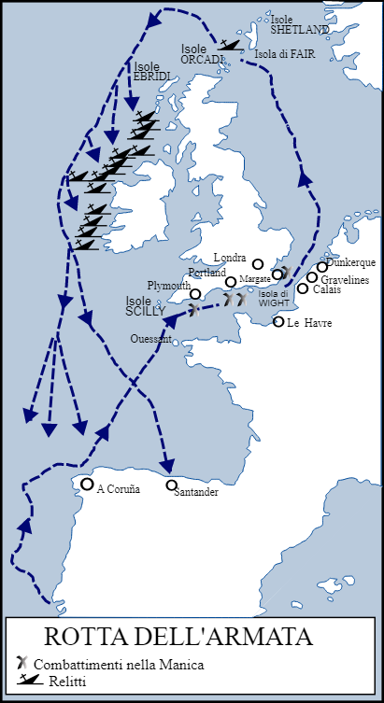

LESSONS 17: To explain the causes of the Spanish Armada invasion in 1588 and the features of the invasion.
Background:
You may be asked a question which simply asks you to ‘describe the features’ of Spain’s invasion plan of England in 1588. For this, it will be useful to remember specific historical facts such as names, dates, places, people, and statistics. However, you may also be asked to EXPLAIN the reasons for the Spanish invasion in 1588. Here, you MUST remember to use phrases such as ‘This caused the invasion because’ or ‘This meant Philip launched an attack as’.
Reasons for the Spanish invasion of England in 1588
The main aim of Philip’s invasion
To remove Elizabeth from the throne of England.
To replace Elizabeth with a Catholic monarch and restore England to the Catholic faith.
RELIGION
POLITICS
Philip was determined to make England a Catholic country again.
Philip was angered at the increasing tough laws on Catholics in England after Elizabeth’s Religious Settlement.
Philip was influenced by the support and encouragement of the Pope.
The Pope had promised to forgive the sins of all those who took part in the armada.
The Pope offered Philip a reward if he was successful.
Spain had already supported plots to remove Elizabeth but they had failed. This was another more direct opportunity.
Elizabeth had been helping the Dutch Protestants in the Netherlands.
Spain now had the support of France for the invasion after they became allies with the Treaty of Joinville in 1584. Spain could use ports in France such as Calais to take on more supplies.
Philip was angered when Elizabeth signed the Treaty of Nonsuch with the Netherlands in 1585 which effectively made the two countries enemies.
Successfully invading England would give Spain even more power with a bigger empire.
Despite time to compromise, it was clear that neither side were willing to back down peacefully. War seemed the only option left.
Elizabeth always hesitated to fully support the Dutch Protestants. This showed weakness & gave the Spanish more confidence of victory.
FEATURES OF THE SPANISH INVASION PLANS
30,000 men in total to invade.
Philip ordered 130 ships.
2431 guns on board the ships.
Under the command of The Duke of Medina Sidonia.
To march on London and remove Elizabeth.
GEOGRAPHICAL
Spain now had control of Portugal which gave Philip access to more ships and ports for an invasion.
The Spanish leader, the Duke of Parma had been successful in the Netherlands. This gave the Spanish another country they could use in their attack of England as well as more confidence for an invasion.
ECONOMIC
27,000 troops to land in England and march to London.
To sail up the English Channel to the Netherlands, meet the Duke of Parma and then sail to London.
Drake’s attacks on Spanish ships in the New World left Spain without their supplies of silver and gold. This angered Philip greatly.
Drake’s attack on Cadiz also caused the loss of Spanish treasure as well as being a huge humiliation for Philip.
To gain more supplies and men in the Netherlands.

Slide 19
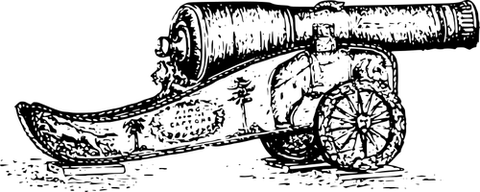

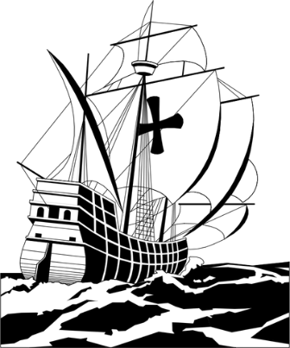

LESSONS 18: To explain the reasons for the English victory against the Spanish Armada in 1588.
Why were the Spanish were defeated in 1588? As always with any question about the causes of an event, make sure you clearly EXPLAIN your reason. For a 16 mark question you may have to then think about which factor would have played the biggest role in the English victory against the Spanish Armada. Can you argue your case strongly in support of the reason you have chosen?
Ship Design
Planning for invasion
Tactics
The Spanish
The Spanish ships were slower to turn.
Loading cannons was slow due to little space on deck.
The English
Elizabeth ordered new ships to be built that were bigger and faster.
The English built new ships called galleons. They were easier and faster to turn in battle.
English canons could be quickly re-loaded could fire more cannonballs.
The English canons could fire further.
The Spanish
Food was stored in barrels made of poor quality wood. Food supplies rotted quickly.
Drake’s raid on Cadiz put the planning for the invasion back a year.
The Spanish wanted to meet with the Duke of Parma in the Netherlands but this did not happen.
It took 2 days for supplies to be taken on board the Spanish ships from smaller boats in the Netherlands.
There were over 118 Spanish Catholic priests on board the ships with little experience of fighting.
The Spanish had been at sea for 10 weeks before they reached the English Channel. They were low on energy and morale.
The Spanish
The Spanish did not know how to deal with the English fire ships or better canon power.
Many Spanish ships cut their anchors in the storms and were sent off track.
The English
At the famous Battle of Gravelines, the English sent in fire ships to break up the Spanish fleet. This tactic created panic amongst the Spanish who had to cut their anchors and flee.
Decision making
Communication
The weather….luck!
Weapons
Leadership at Sea
Philip
Philip ignore the advice he was given from his commanders.
Elizabeth
Elizabeth listened to her naval experts.
She put Francis Drake in charge & trusted his decisions rather than trying to take charge of the invasion plans herself.
The Spanish
The Spanish were meant to tell the Duke of Parma when they were about to arrive in the Netherlands. This took over a week and gave the English more time to prepare.
The English
A set of fire beacons were lit along the coastline of England when the Spanish were first spotted. This quickly informed Francis Drake in Plymouth that his ships needed to be ready.
The Spanish
The Spanish were not used to the English weather or coastline.
The Spanish struggled in the storms.
The English
The strong winds heading towards the Spanish, gave the English to idea of sending out fire ships (ships on fire) to break up the Spanish formation.
The English were used to fighting in poor weather conditions and knew the coastline well.
The Spanish
The Spanish had poor quality canon balls and too few of them.
The English
The English were able to fire 6 times the number of canon balls and from a longer distance.
The Spanish
The Duke of Medina Sidonia did not want to lead the invasion. He had little experience and was sea sick.
The English
Francis Drake and the other commanders were some of the most experienced and respected in Europe.

Slide 20

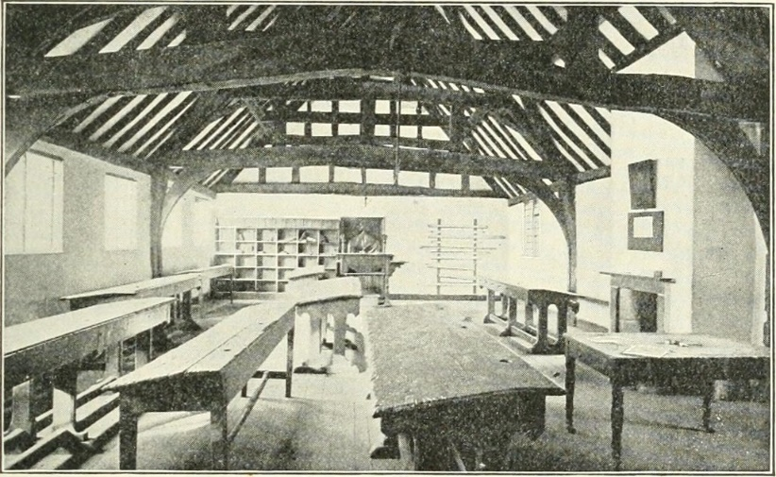
LESSON 19a - The features of and the attitude towards Education in Elizabethan Society
During the reign of Elizabeth I, education became more important and attitudes towards education became more positive. The period also saw key changes to education, especially for the wealthy. However, the Elizabethan people still lived in a very strict social hierarchy where everyone had their place. There was no social mobility, where a person would be able to move into a higher class if they worked hard enough. The education a person received simply prepared them for the life they were expected to lead. For most children, this involved important practical skills with some basic literacy. Only a very small percentage of children and boys in particular would received a formal education. Few girls, even in the more wealthy parts of society received education.
Why did Education Change during this time?
Education for the Younger Nobility – Home Education
HUMANISM
There was a new and fashionable idea called Humanism. These people, called humanists believed that learning was an important part of life for everyone in society. They believed that better education would stop people from being so superstitious (believing in witchcraft and magic) and encouraged people to question and understand the world around them in a more open minded way. Their ideas spread to make education more important.
Boys and many girls of the nobility were taught in their home or the homes of other wealthy families by a private tutor. They could learn a variety of subjects such as foreign languages, History, Philosophy and Theology (religion). As Elizabeth was a highly educated queen, many noble families made sure their daughters were educated too – this way Elizabeth was an influence on education. Girls learned the skills expected of upper class women such as dancing, music, horse riding and needlework. When they were old enough, girls would be sent to spend time in another noble household where they would begin to socialise and then hopefully meet a future husband. The noble boys were taught more ‘male’ related skills such as fencing, wrestling and swimming. After the age of around 7, boys were often sent to another noble household to finish their education. As the sons would inherit their father’s titles, the boys would learn how to become future noblemen and be expected to learn from the other noblemen around them.
RELIGION
Elizabeth’s Religious Settlement had made sure the bible was now written in English (not Latin) so that it was easier for people in England to understand it. This motivated more people to learn how to read so that they could read the bible for themselves. Reading the bible in English was also a more Protestant method of worship which would support her Religious Settlement even more and result in less demand for Catholic priests.
Education for the Older Nobility - University
Many boys from the nobility (and some from the middle classes) could go on to study at a university. Even though girls had home education when they were young, their aim in life would be to marry into another noble family with the role of being a wife. This meant that no girls attended university. Elizabethan England only had two universities – Oxford and Cambridge. However, both of these universities were growing bigger and they were made up of different colleges. For example, in 1571, Queen Elizabeth founded a college in Oxford called Jesus College specifically to educate Welsh boys.
INCREASING TRADE
With towns and ports growing, there was a need for more people to be literate and educated in arithmetic (Maths) so they could trade, run their business and communicate with other businesses. This encouraged more people to gain an education – especially men.
At this time, a young person would start university at the age of 14 or 15. Subjects would include Geometry, Music, Astronomy, Philosophy, Medicine and Law. Another respected subject was Rhetoric. This taught the art of public speaking and persuasion and was mainly aimed at those boys who may wish to have a career in politics.
Elizabeth saw the two universities as highly important as she wanted to educate more Protestant Clergyman. This way, she believed, it would increase the number of well educated Protestant Clergymen who were needed after the removal of so many Catholic priests. This in turn would make sure England remained a Protestant country.
THE PRINTING PRESS
Better printing press machines were developed to reproduce books. This made books a little cheaper and more available to the wealthier classes. Books were printed about a number of subjects such as philosophy, mathematics, religion, medicine & law.
It’s important to remember that for most of the poorer parts of society, education was limited. In rural areas, farming remained a way of life and little changed at all.

Slide 21
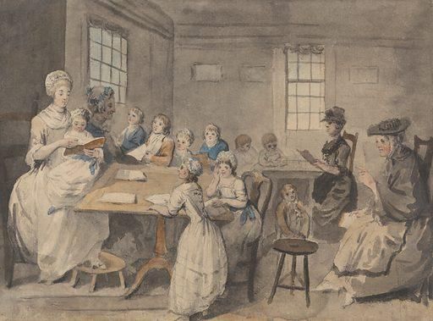
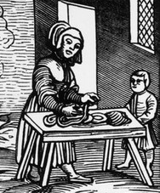
LESSON 19b - The features of and the attitude towards Education in Elizabethan Society
Young Middle Class Girls - Dame Schools
Middle Class Boys – Grammar Schools
University Apprenticeships
Dame Schools were the only schools specifically set up for girls. They would provide a basic education such as reading and writing in English and they would be run by a local, educated woman in their own home.
Women were simply expected to go from being under the control of their fathers to being under the control of their husband. For most girls, education was about learning important skills to be a wife and a mother. For example, learning how to sew, bake and treat injuries.
Grammar schools were private schools set up for wealthy, bright boys – mainly from the towns. Once middle class boys had been at Petty School, they moved on to a Grammar School at around the age of 7 or 8. 42 Grammar schools were formed in the 1560s by 1577, every major town in England had a grammar school. This meant there were more schools in Elizabethan England than there had ever been before.
Families would pay a fee for a place at a grammar school but this was based on how wealthy the boy’s family were and so some families would pay more than others. There were also some very bright, lower class boys who attended grammar schools whose fees were paid for by wealthy people who left money in their wills to help those who could not pay for their education.
School days were very long, beginning sometimes at 6am and lasting for 10 hours. The main subjects taught would be Latin as well as Ancient History and Philosophy. There was also time for archery, chess and wrestling. Debating was an important skill taught to all boys as well as an emphasis put on public speaking to encourage a career in politics. There was also school on a Saturday morning.
Discipline in a grammar school was strict. Boys were made monitors and had to report misbehaviour. Punishments might include corporal punishment such as caning. Children could be placed on report, kept in at break times and could even be excluded.
Some grammar schools ran an alternative curriculum for the sons of merchants (those involved in trade), craftsmen and yeomen. This focussed on more practical academic subjects such as Literacy, Arithmetic and Geography.
There were also Grammar schools for the children of craftsmen and yeomen farmers, but most of their education would be in the form of a university apprenticeship where they would learn the skills that were needed to run the family business or farm.
For most children in the middle orders, whether they went to school or not depended on if their family could cope without them to help with the family trade. As school was not compulsory, there was no legal school leaving age.
Young Middle Class Boys - Petty Schools
Petty Schools were run for middle class boys from the age of around 4 to 7 years old. Boys were educated in a teacher’s home.
Boys who parents could afford to send them would go here. They would learn reading and writing in English as well as basic arithmetic (maths).
Punishments were harsh and beatings for poor behaviour or not achieving well enough were common.
After attending a Petty school, the bright or well off boys would go to a grammar school.
What Impact did Schools have?
Expectations for Elizabethan Children based on Age, Gender and Class
Before Elizabeth’s reign, in the 1530s it was estimated that 20% of men and 10% of women were literate (able to read and write). By the end of Elizabeth’s reign it was believed that 30% of men and 10% of women were literate. Therefore, there was an improvement in education for men but not for women.
However, for wealthy women in the nobility, there was an improvement in the opportunities for education they were given – perhaps inspired by Elizabeth herself as a highly respected and educated monarch.
For the poor, there was still no need for a formal education and families still needed their children to work towards the family income.
Noble Girls
Private Tutor until early teens
Noble household until late teens
Expected to marry
Labourers and Poorer Children
Noble Boys
Private Tutor until early teens
Noble household until late teens
University Oxford or Cambridge
Most people in Elizabethan England had no formal education as most people were labourers (workers) or farmers. They learned the practical skills they needed from their family, from their homes or from working on the land.
In most cases, children needed to contribute towards the family income from a very early age as a way to support their family.
Most jobs that the poor had did not need any need for literacy or numeracy.
Middle Class Girls
Dame School
Expected to marry
Middle Class Boys
Petty School age 4-5 until 7-8
Grammar School age 7-8 until 14
University Apprenticeship
Lower class boys and girls were not expected to have any formal education. They worked as soon as they were old enough.

Slide 22
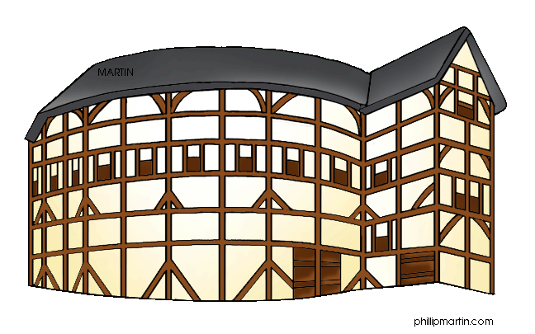




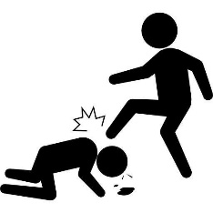


LESSON 20 - Sports, entertainment, pastimes and theatre during the reign of Queen Elizabeth I
Background:
During the reign of Elizabeth I, what a person did in their leisure time would also be based on their class. The wealthier classes had more opportunities to learn skills and take part in organised sports. There were also more leisure opportunities for men than women.
 | Taking part in sports | Watching sports | Literature | Theatre | Music & dancing
The Rich (the gentry, nobility and middle classes) | The rich were able to take part in a wider range of sports and would be taught how to play them by their family or while being educated. For many of these, betting on the outcome of a game was very popular. Hunting – On horseback with dogs or birds of prey. Fishing – Enjoyed by men and women. Bowls – Similar to the modern game but men only. Fencing – Using blunt swords Real Tennis – Played indoors by men only. It was a mix of modern day tennis and squash. Wrestling – In private. | ALL Elizabethans enjoyed watching sports such as wrestling and tennis. Watching animals fight was also seen as a form of entertainment for people of all classes. Large amounts of money would be gambled on the outcome of these blood sports. Baiting This involved watching animals fight. The most common was bear baiting where a bear would be chained to a post and dogs set against it. However, care was taken not to kill bears as they were very expensive. Special arenas were built in London as this was such a popular form of entertainment. Even the queen enjoyed watching this as it was still seen as a sport. Bulls were also used and attacked by dogs to the death. Cock-fighting Cockerels were made to wear metal spikes around their feet and trained to attack each other. In many towns, special arenas were built for this and huge amounts of money would be bet on the outcome. | A lot of new literature was written during this period. History was a popular subject. The increasingly exploration of the world also led to new adventure stories being written which captured people’s imaginations about the world they lived in. The printing press also made reading books cheaper and more available. Poetry and plays were very popular with the rich. The most educated people wrote poetry, including Queen Elizabeth herself. Plays written for the theatre were going through a revolution at the time. | Religion had a huge influence on the growth of theatre. Before Elizabeth’s Religious Settlement, Catholics would tour the country with their Mystery Plays. These would tell the story of famous Catholic Saints and miracles. However, Elizabeth wanted this to end and so encouraged more non-religious plays to be written. This would stop the influence of the Catholic Church on the ordinary people of England. The secular (non religious) plays were more entertaining, funny & exciting for ordinary people and became popular. Theatre companies increased and even the nobility would help pay for them. For example, Elizabeth formed her own theatre company called ‘The Queen’s Men’ in 1583. The first purpose built theatres were constructed, especially in London. The first to be built was the Red Lion in Whitechapel. The theatre was popular with all classes, but the seats divided the rich and poor. The poor could pay a penny to stand in The Pit at the front of the stage. Women were not allowed to perform. | Music and dancing was popular with men and women of all classes. However, the classes would never dance together. Many played instruments such as lutes (similar to a guitar) and harpsichords (similar to a piano). Wealthy families would employ their own musicians to play during meals and feats. Books of popular music could be bought by the rich.
The Poor (farmers, craftsmen and lower classes) | Football – It was the most popular game for lower class men only. It was very violent and some men were killed during matches. The aim was to get the ball to the other side’s goal like today. However: The ball could be picked up The number of players was not restricted. There were no rules about tripping up other players. The size of the ‘pitch’ could be as much as between two villages. Wrestling – Competed in public.
 |  |  |  |  | The poor would enjoy listening to music at fairs, markets or public occasions. There was music at the church and in the taverns (pubs).
 |  |  | Literacy rates among the poor were very low. The poor relied on stories told word of mouth. The type of work they had to do also gave them very little time for leisure activities such as reading.

Slide 23
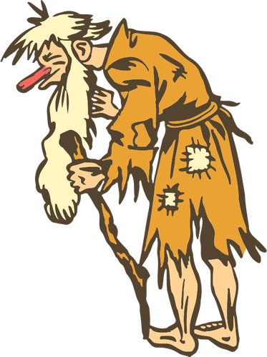

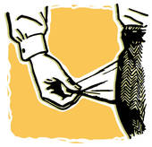
LESSON 21 - To explain why there was an increase in poverty and vagabondage in Elizabethan England.
Background:
During the reign of Elizabeth I, the amount of poverty increased. Alongside this, the number of people without a home or work also increased. This was known as vagabondage or vagrancy. The people who experienced this were called vagabonds or vagrants. The main causes of this increase in vagrancy and poverty can be organised into the following categories: population growth, poor harvest, the increase in sheep farming and enclosure of land. As well as being able to explain how each factor led to an increase in poverty, you should argue which factor played the most significant role.
Features of poverty in Elizabethan England
There was very little help for those without work, living in poverty. For many, an illness could mean starvation for them & their family.
There was some help for the poor from ‘Poor Relief’ from the local town or ‘alms’ (charity) from the church.
Vagrants were people without a home or regular work. They would be given more help and sympathy by Elizabethan society.
Vagabonds were those who committed crimes or were too lazy to find work. There was no sympathy towards vagabonds in Elizabeth society.
The poor at this time were those who spent 80% or more of their income on bread.
40% of the poor in some places were under 16 years old.
Families with mothers only, lived in more poverty as women were paid a lot less than men.
The type of people more likely to live in poverty were widows, the sick, the elderly and orphaned children.
POPULATION GROWTH
The population grew by 35%. The population of England grew from 3 million in 1551 to 4.2 million by 1601. Most of the growth was in towns and cities. London became the fastest growing city in England and had a population of 150,000. The food needed in these growing towns was grown in the countryside and so had to be brought in. Food prices therefore increased as there was more demand for it.
LOWER PAY
With more people living in towns, less work was available and the wages could fall. This gave people fewer opportunities for work and a lower wage could also mean less money for rent and food.
INCREASED RENT
A bigger population also produced a bigger demand on places for people to live. Landowners took advantage of this by increasing their prices. The price of rent therefore increased so people had less money to spend on food.
LAND PRICES
As the population grew in the countryside, the demand for land also increased. Landowners took advantage of this by charging higher rent for land. If a family could not afford this rent they would be evicted.
SHEEP FARMING
The trade in wool, was big profit for farmers at this time. The wool trade made up 81% of all England’s export trade. Farmers began to farm sheep for their wool rather than grow crops for food. This caused more poverty as:
Keeping large flocks of sheep used up land which would have been used by locals to grow food.
Farming sheep did not require as many workers as growing crops so more people were made unemployed.
Feeding the sheep meant using more land to grow food just for the sheep, not people.
CLOSING OF THE MONASTERIES
The monasteries used to help the local poor by giving them handouts of food or offering shelter. After Henry VIII had closed the monasteries and with the decline of the Catholic faith, this form of help was no longer available for the poor.
ENCLOSURE OF LAND
In order for farmers to keep their animals (sheep) many began to fence off the land or ‘enclose’ it. Often, this took more land away from the local villages which was once ‘common land’. Families who once lived on the land that was now enclosed would be left homeless.
POOR TRADE WITH SPAIN
Due to the tension and conflict with Spain, there was less demand for goods to be made which were then sold abroad. This increased unemployment further and even led to an economic recession.
INFLATION OF FOOD PRICES
With less land, sheep farming, more people and enclosure of land, the price of food increased as there was less of it. It was harder for families to feed themselves with what they earned.
POOR HARVESTS
During 1565 and 1562, there were particularly poor harvests due to the bad weather. With less food, prices increased further.

Slide 24
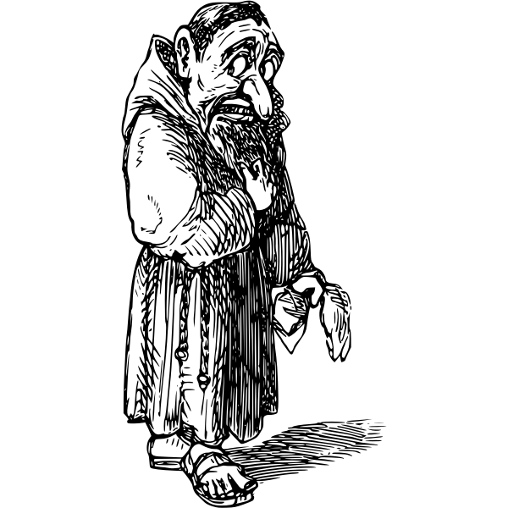
LESSON 22 - To explain the changing attitudes towards the poor in Elizabethan England.
Background:
There was some help for the very poor in Elizabeth England, but the government had to respond to the increasing problem of poverty, vagrancy and vagabondage. Help, called ‘Poor Relief’ was given out and paid for by a special local tax called the poor rate. Some Elizabethans also saw helping the poor as their Christian duty. Over the period, more help was offered for those in genuine need and the attitude towards some of the poor changed. There was a more ‘national’ approach to how the poor were dealt with, who should be helped and who should be punished.
Features/basic facts about the Elizabeth attitude towards the poor
People were sympathetic towards those who could not work because of genuine illness or disability.
People were worried that poverty in England would lead to disorder and more crime.
People were worried about the cost of dealing with the poor.
People were worried as the poor were more visible around them, especially in towns and cities.
Features of the Elizabethan System of Poor Relief – What happened?
Feature | Type of Change | Specific Detail
The Poor Rate | These types of help existed before Elizabeth came to power but were allowed to carry on during her reign. | A local tax was organised by a Justices of the Peace (JP). He then decided who deserved this help. The poor were given either money, or items which they could make and then sell in order to earn money.
Charity | This existed before Elizabeth’s reign. Monasteries used to give help to the poor but they were closed by Henry VIII. | The Church and wealthy people donated money to help the poor. There was a belief that it was a Christian duty to help the poor. Wealthy people would give their name to a charity.
Statute of Artificers 1563 | A change which helped the poor. | This law made sure that the tax and collection of Poor Relief was collected from all those who had to pay. Anyone who refused to pay the Poor Rate could be put in prison. Any officials who failed to organise the collection of Poor Relief could be fined up to £20.
Poor Relief Act 1576 | This law aimed to make it clear which people were in genuine need of help and which people were the ‘idle’ poor who were simply too lazy. | Justices of the Peace JPs would provide the able bodied poor with wool and raw materials to make items to sell. This would allow them to make money and further fund their work. Those who refused to work were sent to a special prison called the ‘House of Correction’, where they would be forced to work for no pay.
Vagabond Act 1572 | Aimed to stop criminal vagrants and vagabonds using harsh punishments. | Criminal vagrants would be whipped and a hole drilled through each ear as a mark of shame, and as a deterrent to others. Vagrants given the death penalty if caught a third time. The Justices of the Peace had to keep a register of the poor who they had to find work for.
Elizabethans did not have sympathy when…
They believed the poor were fit to work but too lazy (called the ‘idle poor’).
They believed beggars (vagabonds) were committing crimes.
The believed a person was deceiving or conning the public about an illness in order to get money.
The punishments for these ‘idle’ or criminal poor were:
Imprisonment
Publicly whipped through the streets
Hanged if caught three times.

Slide 25


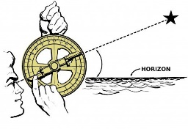
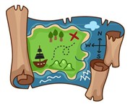

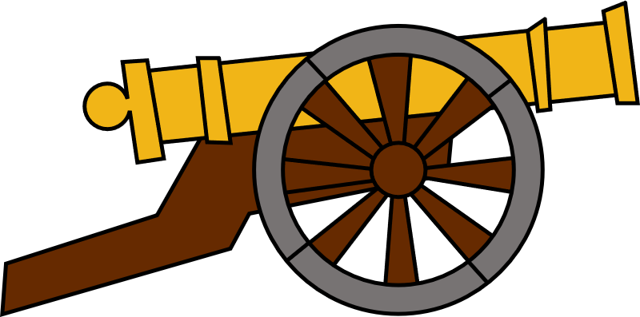
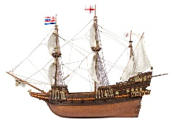


LESSON 23 - To explain why there was an increase in exploration in the Elizabethan period.
Background:
For those with money, the opportunity to explore the world was better than ever before during the Elizabethan era. A number of factors led to a huge increase in exploration during this time. As with any set of causes, think about being able to clearly explain how each factor led to the increase in exploration. Then, consider which of the factors played the most important part.
Expanding Trade
Adventure
New Technology
The New World (the area covering the Americas) was offering more opportunities for trade.
Conflict with Spain and the Netherlands had closed down some trade routes and it was vital for explorers to find new places to trade with. This included areas of Africa.
Explorers and traders worked with each other to find these new trading locations in the New World.
There were reports of new , exciting crops and resources in the New World which could make money in England.
Young, Elizabeth men were inspired to go on voyages of discovery and adventure hoping to make a fortune and become a hero like Francis Drake.
They were inspired by the publication of books and diaries from explorers such as Drake and Raleigh.
The development of the printing press made more stories of adventure available to the young men of the gentry and nobility who could then afford to take their own journeys of exploration.
Navigation equipment was developed to become even more accurate and longer lasting.
Voyages were safer, more direct and faster as a result.
This gave confidence to encourage further exploration to new places from less experienced sailors.
Quadrants and astrolabes were able to calculate a ship’s position using the stars more accurately. These calculations could be written down and printed in books.
Printing Press & Maps
Improved Weapons
Improved navigation then led to more accurate maps.
In 1569, the first map with longitude and latitude was published.
The development of the printing press further developed the number of explorers being able to use these maps on their travels.
As maps were now printed and not hand copied, all maps were standardised (the same) which again led to more reliable journeys.
The new galleons designed by John Hawkins had bigger and stronger decks for guns. Canons could be fired from both sides of the ships in case of attack and were able to fire further than the canons from other countries – even the Spanish.
The ships could defend as well as attack if needed.
This was key during the tension with the Spanish in the New World.
The Slave Trade
Ship Design
Investment
It was not just in the New World where explorers began to trade. Slave Traders had discovered they could trade their guns in West Africa for slaves.
These slaves could then be taken to the New World and used to grow exotic crops such as sugar, spices, coffee and tobacco.
John Hawkins was one slave trader who helped develop this trade further and influenced others who saw his success. He made huge fortunes from the slave trade.
Galleons were developed which were much larger and more stable than previous ship designs.
Galleons could hold more cargo and were much better for longer journeys to the New World and journeys of exploration.
Ships were easier to manoeuvre which also made them safer (to avoid pirate attacks) and gave sailors more confidence at sea.
Rich, private investors, including Elizabeth herself, funded new voyages of discovery. They knew the rewards could be enormous and wanted the power and the glory that this gave.
Elizabeth had seen how rich Spain had become from its trading in the New World from tobacco, sugar and exotic crops and so was willing to spend huge amounts to explore further.
Goods brought back could then fund the government too.

Slide 26
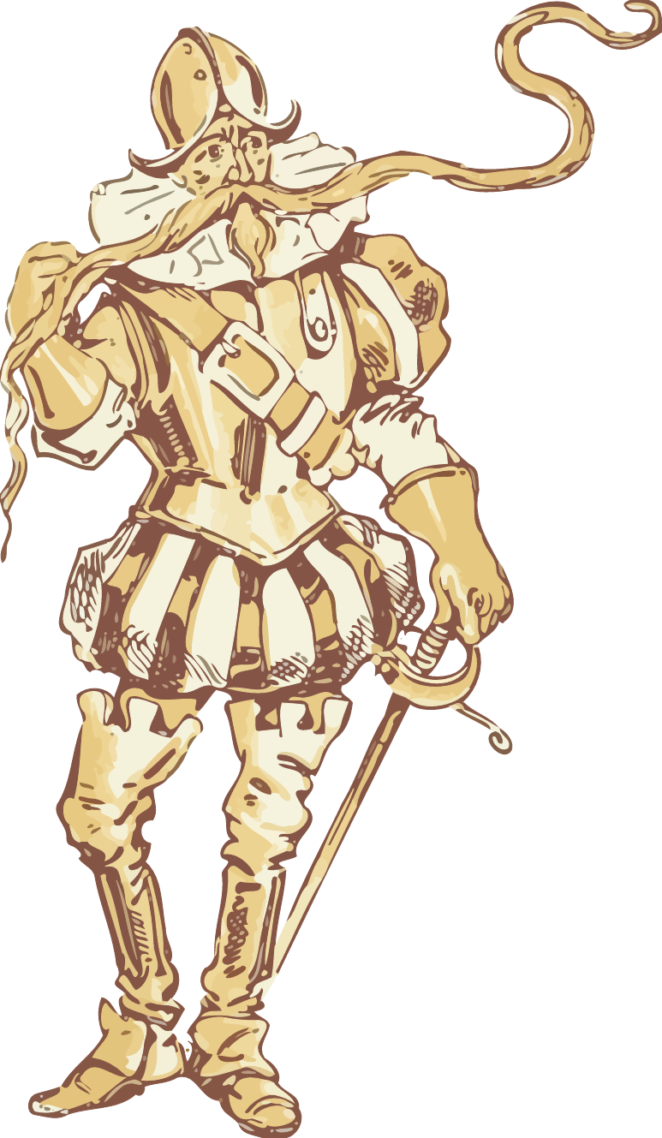
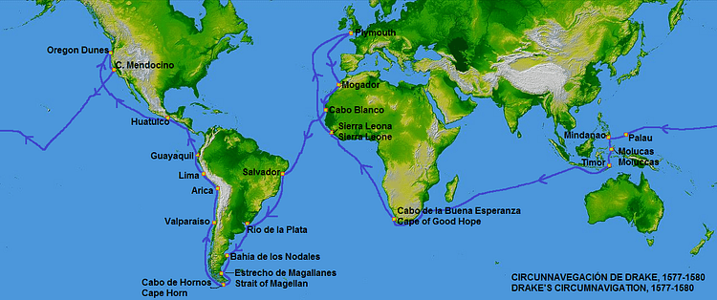
LESSON 24 - ELIZABETHAN EXPLORATION – Drake’s Circumnavigation of the globe (1577-1580).
Francis Drake and his crew took 3 years to circumnavigate the world. However, he did not set out with the aim of being the first Englishman to sail around the world. His main focus was to raid Spanish colonies and ships in the New World. The voyage almost ended in disaster. Setting out with 5 ships, by the time Drake reached the Pacific Ocean in 1578, he only had one ship left – The Golden Hind. Drake had even executed one of his sailors, who he accused of mutiny (helping the Spanish)! By 1580, only 56 men had survived on board the Gold Hind and returned to England. For his achievement he was knighted by Queen Elizabeth I on board The Golden Hind before he took a key role in the defeat of the Spanish Armada in 1588. This achievement had a significant impact and influenced many other voyages of exploration. It also sent a powerful message to the Spanish about the quality of the English navigators at the time.
Why did Drake Circumnavigate the globe?
The Importance of Drake’s Circumnavigation of the World
POLITICAL GAIN OVER SPAIN
Carrying out such an achievement of circumnavigating the world sent a powerful message out to the Spanish about the power and reputation of the English in the world.
It Angered the Spanish
Drake’s attack on Spanish ships and his looting of their resources led to the further decline of Anglo-Spanish relationships.
Elizabeth’s knighting of Drake for his actions, on board the Golden Hind clearly showed Elizabeth’s support for what he had done. Phillip II was said to be furious with Elizabeth knighting Drake who he saw as a pirate.
The Reputation of the English
Drake became famous as this was only the second crew in History to have achieved the circumnavigation and the first ever English circumnavigation.
It improved the English morale (made them feel better and more motivated), especially at a time when their relationship with Spain was poor.
It gave English sailors a great reputation as the best in the world.
Drake became a hero
Drake’s ship, the Golden Hind was only 1 of 5 ships to survive and Drake was only one of 56 remaining men who returned.
His voyage, and the stories that came from it made Drake a hero and inspiration to others who heard about his adventure.
TO GAIN WEALTH
There was a huge amount of money to be made out of a voyage like this to the New World. Many people were willing to invest in Drake’s voyage with the hope of making a huge amount of money.
The voyage made his investors very rich from the treasure and foreign goods which he brought back. Drake’s treasure haul was worth 500 million in today’s money. Elizabeth I herself was willing to invest in his voyage in the knowledge that great wealth could be made for her country.
Davy Ingram
One of the most famous accounts from the voyage was from explorer Davy Ingram. Ingram walked over 3,000 miles north up the coast of America. He wrote down his amazing tales of great wealth including precious metals such as silver and lumps of gold.
He spoke of red sheep and rabbits and also acts of cannibalism being practiced by the Native American people who killed and then ate their sick. These tales actually encouraged more exploration.
New English Land – Nova Albion
In 1579, The Golden Hind needed repairing and reached west coast of America. They met Native Americans who treated the sailors well and they even performed a ceremony that made Drake the leader of their land.
Drake named the land Nova Albion (New England) and declared Elizabeth its Queen.
This encouraged other English sailors to conquer any land that had not already been taken. For example, Sir Humphry Gilbert set off to North America in 1578 to colonise land for England.
However, the rights of the Native Indians were not thought about and this eventually led to their decline.
Encouraged more exploration
Drake and his crew travelled up the coast of America. and collected very useful and fascinating information about what they saw in detailed logs and maps.
Drake’s logs were an inspiration to other sailors and explorers to find out more about the Americas knowing that they could survive like Drake did.
FOR REVENGE
Drake wanted revenge for a Spanish attack on his fleet in 1567. Drake and John Hawkins were on their third transatlantic voyage from Africa to the New World. The Spanish, were angry with Drake for attempting to destroy the Spanish monopoly (control) of trading in the New World. The Spanish therefore attacked Drake and Hawkins’ ships at a place called St Juan in the New World. The English fleet were devastated and 325 English sailors were killed. Drake and Hawkins returned to England with only 15 sailors.

Slide 27

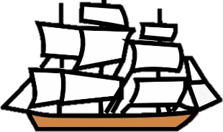
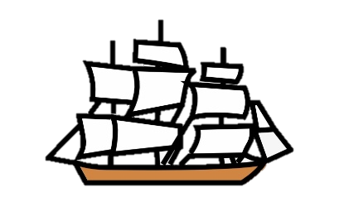
LESSON 25a - ELIZABETHAN EXPLORATION – To explain why Walter Raleigh attempted to colonise Virginia (1584-5).
With support and encouragement from Elizabeth I, Sir Walter Raleigh organised a voyage to colonise an area of North America named Virginia (named after Elizabeth, ‘The Virgin Queen’). Raleigh was born into rich landowning family of the gentry. He was known for bringing back tobacco and making it popular in England. Raleigh did not go on the voyage to Virginia himself, but he helped fund and plan the colonisation. Importantly, he had to find volunteers to leave England and settle in North America. The Virginia Project aimed to settle English people in a community in Virginia with the aim of being able to expand English territory abroad and also develop its trading ability. Raleigh wasn’t part of the exhibition himself as Queen Elizabeth thought he was too important to risk on the long voyage. However, previous attempts to do this by explorer Sir Humphrey Gilbert had failed and unfortunately, this attempted colonisation also failed. This lesson will examine the planning for the voyage and colonisation as well as explain why it failed.
The First Stages of the Colonisation
The Organisation and Planning of the Virginia Project
Sending out a Fact Finding Voyage
Raleigh first sent a team to Virginia to investigate the Native Indians who lived in this part of North America. The relationship between the English and the Native Americans (the people who originally lived on the land) was friendly. They exchanged English goods for food from the native Americans. On their return to England, the team reported that Virginia was like a ‘paradise’ and that the native people there were very friendly. This was important as it gave Raleigh the opportunity to promote Virginia in a positive way to persuade people to live there.
The use of Manteo and Wanchese
As well as bringing back exotic goods and foods to show off, the fact finding exhibition to Virginia also brought back two Native American Indians called Manteo and Wanchese. Manteo and Wanchese were also used to promote the Virginia Project. They helped English explorers learn some of the Native American language and they were also taught some English. It was hoped that having the support of Manteo and Wanchese would help the colonists make contact with other Natives in order to trade with and find workers..
Supplies
Ships
Timing
The colonists needed enough:
Food to get across the long voyage over the Atlantic.
Fresh water and drink for the voyage.
Farming tools and seeds
Animals such as chickens to use as food
Weapons for the voyage and the colonisation.
They needed enough ships which were big enough to carry all of the colonists and their supplies.
The ships needed to have weapons in case of attack by the Spanish or pirates.
The ships needed to be strong enough to survive the voyage.
They had to reach Virginia during a time of year when they could grow crops that would help them survive over the winter.
Arriving too late or growing the wrong crops would cause problems.
Raising Money for the Colonisation
Elizabeth refused to fund this voyage on her own – she needed to think about the funds she might need to potentially fight against the Spanish now that tensions with Spain were high. However, she did give Raleigh a ship, gunpowder worth £400 and her official royal backing. This royal backing is what attracted other wealthy people to invest in the project to colonise Virginia. Raleigh also had to invest money of his own to find the voyage to Virginia. Anyone who invested their own money in the colonisation would hope to gain money back from the trading opportunities it would give in the long term.
Persuading people to leave England
Raleigh used the findings from the ‘fact finding’ trip to persuade a group of English men to make the dangerous and long voyage to Virginia across the Atlantic Ocean. These people were led to believe they could find their fortune and live in a ‘paradise’. They had to be people who were willing to leave their life in England and live in Virginia permanently.
Spain
People
Spain controlled a lot of the land and sea around Virginia. This meant that they would need to safely find a route through without being attacked by the Spanish. They also needed soldiers on board to protect the colonists from any Spanish attack.
Raleigh believed he needed 300 colonists with a variety of skills to first reach Virginia and then survive. He listed hunters, farmers, soldiers and stone masons (to build forts).
He chose Richard Grenville as his Expedition Leader. He was an experienced sailor as well as an experienced soldier
Ralph Lane was chosen to be the Governor of Virginia (a soldier and an expert fort builder).
Thomas Harriot had worked with Manteo and Wanchese and understood their language, as well as being skilled at map making. He too was taken on the voyage.

Slide 28
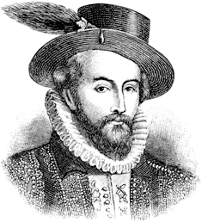
LESSON 25b - ELIZABETHAN EXPLORATION – Why did the attempted Colonisation of Virginia fail?
The Voyage
Inexperience
Native American Resistance – Roanoke Island
The colonists left England too late in the year and did not arrive in Virginia in time to plant the crops they needed to be able to feed themselves over the winter months. This left them having to rely on the food of the native Americans in order to survive. At first the Native American people were generous but then felt that they were being taken advantage of. This made the relationship between the two groups difficult.
The food on board the ships rotted too quickly and so resulted in the colonists being too weak and sick.
One of the ships called The Tiger was damaged and flooded on the voyage. This ship contained most of the voyages’ food stores as well as some important seeds for planting in Virginia.
Many of the colonists were ill on the journey. With little medical knowledge, morale became low even before they reached Virginia.
The colonists did not understand how to survive in North America or how different it would be to England. They could not adapt to many of the changes they experienced.
The colonists had to rely on the Native Americans too much. When the Native Americans began to refuse to give any more help, this left the colonists without.
The colonists did not expect the setting up of their colony to be such hard work and require so many skills. Many of the wealthier members of the party still expected that their social status would mean others would do all the hard work. This led to tensions increasing between the colonists.
Despite having Manteo and Wanchese with them, this was not enough to set up a good relationship with the Native American people.
A group of natives on one of the English settlements in Virginia called Roanoke Island were far more unpredictable and suspicious of the English than the English were expecting. The chief of Roanoke Island became fed up with the constant demands from the colonists for food and supplies.
The Roanoke people feared the English. They believed the colonists had strange supernatural powers to kill them. For example, when the colonists left their settlement, many of the Roanoke people died. We now know that this was due to the English diseases that had been brought over that the Roanoke people were not protected from. However, the Roanoke people did not know this and so feared the English.
Finally, through fear and anger, the Roanoke set out to fight against the colonists. The colonists found out about this planned attack and prepared to fight back. With better weapons and armour, the English colonists killed many of the Roanoke as well as their tribal chief. However, there were also many deaths amongst the English colonists.
The colonists who survived decided to return back to England in 1586. They simply could not cope and the colonisation failed.
A second group of colonists left England and travelled to Roanoke in 1587. This was another attempt at colonising this area of Virginia. However, despite having Manteo with them, the Native Indians were still hostile and there was more fighting.
The Colonists
The colonists found it difficult to cope with the hot and humid climate as well as the mosquitos which were everywhere.
Many who came on the trip just wanted to get rich quick rather than put in the hard work that was needed to survive.
The colonists could not work well together. The richer ‘gentlemen’ were not prepared to do any hard physical work and expected the poorer classes to do it for them. The ‘poorer’ farmers refused to work for the richer colonists as they had agreed to travel to North America for their OWN land not work on someone else’s land.
There were too many soldiers on the voyage. They did not have important farming skills to help the colonists survive and they were poorly disciplined.
The hunters, farmers and the fishermen struggled. Different farming and hunting methods were needed in such a different climate. Some of the seeds brought over from England would not grow in the different types of soil in Virginia.
Most of the gunpowder on the ships was damaged so shooting animals for food was difficult. English fishing techniques did not work.
False Expectations
In reality, the belief that Virginia was a ‘paradise’ was not true. The colonists felt that they had been lied to by people such as Walter Raleigh who ‘sold’ them the idea of colonising Virginia.
When they were promised exotic foods, in actual fact they were forced to search for nuts and berries to eat in order to survive.
The richer colonists simply believed that the Native American Indians would be willing to do all the hard physical work for them. This was not the case as it was difficult to form friendly relationships with the natives.
The Native American people were more hostile towards the English colonists than they had been led to believe.

