Slide 1
ICT Knowledge Organiser
1.1.1
Functionality of different hardware devices
IT1: Peripheral devices
What is an input device?
A piece of equipment that allows users to enter data into a computer. These device are used to create a digital product.
Navigation
Mouse
To select, drag and drop items, control tools and scroll through pages.
Trackball | Gaming | Touchpad
Includes a large ball on the top or side that can be controlled by a thumb. | Designed to play for long periods with a right and left button and a scroll wheel. | A pointing device built into a keyboard on devices like a laptop.
Capturing images
Scanner: To digitise documents which means to convert a hard copy (paper) into a digital version stored on a computer. There are two types of scanner: flatbed and handheld.
Keyboard
A standard QWERTY keyboard is a fast method of data input for those who are able to touch-type.
Braille keyboard | Concept keyboard
Uses raised patterns on each key to aid users with visual impairment. | Uses symbols/images on each key to allow fast input of data.
Digital camera: A way of capturing a digital image. Commonly embedded within smart devices now.
Graphics tablet: It allows the user to input a drawing to the computer using a type of pen called a stylus.

Slide 2
1.1.1
Functionality of different hardware devices
IT1: Peripheral devices
Readers
Capturing sound
QR code reader
This allows you to scan the code normally found on a mobile phone and get information about a product or service.
Barcode reader
This allows data held by a barcode to be transferred to a computer. This could be information about a product in a supermarket.
Webcam: Used to communicate with each other using an internet connection. This captures audio and visual elements and is commonly used for online meetings.
MIDI keyboard: A way of inputting sounds to a computer through digital signals.
Optimal mark reader
An optical mark reader recognises the position of marks on a document and inputs this information to the computer.
Magnetic ink character recognition
This input device reads magnetic ink characters such as those at the bottom of a cheque.
Microphone: Used to input data that can be converted digitally or outputted to an output device like speakers.
Magnetic stripe reader
A magnetic stripe reader is needed to input the information held on the black magnetic stripe that you find on the back of cards,
RFID reader
A small chip and an antenna to identify electromagnetic fields using radio waves and can be used from a distance.
Sensors
Sensors: It uses different methods to input data into a computer for a specific purpose. For example, a thermostat will read room temperature and an infrared sensor may detect movement
Biometrics: It uses unique physical characteristics of an individual to input data into a computer such as: eye (retina and iris) recognition, facial recognition or fingerprints.

Slide 3
1.1.1
Functionality of different hardware devices
IT1: Peripheral devices
Printers
What is an output device?
A piece of equipment that allows users to receive data from a computer. These device are used to view a product in digital or hard copy form.
Inkjet printer
Common household printer which is affordable and prints to a good standard.
Laser printer
A quicker and more expensive form of printing with users toner instead of printer ink.
Dot matrix printer
It has small pins on the print head that hit against an ink soaked ribbon to make a mark on the paper.
Thermal printer
Produces a printed image by passing paper with a special coating over a small electrical print heads.
View
Listen
Monitor/Screen
This allows you to view information on a screen.
Speakers
This allows the user to hear sound such as: listening to music, watch a video, enhance the sound quality on a computer game.
Dye-sublimination printer
Uses heat to print onto materials other than paper such as plastic, fabric and cards.
3D printer
These use instructions from CAD software to create a 3D design of a product. Useful when creating prototypes.
Projector
This is used to view data on a larger screen, used in meetings and conferences.
Headphones
This is an alternative way of hearing sound but instead this is used so that one individual can hear the sounds instead of being heard by everyone.
Plotter: This allows large scale drawings such as maps and large posters to be printed. It also uses vector graphics which enables high quality content to be printed.

Slide 4
1.1
1.1.1 Functionality of different hardware devices
IT2: Solid-state storage
Evaluation against storage characteristics
What is solid-state storage?
A solid-state drive (SSD) is a solid-state storage device that uses integrated circuit to store data persistently, typically using flash memory. Examples include Solid-State Drive, USB Flash Drive and SD Card.
Cost | Capacity | Reliability
Expensive, even the cost per MB. Although, the price is beginning to come down. | You can purchase up to 4TB of data, not as much as you can with a HDD. | It has a limited number of read and write cycles which means performance will deteriorate quickly.
Advantages:
No spin up time.
Fast access to data
Silent
More robust, uses less energy and no moving parts.
Durability | Portability | Speed
Resistant to being dropped because it has no moving parts. | Most devices are small, lightweight and easy to carry around. Easy to transfer files. | It doesn’t use a mechanical arm and relies on the processors embedded within.
Disadvantages:
High cost (compared to HDD)
Relatively low write speed
Limited of read/write cycles.

Slide 5
1.1
1.1.1 Functionality of different hardware devices
IT3: Magnetic storage
Evaluation against storage characteristics
What is magnetic storage?
The most common example of magnetic storage is a Hard Drive.
The hard drive contains several moving mechanical parts such as a spinning platter with a thin magnetic coating.
A "head" moves over the platter, writing 0's and 1's on the platter. A magnetic tape device another form of magnetic storage primarily used for data archiving.
Cost | Capacity | Reliability
Expensive from the outset but cost per MB represents value for money. | Enough capacity to store different types of files. | Performs well for a long period of time but will eventually deteriorate.
Durability | Portability | Speed
If it’s external, then it can become damaged if dropped because it has moving parts. | Would have to be detached from the computer and it’s heavy. | Uses a head that moves over a platter to read and write data so it’s not instant.
Advantages:
Low cost per GB
It has an unlimited number of read/write cycles.
Disadvantages:
Slow to read and write data because it uses an actuator arm.
Uses more energy.

Slide 6
1.1
1.1.1 Functionality of different hardware devices
IT4: Optical storage
Evaluation against storage characteristics
What is optical storage?
Optical storage works when lasers write data to the disc and read from it using a series of pits and lands.
Examples of magnetic storage include CD, DVD and Blu-ray
Cost | Capacity | Reliability
Cheap to buy and cheaper to buy as a bulk. You can get a blank CD for less than £1. | CD’s can only store 700 MB which might not be enough to store larger files. Blu-ray can hold up to 25GB. | If CD’s are stored in cases or plastic wallets then they can continue to be used for long periods.
Advantages:
Portable as it’s small, lightweight and easy to carry around.
Reliable if it’s looked after properly (i.e. in a protective case)
Durability | Portability | Speed
Sensitive to scratches and dust which can make it difficult to read the data. | Most devices are small, lightweight and easy to carry around. Easy to transfer files. | It is slow reading the data because it has to access the optical disk drive.
Disadvantages:
Might not be as durable because the disk may get scratched.
Low capacity in comparison to other portable alternatives (e.g. USB flash drive)

Slide 7
1.1
1.1.1 Functionality of different hardware devices
IT5: Cloud storage
What is optical storage?
Cloud storage is a form of online storage that enables data to be stored and backed up over a network.
Many individuals and organisations will pay cloud service providers to store their data remotely which can be accessed anywhere if there is an internet connection.
Advantages | Disadvantages
Data is backed up frequently and easy to recover.​ | Data is held offsite by a company you do not control.​
You can extend the amount of available storage by varying how much you pay.​ | If your Internet connection fails, so does your access to remotely stored data.​
Since your data is stored remotely you can access it whether you are in Manchester or Madrid.​ | Difficult to migrate data to another cloud provider later.​ ​
Cloud storage providers
Google Drive
Dropbox
Microsoft OneDrive.
iCloud
Organisations that use cloud storage/computing:
E-mail, virtual desktops, software development/testing, databases and big data analytics.

Slide 8
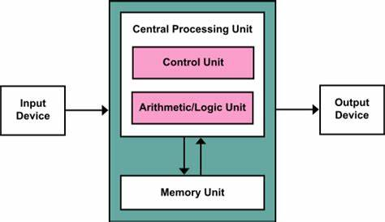
1.1
1.1.1 Functionality of different hardware devices
IT6: Internal components
Structure of the processor
What is an internal component?
An internal component is a part that is designed to be connected/attached to the inside of a computer system.
Control Unit:
Decodes instructions and sends signals the other components on how to respond to this instruction.
Internal components
CPU - To fetch, decode and execute instructions
Graphics card - It outputs images to a display device and controls each pixel on the screen.
Main memory - To store data/programs currently in use.
Sound card - Generates sounds that could be recorded and played.
Motherboard - To connect all the components together.
Network interface card - Enables users to connect to a network.
Arithmetic Logic Unit:
Responsible for performing arithmetic calculations and logical decisions.
What is a computer port?
Ports are slots on the motherboard into which a cable of external device is plugged in.
Examples
HDMI | VGA | PS/2 | Ethernet | Serial
USB | Parallel | Display | DVI

Slide 9
1.1
1.1.2 Functionality of different software
IT7: Systems software
What is systems software?
Systems Software comprises of two parts: Operating System and Utility Software.
The purpose of the operating system is to provide an interface that will allow the user to interact with the computer.
Tools of an operating system:
User interface – This allows the user to interact with the computer.
User management – This will allocate the user with an account which will give them access to files based on the permissions set by an administrator.
File management – This allows users to store files in a logical structure.
Device drivers – Each peripheral device will contain software called a driver that will allow the device to communicate with the CPU. In the modern era of technology, this would be referred to as ‘plug and play’.
Memory management – This ensures that programs/data do not corrupt each other and is stored in correct memory locations.
Multitasking – To ensure that all tasks appear to run simultaneously.
Examples of operating systems
From left to right: iOS (Used in Apple devices), Android, Linux (Open-source operating system) and Windows (A widely used proprietary operating system.

Slide 10
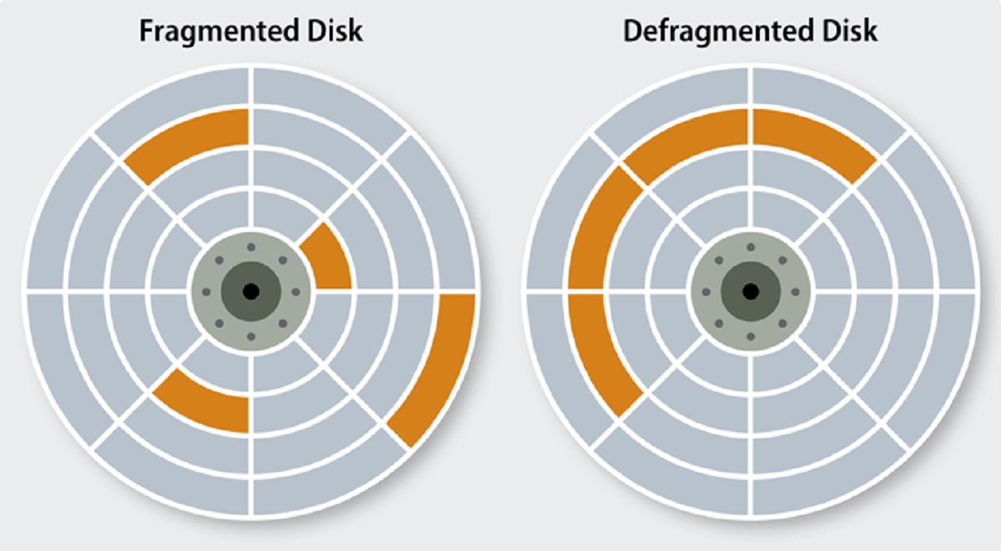
1.1
1.1.2 Functionality of different software
IT8: Utility software
What is utility software?
The purpose of the utility software is to maintain and optimise the performance of the computer.
Other utility software tools
Anti-virus: It is designed to protect your computer from viruses that can infect your computer or steal confidential data.
Backup: Designed to create duplicate copies of files so they can be distributed or retrieved in the case of data loss.
Defragmentation
Compression: It is designed to reduce the size of one or more files in order to take up less disk space.
Systems cleaner: Frees up disk space on your computer by removing unnecessary files.
Data is divided into multiple chunks of data that are stored on the hard drive. This means they’re not grouped together.
Encryption: Designed to make data unreadable to users that should have no access to this information
Firewall: Firewall software monitors what data is attempting to enter your computer or network.
Package installer: Installs files such as applications, drivers, or other software onto the computer.
File explorer: A graphical user interface (GUI) for accessing the file systems.

Slide 11
1.1
1.1.2 Functionality of different software
IT9: Applications software
What is applications software?
Software that is designed to perform a specific task. Some applications are designed to handle information, communicate with others or perform a specific set of functions for one organisation.
Information handling software
Software that is able store large sets of data. That could be databases, spreadsheets or any other application that is able to handle information.
Types of applications software
Specialised software
Specialist software is software written to achieve a task for an individual or company. For example, payroll can be managed through spreadsheet software, but organisations opt to use payroll management software
Word processing software
Desktop publishing software
Presentation software
Spreadsheet software
Database software
Photo editing
Video editing
Webpage editor
Computer-aided design (CAD)
Computer-aided manufacturing
Pros | Cons
Time saving | Initial high cost
More specific purpose | More time to develop
Better support | Not readily available

Slide 12
1.1
1.1.2 Functionality of different software
IT9: Applications software
What is open-source software?
Proprietary software is software that is owned by one person/organisation and they have exclusive control over it. Open-source software allows users to access the source code and modify the software to meet their needs.
What is source code?
The part of software that most computer users don't ever see; it's the code computer programmers can manipulate to change how a piece of software works.
Open-source | Proprietary
Very little professional and technical support and no user manuals to troubleshoot. | Professional and technical support available. User manuals provided for troubleshooting.
Reliable as there are community of users constantly creating updated versions. | Stable product that will contain regular updates to automatically fix any bugs.
There are very little or no upfront costs. | Can be costly to buy a license.
Source code can be viewed, shared and modified. | Source code cannot be modified.
Examples
Examples of Proprietary Software:
Windows, Adobe Web Premium, Microsoft Office, Internet Explorer.
Examples of Open-source Software:
Linux, WordPress, Mozilla Firefox, Open Office

Slide 13
1.1
1.1.3 Services provided by IT
IT10: Online services
What is an online service?
There are a range of services provided by IT that improves efficiency/productivity for individual users.
Online entertainment
To access content for our enjoyment and pleasure such as VoD and streaming services.
Benefits of using a smart TV
Benefits of streaming music
Online shopping
Online shopping is a convenient way of buying goods. Users can enter the name of a product in a search engine and a list of results appears almost instantly.
Apps made available to use.
Access the internet
No need to buy an additional smart device as smart TV offers the same functions.
Accessible on all smart devices.
Create your own playlists.
No requirement for additional equipment such as a radio player.
Access to large libraries of songs and audiobooks.
Benefits of online shopping
Online booking
Software that’s used to manage reservations for business services. Most systems can accept customer payments online as well as making bookings.
You can search for goods, sort them by price, relevance, reviews.​
Images of the products provided.​
24/7 Availability​
Read customer reviews​
You can compare prices from different shops​
Book a delivery/collection service.​

Slide 14
1.1
1.1.3 Services provided by IT
IT10: Online services
Online banking
Online banking is a convenient way to organise your finances. It allows you to view multiple accounts so that you can effectively view and manage your transactions.
Online booking
Online gaming is constantly developing. 3D graphics have given game creators the ability to provide life-like textures, realistic physical characteristics and in-game interactions between objects. Special effects allow players to immerse themselves in the online gaming world.
Benefits of online banking
You can view up to date bank statements​
You can view all incoming and outgoing transactions​
You can make payments online such as a standing order or direct debit.​
You have secure access via a login and encryption tools used by the banks network security system.​
Promotions can be offered to online customers. ​
Benefits of online gaming
Players can select the game they want to play, create online accounts
Interact with other players as well as computer opponents.​​
Access games for download 24/7.
Quick access to games as they can be downloaded straight away with an internet connection.
Other acceptable answers.

Slide 15
1.1
1.1.3 Services provided by IT
IT10: Online services
Online education
Online learning is when you study at home with all the lessons, materials, support and assessment provided over the Internet
Blended learning
Blended learning is a mixture of online study and face-to-face teaching in a classroom. Learners spend some time at school or college for lessons taught by teachers or lecturers, and some time learning remotely using digital learning methods.
Benefits of online education
It provides the opportunity for teaching material to be more interactive instead of just using a text book as a source.​
Students can interact with each other and teachers through forums or chat facilities.​
It can provide personalised learning.​
It allows students to work from home providing they have access.
Benefits of blended learning
Blended learning provides flexibility in terms of time and location.
Students can access online materials and complete assignments at their own pace and convenience.
Blended learning enables personalized and individualized instruction.

Slide 16
1.1
1.1.3 Services provided by IT
IT11: Smart technology
Mobile phones
A smartphone is an example of a smart device which provide messaging services, access to the Internet amongst other features.
Control systems
A control system is a set of devices that work together to achieve set objectives such as to regulate an environment.
Wearable technology
The term wearable technology covers any kind of smart electronic device designed to be worn on the body. These ‘wearables’ can be worn as accessories, embedded in clothing, implanted in the user’s body or tattooed on the skin.
Features:
Make calls
Text using SMS
Torch
Timer/Stopwatch
Play games
Browse the internet
Calculator
Photo libraries
Weather forecasting
Social media
Shopping
Examples:
Motion-activated security cameras
Lighting
Cooking appliances
Pet feeders.
Thermostat
Examples:
Heart rate monitors
Sleep monitors
Checking glucose levels
Smart watches
Fitness trackers (e.g. Fitbit)
Smart jackets
Full body suits with sensors.
Head cameras.

Slide 17
1.1
1.1.3 Services provided by IT
IT12: Artificial Intelligence
What is Artificial Intelligence?
Artificial Intelligence is the broader concept of machines being able to carry out tasks in a way that we would consider “smart”.
Three branches of AI
Neural networks
A Neural Network is a computer system designed to work by classifying information in the same way a human brain does. It can be taught to recognise, for example, images, and classify them according to elements they contain.
Examples of AI being used.
Voice assistants
Driverless cars
Smart bins
Smart alarms
Streaming services
GPS (Google Maps)
Healthcare
Video games
Machine learning
Machine learning use systems that automatically learn and improve from experience without being explicitly programmed.
Deep learning
Deep learning closely tries to mimic how the human brain works.

Slide 18
1.1
1.1.3 Services provided by IT
IT13: Autonomy
What is Autonomy?
With the help of artificial intelligence and some clever programming, ​technology that can perform jobs that would normally be done by humans.
Pros and cons to Autonomy
Pros
Cons
Operate 24 hours without a break,
High development costs.
Examples of autonomy
Robotics
This is to undertake functions normally done by humans.
An example of this is to manufacture cars in factories, where an action needs to be carried out many times.
Bionics
Uses a combination of mechanical engineering and electronic control technology to create mechanical systems that function like living organisms.
This is the technology behind prosthetic limbs.
Can make reliable and accurate decisions.
Risk of computer malfunction.
Will accurately repeat actions over and over again
If it relies on electricity and there is a power cut.
Do not need to be paid.
Uncertainly that a human isn’t in control.

Slide 19
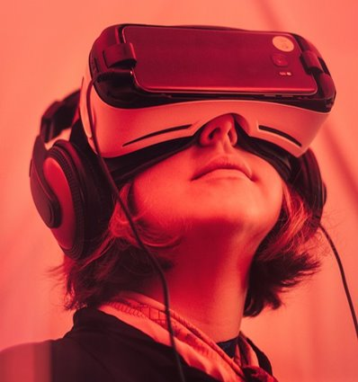
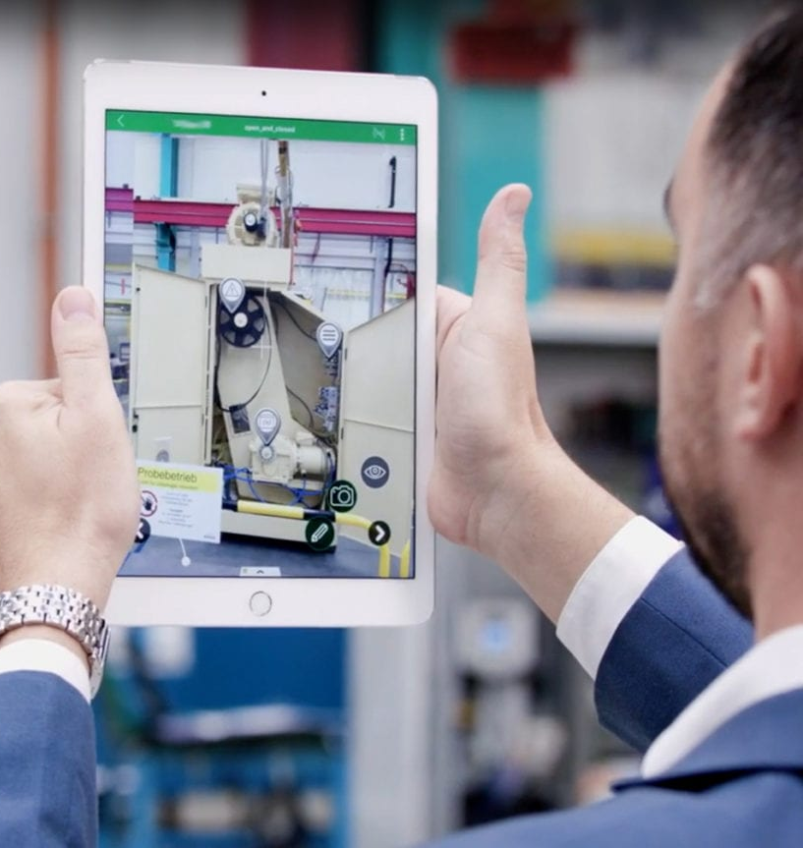
1.1.3
1.1.3 Services in IT
IT14: Immersive technologies
What is Virtual Reality?
Virtual reality (VR) refers to a computer-generated simulation in which a person can interact within an artificial three-dimensional environment using electronic devices, such as special goggles with a screen or gloves fitted with sensors.
What is Augmented Reality?
Augmented reality (AR) applications are best suited for use cases where users need to be connected to and present in the real world. ​Examples of this include remote assistance, on-the-job training, remote collaboration, and computer-assisted tasks.
Advantages
Advantages
Connect with people from around the world.
Enhances experience of natural environment.
Accessible for people with disabilities
Can reduce stress, anxiety and depression.
Experience things that are impossible in real-life
Smartphone apps embed AR technology.

Slide 20
1.1.3
1.1.3 Services in IT
IT15 – Social networking
What is Social networking?
Social networking is the creation of a website to set up an online community where people are linked together using their personal information.
Benefits to using Social networking:
Staying connected with friends and family, especially those who live far away. Finding and sharing information and resources. Participating in online communities and discussions with others who have similar interests. Promoting businesses, organisations, and causes. Easy to create a personal page/profile. Easy to keep in contact with people. Easy to make new friends with similar interests Often free to join and use.
Social networking categories:
Social networking
Media
sharing
Blogging
News
interest
Content curation
Shopping
Consumer review
Interest-based network

Slide 21
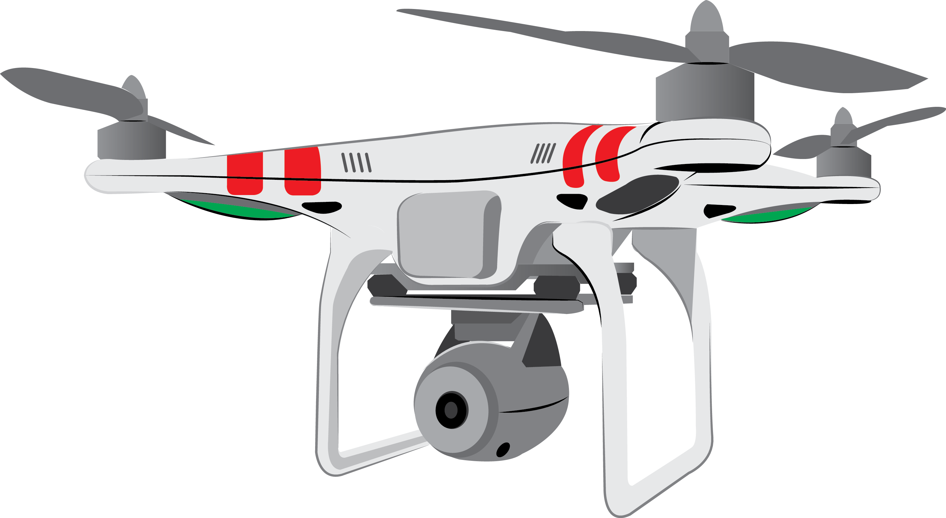
1.1.3
1.1.3 Services in IT
IT16 – Image capture and manipulation
Diagram of a drone
Drones
A drone is an unmanned aerial vehicles (UAVs) that can be controlled remotely or fly autonomously.
Battery
Propeller
Uses
This device used for capturing images is commonly used in fields such as: agriculture, search and rescue, or delivery services.
Motor
LED light
Advantages
Because of it’s size and portability it can be good to access areas that may be difficult for bigger equipment and this makes it a cost-effective option. It may be able to cover areas that are dangerous for humans to access so it’s much safer and finally, it’s designed to capture images which gives users data they wouldn’t normally be able to capture.
Camera with a mounted frame.
Landing gear

Slide 22
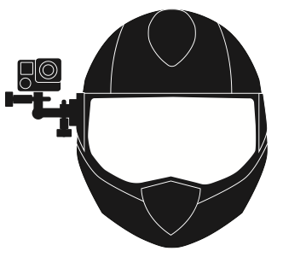
1.1.3
1.1.3 Services in IT
IT16 – Image capture and manipulation
Diagram of a head camera
Head cameras
Head cameras can record footage when on the move and capture images while in action.
Camera
Other features include:
Battery pack
Memory storage
Uses
Commonly used in video production, extreme sports, and first-person gaming
Control buttons
Advantages
It’s small, portable and lightweight option that is easy to carry around because it’s operated hands-free. It’s useful for users who want to take point of view shots. It can be a useful too for athletes can it can help them to better analyse the techniques used, their performance and how they could improve.
Mounting system
Microphone

Slide 23
1.1.3
1.1.3 Services in IT
IT16 – Image capture and manipulation
Diagram of a webcam
Webcam
A video camera that is connected to a computer or integrated in a device and allows its images to be seen online.
Lens
LED Indicator
Uses
Commonly used for video conferencing and online gaming.
Advantages
It’s convenient because webcams allow for easy video communication with friends and family, as well as for online meetings and classes. This makes them generally inexpensive and widely available and compatible with multiple devices that have a built-in webcam, and external webcams can be easily connected to a computer via USB.
Base
Microphone

Slide 24
1.1.3
1.1.3 Services in IT
IT17 – Management information systems
Features of an MIS
What is an information management system?
A management information system (MIS) is a computerised system that provides managers with the information they need to make informed business decisions.
Hardware
Software
Outputs
Inputs
Management information system
Messaging
Advantages
More efficient because tasks can be automated to increase productivity and save money. Allows managers to quickly access and analyse data from different sources, which can help them to respond more quickly to changing business conditions. Better planning and forecasting which provides managers with the historical data they need to make better predictions about future trends and patterns. Improved customer service by tracking customer data and monitor customer satisfaction Increased likelihood to comply with legislation
Personnel
Databases
Procedures
Personnel
Payroll
Who uses MIS?
Retail companies, Financial organisations. Health organisations. Schools. Manufacturing companies Government agencies

Slide 25
1.1.3
1.1.3 Services in IT
IT17 – Management information systems
What is Payroll software?
Payroll software is a computer program or system used to manage and automate the process of calculating, collecting, and distributing employee wages and taxes.
Features of Payroll software
Employee information
Time and attendance
Payslips
Advantages
Saves time because tasks and processes can be automated. Reducing errors such as incorrect calculations. Better security of employee data. Cost effective as it removes manual data entry. Better reporting and analysis. It can be easily integrated with other systems. Remote access so can be accessed anywhere as long as there is an internet connection. A more efficient way of keeping and maintaining records.
Mobile and remote access
Payroll software
National insurance
Deposits
Tax calculations
Generating reports

Slide 26
1.1.3
1.1.3 Services in IT
IT18 – E-commerce services
Benefits of an e-commerce service:
What is an e-commerce service?
E-commerce refers to the buying and selling of goods and services, or the transmitting of funds or data, over an electronic network, primarily the Internet.
Customers
Businesses
Convenience and 24/7 accessibility
Start-up and running costs are low
Wide selection and access to a global market
Increased/wider customer reach
Examples:
Online retail shopping (Amazon, eBay) Digital marketplaces (Uber, Airbnb) Online banking and bill payments Online ticket sales (movie theatres, concerts) B2B (business-to-business) sales and purchasing.
Time-saving and streamlined shopping experiences
Provides a more convenient service for their customers.
Ability to easily compare prices and products
Improved ability to track and analyse consumer behaviour.

Slide 27
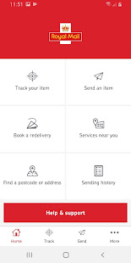
1.1.3
1.1.3 Services in IT
IT18 – E-commerce services
Example: Royal Mail mobile app
What is mail handling?
Mail handling methods refer to the processes and procedures used for sorting, organising, and delivering physical mail, such as letters and packages. These methods can include manual sorting by postal workers, using automated sorting machines, and using technology such as barcode scanning and GPS tracking. The goal of these methods is to efficiently and accurately deliver mail to its intended recipients.
It can be used to track items to see how far away they are.
You can find local drop-off points which are useful when you know nobody will be at home to receive the delivery.
It can be used to buy postage which allows customers print shipping labels.
You can measure the size of the parcel to ensure you pay the correct amount of postage.
You can book a collection for a specific date which fits around your schedule.

Slide 28
1.1.3
1.1.3 Services in IT
IT18 – E-commerce services
Benefits to using a registration system:
What is a registration system?
A registration system is a software application or process used to manage and track the enrolment or participation of individuals in events, courses, programs, or membership. It typically involves the collection of information, payment processing, and the creation of records for each participant.
Keep track of users and their information.
Collect and store data on users for future reference.
Control who has access to what resources.
Verify the identity of users.
Provide personalised experiences to users.
Examples:
Many public services such as schools and doctors use electronic registration systems over paper-based systems. It can be used to enrol students and patients respectively. Its also common for businesses to use similar registration systems.
Use collected data for marketing purposes.
Enhance security by tracking user activity.
Keep track of resources and users in an organised manner.

Slide 29
1.1.3
1.1.3 Services in IT
IT19 – Assistive technologies
Devices and tools
Benefits
Tools:
Alternate text
Captions
Text readability
Contrasting colours
Flexible input
Mobile device accessibility
Screen size and orientation adjustments
Increased independence
What is meant by accessibility?
In the context of technology, accessibility refers to the ability of a device, application, or website to be used by individuals with disabilities.
Enhanced communication
Increased employment prospects
Why is accessibility important?
Accessibility through technology ensures that individuals with disabilities have equal access to information, services, and resources, regardless of their abilities. This technology can be referred to as assistive technology.
Greater access to online content.
Devices:
Screen readers
Voice recognition software
Text-to-speech
Speech-to-text
Alternative keyboards
Braille displays
Electronic magnifiers
Improved accessibility
Better education
Better quality of life.

Slide 30
1.1.3
1.1.3 Services in IT
IT20 – Emerging technologies
Blockchain technology
Internet of Things (IoT)
Description:
Blockchain technology is a decentralised and distributed to record transactions across many computers. Each block in the chain contains a cryptographic hash of the previous block, a timestamp, and transaction data.
Description:
Internet of Things involve devices connected to a giant network that collect and share information such as how they’re used and the environment in which they operate in.​
What is meant by emerging technologies?
Emerging technology refers to any new or rapidly developing technology that is expected to have a significant impact on society, the economy, or a particular industry.
Examples:
Artificial intelligence (AI) Virtual reality (VR) and Augmented reality (AR) Blockchain technology Internet of Things (IoT)
Decentralised and not stored on one single location.
More efficient because tasks can be automated/scheduled.
Highly secure because each block stores data with a hash.
Reduce the consumption of energy.
More trustworthy as data cannot be tampered with.
Devices can be managed remotely.

Slide 31
1.2.1
1.2.1 Why data must be fit for purpose
IT21 - Quality of data
Data
Information
Knowledge
Garbage In – Garbage Out (GIGO)
This concept is common when data lacks quality. For example, a user completes a form incorrectly and the data becomes erroneous. The internet will include content that is not always accurate and up-to-date such as fake news.
Data is raw facts and figures such as 12:00
Information is to add context to the data. For example, the time is 12:00
Knowledge is when it’s understood by the user for example, the time at the moment is 12:00 and my lesson started at 11.30 so I’m late.
Encoding data
Encoding of data refers to the process of transforming collected data into a set of meaningful, cohesive categories. (e.g. Airport Codes)
Pros to encoding data:
Fewer data errors.
Less time spent on data entry.
Greater data consistency.
Less memory required.
Cons to encoding data:
Data does not always fit into a particular category.
Subjective judgements which makes it hard to measure.

Slide 32
1.2.1
1.2.1 Why data must be fit for purpose
IT22 - File properties
What is a property of a file?
A property is information about the file itself. It can also be referred to as metadata. Different types of files will store different properties.
File formats (types)
The file format is the structure of a file that tells a program how to display its contents. It’s also known as file types. Here are a few examples below.
Images
File format
Dimensions (Height and Width)
Resolution
Colour depth
Timestamp
Location
Text
File format
Pages
Word count
Line count
Character count
Word processing software | .doc
Spreadsheet software | .xls
Database software | .db
Graphics software | .jpg, .png, .tiff, .pdf
Video editing software | .mp4, .mov, .avi
Audio editing software | .mp3, .flac, .wav
Desktop publishing software | .pub
Audio
File format
Duration
Bit rate
Sample rate
Channels
Video
File format
Duration
Frame rate
Bit rate
Sample rate
Channels

Slide 33
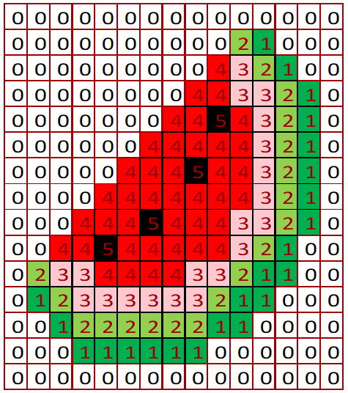
1.2.1
1.2.1 Why data must be fit for purpose
IT22 - Compression
Lossless compression example:
Run-length encoding
Why is compression used?
In some cases, documents my be too big and therefore can’t be stored on a local drive, loaded onto a webpage or even emailed to someone else.
Compression reduces the file size to allow documents to be used in these ways. There are two types of compression.
Image 1: Worked example
Row 1 – 5
Row 2 – 1,1,1,1,1
Row 3 – 2,1,2
Row 4 – 5
Row 5 – 1,3,1
Row 6 - 5
Lossy compression
Lossless compression
Lossy compression will permanently remove data.
This can significantly reduce the size of a file.
The compromise of reducing the file size is that is can have an impact on the quality.
The file also becomes irreversible which means it cannot be changed.
Lossless compression uses an algorithm to temporarily group data together so it can be restored into it’s original form.
This means the quality of the file can be maintained.
The file is reversible which means you can continue to make changes to it.
Image 2
Row 1 – 15
Row 2 – 10,1,1,3
Row 3 – 9,1,1,1,1,2
Row 4 – 8,2,2,1,1,1
Row 5 – 7,2,1,1,1,1,1,1

Slide 34
1.2.2
1.2.1 Why data must be fit for purpose
IT23 - Sources of errors
General input error
This could be a customer entering data on a form incorrectly.
Forms mistakenly lost.
Problems with automatic data collection devices such as bar code readers.
Transcription error
This could occur when a data entry clerk enters incorrect data. In particular, when data is being copied down via a telephone conversation.
Entering a date of birth of misspelling a surname or address name.
Processing error
This could be down to the way the program is written. Some mathematical calculations might be incorrect which causes a logic error.
This means the system will work, but not the way it’s intended to.
Transmission error
This could occur when data is being transferred from one computer to another over a network.
It could be loss of, or poor connection.

Slide 35
1.2.2
1.2.1 Why data must be fit for purpose
IT23 - Data verification
What is data verification?
This checks the data entered is accurate and data can be checked in many different methods:
Traditional methods
New methods
Manual proofreading
This would involve somebody checking the data has been entered correctly. However, this manual process can be very time consuming.
Enter password twice
The user might be encouraged to enter their password in twice to double check they entered it correctly in the first place.
Two-factor authentication
When logging onto an account of making a payment. A text can be sent to your mobile phone with a passcode to enter.
Double entry
This requires data to be entered twice. However, this is a time consuming and costly process.
CAPTCHA
This uses an image that users must identify. It helps to identify whether it’s human or bot entering the data. Bots are unable to recognise images.
Memorable information
For online banking, you need to log in by knowing the specific order of the characters in your memorable word. For example, what are the 2nd, 3rd and 9th character.

Slide 36
1.2.2
1.2.1 Why data must be fit for purpose
IT23 - Data validation
What is data validation?
Data validation is a check performed by a computer to check that the data entered is reasonable and appropriate. It does not however, check the accuracy of the data – that is what data verification is for.
Format check
This checks that data entered has been done so using the correct format. For example, the format of a national insurance number is
LL NN NN NN L.
Range check
This checks the data entered is within a certain set criteria. This could be entering a page on a web form for example.
Presence check
This checks that data has been entered in that field. On forms you make a field a ‘required field’ which doesn’t allow the user to go any further until they’ve completed that field.
Length check
This checks the length of the characters entered. It’s possible to set a minimum or maximum number of characters. This is found on forms where passwords must be at least 8 characters in length for example.
Lookup table
This looks up acceptable values within a table. This is usually provides users with a pop up calendar to select the date and this removes the need for a manual entry and removes errors.
Type check
This checks that data has been entered in that field using a particular data type. For example, quantities can only be entered numerically.

Slide 37
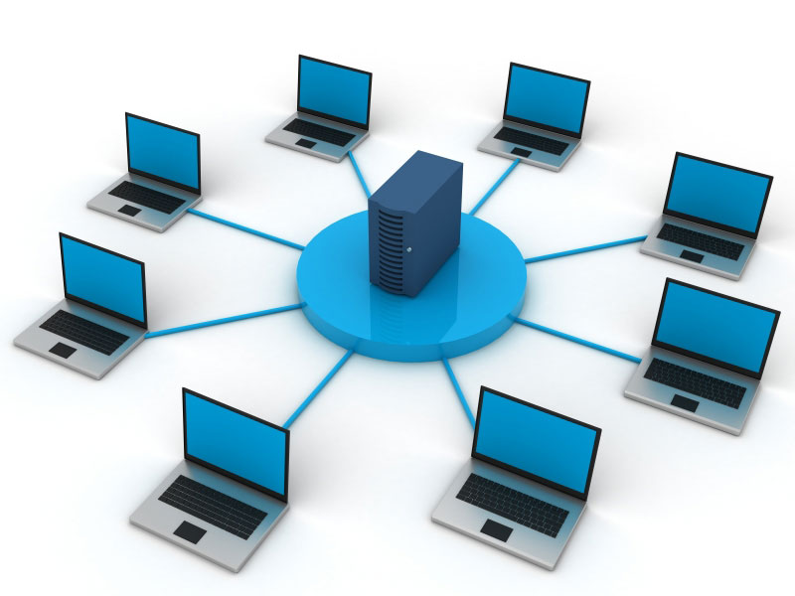
1.3
1.3.1 Networks and topologies
IT24 Network types
What is a network?
A network is a group of interconnected devices that share an internet connection.
LAN
WAN
What does it stand for?
Local Area Network
What does it stand for?
Wide Area Network
How is a networked computer different to a stand alone computer?
A stand-alone computer is a device that is not connected to a network.
How does it work?
It’s a network that covers a small geographical area.
How does it work?
It’s a network that covers a large geographical area.
Infrastructure
It uses network hardware and cables owned by the individual/organisation
Infrastructure
It uses additional transmission media owned by other companies such as telephone lines.
Network types:
LAN (Local Area Network) WAN (Wide Area Network)
Who uses a LAN?
Schools, homes and business that works in a small building or site.
Who uses a WAN?
A chain of supermarkets that need a network across all stores.

Slide 38
1.3
1.3.1 Networks and topologies
IT24 - Network models
Client-server
Peer-to-peer
Network models:
Client-server network Peer-to-peer network.
Where are files stored?
In a centralised location such as the server.
Where are the file stored?
It’s decentralised. Stored on the individuals computer.
Factors that affect network performance:
Number of users using the network. It uses more bandwidth. Distance from the router. Interference from physical objects. Choice of transmission cable (e.g. fibre optic) Streaming videos in HD. The use of a VPN (Virtual Private Network) Wi-Fi frequency may need to be changed.
Backing up data
All data is backed up in a centralised location. (i.e. a server)
Backing up data
Peer-to-peer may need to perform their own backups.
Updates/Installation
Upgrades can be done centrally and not on individual computers.
Updates/Installation
Upgrades would need to be performed on each computer.
Hardware
File servers to store/retrieve files.
Web servers to access the world wide web.
Hardware
Router to connect to the network and access the internet,

Slide 39
1.3
1.2.3 How data transfers over different types of network
IT25 - Network hardware
Different types of network hardware
Switch
Router
Creates networks
Connects to other networks
Switch
Network hardware that allows you to create networks is responsible for re-directing data packets to the intended recipient.
Inspects MAC addresses
Inspects IP addresses
Re-broadcasts data packets to the correct recipient.
Forwards data packets onto the intended recipient once IP address have been inspected.
Router
Hardware that allows you to connect to other networks by inspecting the IP address.
Reduces security issues and unnecessary traffic.
It can exchange data outside of it’s own network.
Can connect LAN’s together using a bridge.
Can connect LAN with a WAN using a gateway.

Slide 40
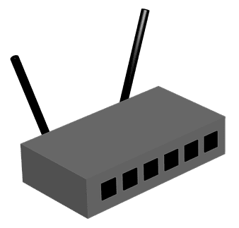
1.3
1.2.3 How data transfers over different types of network
IT25 - Network hardware
172.16.254.1
Different types of network hardware
What is a Wireless Access Point?
Hardware that relays data from a wired network to a wireless device. It’s used to extend the coverage of a network so users can access the network from longer distances.
MAC address
IP address
It uses hexadecimal numbers and 6 bytes long.
It uses denary numbers and is 4 bytes long.
MAC address is fixed to one device and doesn’t change.
Can be changed / are allocated as needed
Configured in hardware.
Configured in software.
Network interface controller
A chip that allows the computer to connect to a network. Each NIC contains a MAC address.
Uniquely identifies a device on a network.
Not unique to one individual device or network.
MAC addresses are only used within the LAN
Used for routing across a WAN / internet

Slide 41
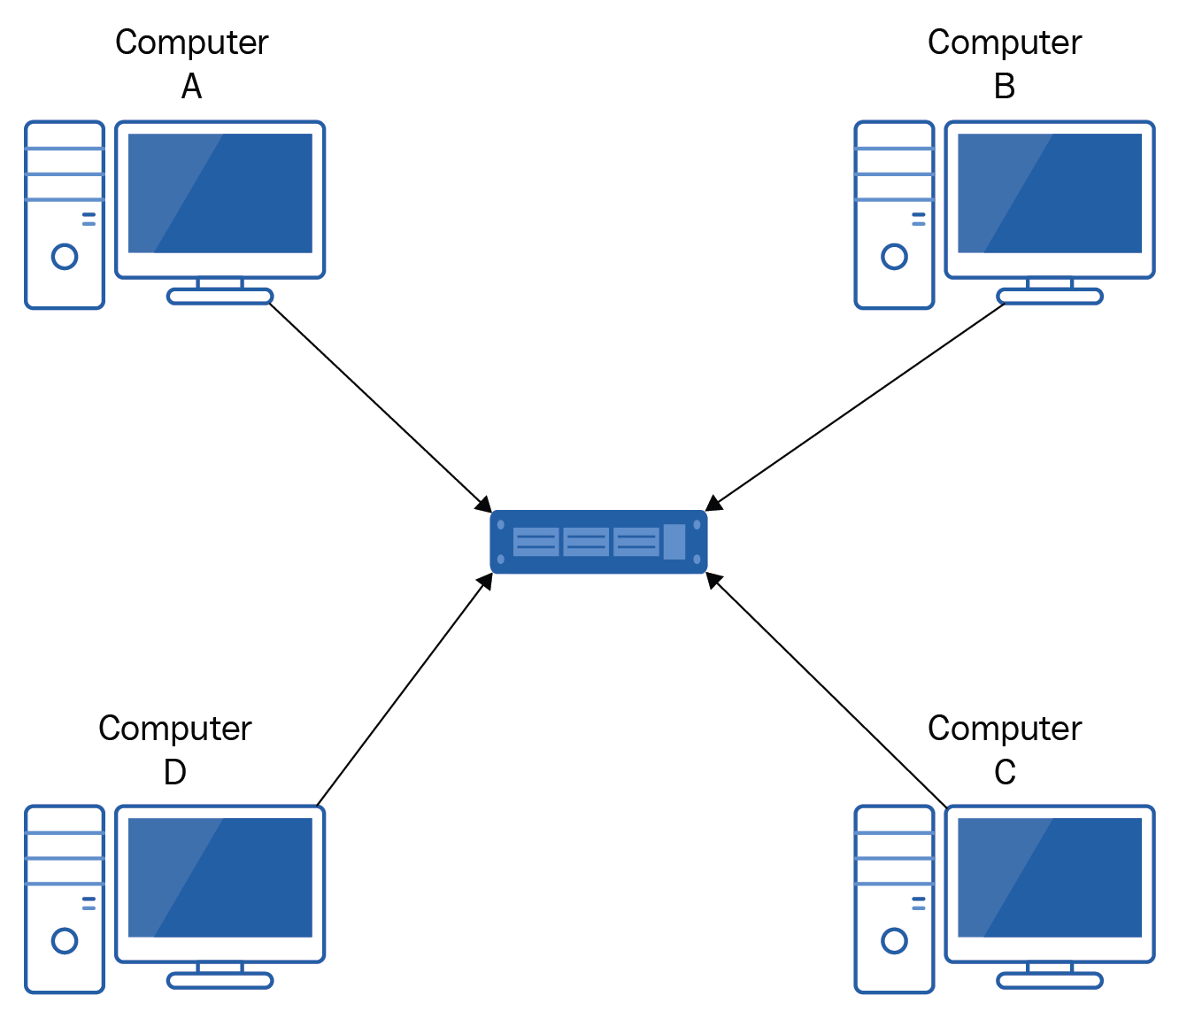
1.2.3
1.2.3 How data transfers over different types of network
IT26 - Star network
What is a star network?
It consists of a central device, typically a switch for all other nodes in the network. Each node in the network is connected directly to the central switch. This means that every node has a dedicated point-to-point connection to the central switch.
Disadvantages
Higher latency - data must pass through the central switch, causing delay.
Advantages
All connected to central switch
Limited cable length
Easy to add new devices
More expensive due to the more hardware needed.
Easy to troubleshoot and isolate faults
Single point of failure - if the central switch fails, the entire network is down.
Network continues to run if one device fails.

Slide 42
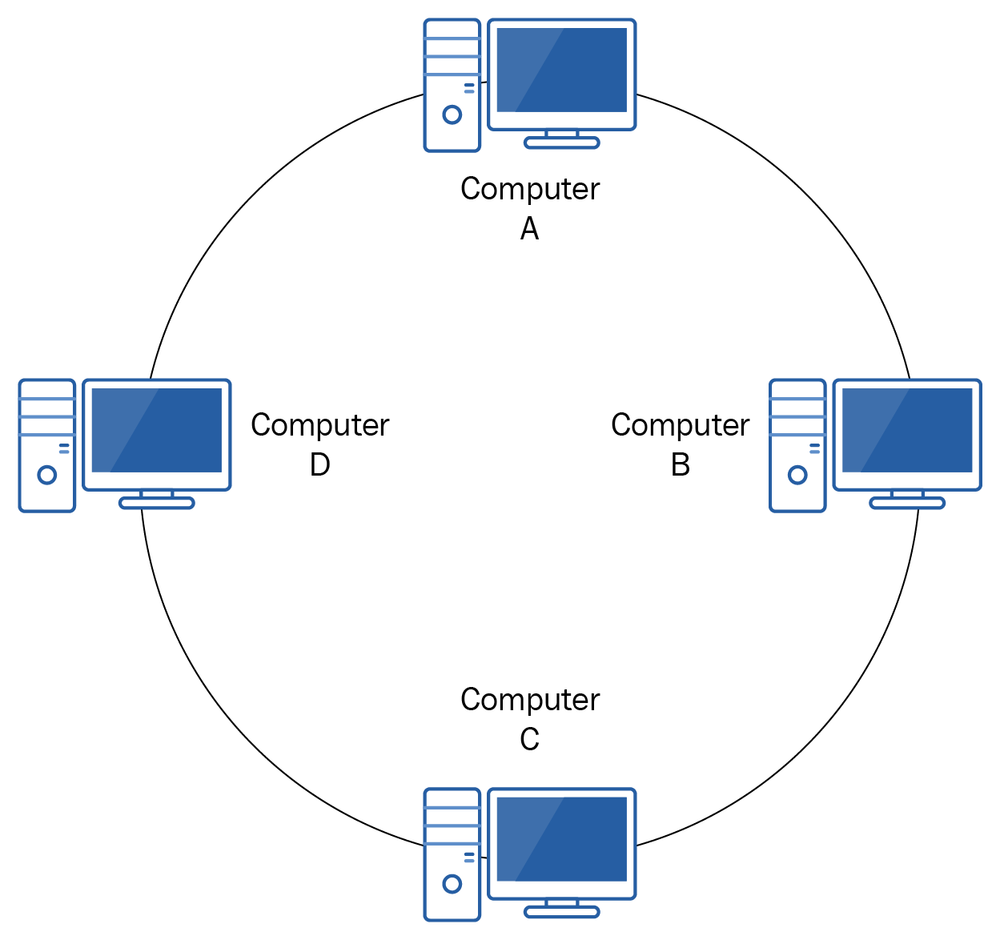
1.2.3
1.2.3 How data transfers over different types of network
IT26 - Ring network
What is a ring network?
Each device on the network is connected to exactly two other devices, forming a circular loop or "ring.“ Data is transmitted in one direction around the ring, with each device passing the data along to the next device until it reaches its destination.
Advantages
Disadvantages
Data is transmitted in a sequential and organised way, which makes it an efficient method of data transmission.
Ring networks can become slow and congested as the number of devices increases, which can limit their scalability.
Increased performance and reliability because one device is allowed to transmit at a time.
The entire network can fail if one device or connection fails

Slide 43
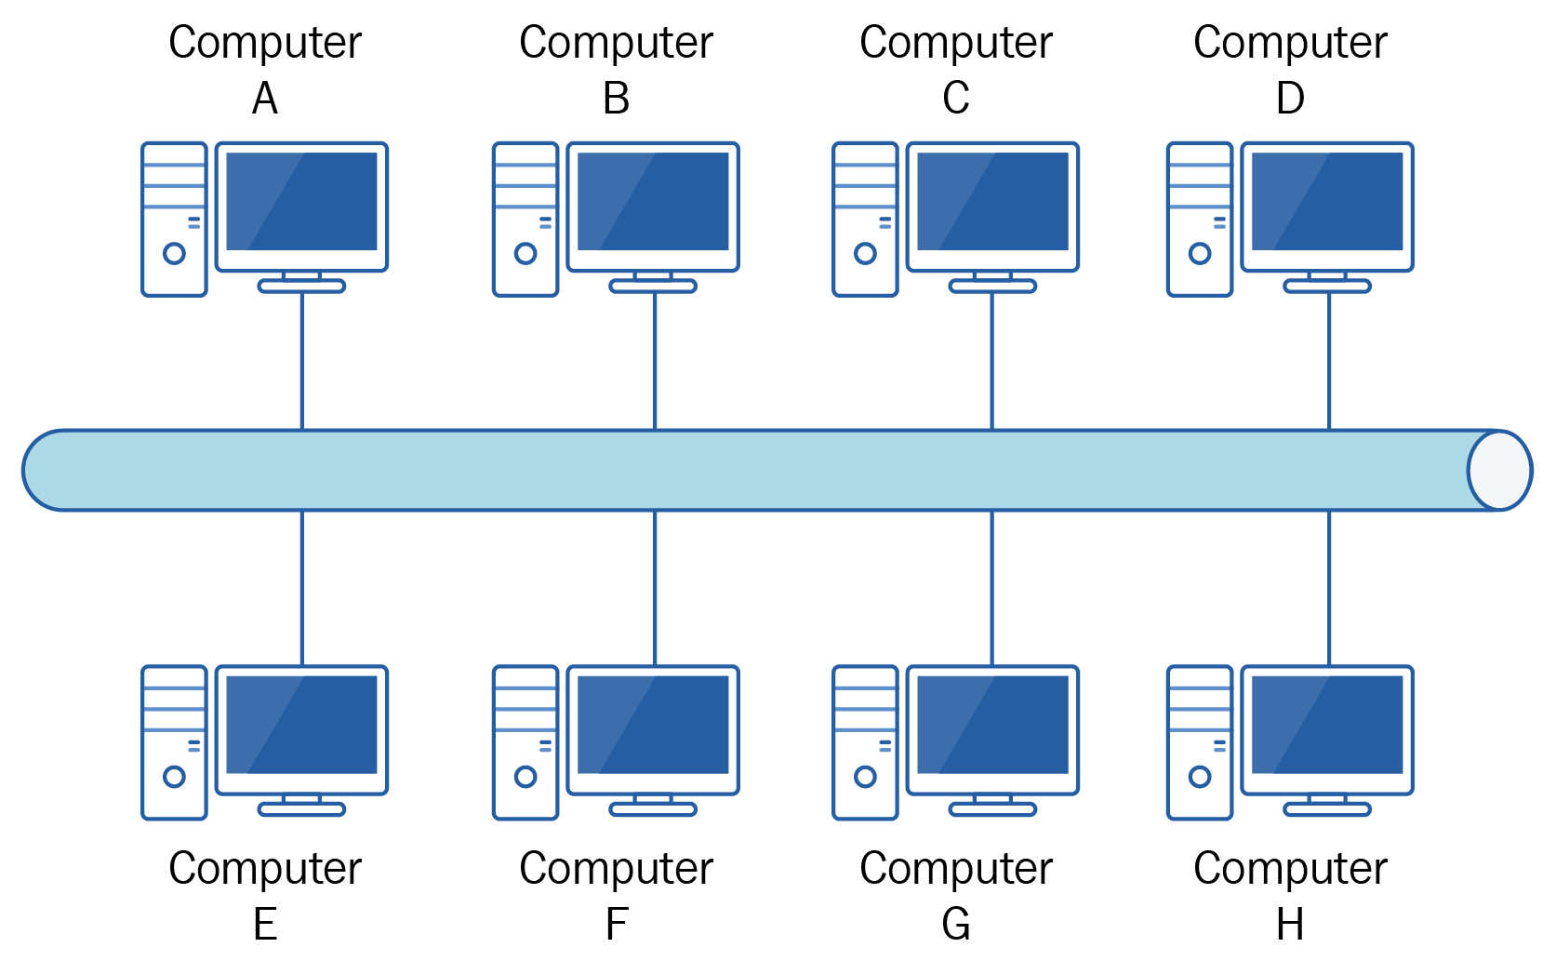
1.2.3
1.2.3 How data transfers over different types of network
IT26 - Bus network
What is a bus network?
All devices on the network are connected to a single cable, known as the "bus" or backbone. Data is transmitted in both directions along the bus. Each device on the network listens to the data being transmitted, but only the device that is addressed will accept and process the data.
Advantages
Disadvantages
Adding new devices to a bus network is straightforward. All you need to do is connect them to the bus cable.
The bus cable is a single point of failure. If the cable fails, the entire network goes down.
Inexpensive to install and maintain, making it an ideal choice for small businesses and home networks.
The scalability of a bus network is limited. As more devices are added.

Slide 44
1.2.3
1.2.3 How data transfers over different types of network
IT27 - The internet
What is meant by DNS?
It contains a database of domain names that allows users to look the IP address and its associated domain name.
What is the internet?
The Internet is a global network of networks while the Web, also referred formally as World Wide Web (www) is collection of information which is accessed via the Internet. The internet is an example of a WAN (Wide Area Network)
The DNS process
Step 1:
User enters the domain name into the web browser.
Step 2:
Client contacts DNS to find domain name.
Step 3:
If the domain name doesn’t exist, it will try a second server.
Intranet and Extranet
Intranet is a connected private network that only gives users of that organisation access to data. This is usually done by providing each user with a secure login. Extranet is a connected public network that can be accessed by an organisation and external users such as customers. For example, an e-commerce site.
Step 6:
Client contacts the host using the IP address.
Step 5:
The server returns the IP address to client.
Step 4:
The second server finds the domain name and returns to first server.

Slide 45
1.2.3
1.2.3 How data transfers over different types of network
IT27 - The internet
Pros and cons to cloud computing
What is meant by cloud computing?
Cloud computing allows users to store files and collaborate remotely as long as there is an internet connection.
Pros
Cons
Lower set up costs
Internet connection required.
What is meant by hosting?
A web hosting service is a provider that is able to host a users (client) website through their own server.
Can add more capacity over time.
Technical issues can cause downtime.
Files/documents can be accessed anywhere within an internet connection.
Security risks/vulnerable to hacking.
Why is hosting used?
They offer facilities to create and maintain a website. It manages security and any updates. Users can host websites from their own broadband but if they gain high network traffic then it would struggle to cope, servers provided by hosts hold more capacity.
Encourages collaborative working.
Increased costs when more storage is required.
Data is backed up remotely at another site.

Slide 46
1.2.3
1.2.3 How data transfers over different types of network
IT27 - The internet
Pros and cons to in-house servers
What is an in-house server?
An in-house server is a computer system managed and maintained on the premises, as opposed to being hosted by a third-party service provider.
Pros
Cons
Complete control and ownership of data
Up front costs in purchasing the server.
Who uses in-house servers?
Large corporations with a significant amount of data and computing needs, such as financial institutions, healthcare providers, or technology companies. Government agencies that handle sensitive information and require strict control over their IT infrastructure. Small and medium-sized businesses that require specialised software or customized applications that are not available in cloud-based solutions.
Customised to meet needs of the business/user.
Maintenance and upgrades
Faster access to data because it’s located on site.
Security risks from internal networks.
Lower long-term costs
Limited scalability of organisation wants to expand network.

Slide 47
1.2.3
1.2.3 How data transfers over different types of network
IT28 - Network protocols
Network protocols
HTTP
Used to access web pages.
HTTPS
Used to access web pages that require communications to be encrypted.
What is a standard?
We communicate with each other in our native language and this is exactly how computers communicate with each other and this is known as standards.
FTP
Used to transfer files between client and server.
TCP
Breaking down data into packets ready to be transmitted.
What is a network protocol?
When standards are used by computers to communicate over a network, it has to follow a number of protocols. Each protocol is responsible for transmitting data in a different way.
IP
Identifying the IP address of the source and the receiver of the data packets.
SMTP
Used to send email messages over a network.
IMAP
Used to receive emails that are stored on the server.
POP
Used to receive emails that are stored on a device, deleted from the server.

Slide 48
1.2.3
1.2.3 How data transfers over different types of network
IT28 - Network protocols
Packet switching process
Packet sniffers
Step 1:
Request processed by web server.
Step 2:
Request put into packets.
Step 3:
Packets given address & number.
Step 4:
Packets sent across the network
This involves the use of packet analysers (packet sniffers)
These are used to intercept data packets on a network which are then analysed. Sensitive data such as login names, passwords and credit card numbers can be stolen.
Step 8:
If yes, packets put in order.
Step 7:
If not – back to Step 4.
Step 6:
Have all packets arrived?
Step 5:
Packets received by host server.

Slide 49
1.2.3
1.2.3 How data transfers over different types of network
IT29 - Emerging technologies (Part 2)
Virtual networks
5G networks
Edge computing
A software-defined network that allows multiple virtual machines (VMs) or other virtualised resources, such as containers, to communicate with each other as if they were connected to the same physical network.
For example, you could use all the network resources from one physical site from any other location provided your connected to that network.
5G is the next generation of mobile internet connection.
5G is significantly faster than 4G
5G has more capacity than 4G
5G has significantly lower latency than 4G.
5G is better placed to deal with the wave of IoT devices.
5G can support immersive experiences such as VR and AR with faster, lower latency, and lower cost-per-bit.
Edge computing enables the processing and analysis of data closer to the source, which can reduce network latency and improve application performance.
This technology is becoming increasingly important with the rise of IoT devices, which generate vast amounts of data that need to be processed in real-time.

Slide 50
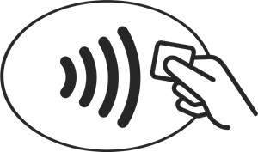
1.2.4
1.2.4 Different types of connectivity
IT30 - Connectivity methods
Wi-Fi enables devices to connect to the internet or other local networks without the need for physical cables.
NFC allows two devices to communicate with each other over a short range, typically up to a few centimetres. For example, making a contactless payment.
Bluetooth enables data transfer between devices over short distances.
RFID uses radio waves to read and transmit data between a reader and an RFID tag. The RFID tag contains a small microchip and antenna, which can be attached to or embedded in an object, such as a product.

Slide 51
1.2.4
1.2.4 Different types of connectivity
IT30 - Connectivity methods
Mobile data is a medium range wireless connection which works by transmitting data between cellular networks and a mobile device. Examples include: 3G, 4G, and 5G.
Ethernet is a standard protocol for wired local area networks (LANs). It allows devices on the same network to exchange data packets with each other.
Satellite is a long range wireless connection which works by connected to a satellite position in orbit above earth. Commonly used to connect remote areas or regions where communication is limited.
USB which is a standard interface used to connect peripheral devices, such as printers, keyboards, mice, and storage devices, to a computer or other host device. This has further evolved into Micro USB and USB-C which fits into the port both ways.

Slide 52
1.3.1
1.3.1 Risks to information held on computers
IT31 - Social engineering
Social engineering techniques
Prevention methods
What is social engineering?
Social engineering refers to the use of manipulation by an individual or group to trick individuals into disclosing confidential information.
Blagging - a form of social engineering that involves the use of deception or false pretences to obtain confidential information or access to restricted areas.
Be cautious of unexpected calls or emails.
Verify the identity of the individual.
Phishing - a fake email or website that looks legitimate, but is used to steal personal information such as passwords or credit card numbers.
Block the sender
Report to anti-phishing
Don’t open any suspicious links.
Check the email address.
Why use social engineering?
For some attackers it’s an easier way to gather sensitive information because no technical knowledge is required and some people can be considered as the ‘weak point’ due to their lack of knowledge.
Shouldering - a type of social engineering technique that involves physically standing behind someone or looking over their shoulder in order to gain information.
Be aware of your surroundings.
Use your hand the block the view.

Slide 53
1.3.1
1.3.1 Risks to information held on computers
IT32: Malware
Virus =
Trojan =
Adware =
Worm =
A type of malware that can copy itself and spread to other users by attaching itself to other files.
Enter users computer as a normal file or program and once downloaded, will perform malicious tasks.
This is designed to provide users with advertisements in the form of pop-ups that redirect them elsewhere.
This needs user actions to spread it and as a result, can continue to spread, exploiting the network and consuming bandwidth.
Rootkit =
Ransomware =
Spyware =
Created to provide remote access to a computer without detection. This can allow it to modify system settings and even install other types of malware.
Encrypts the user personal data using strong encryption methods and will demand a ransom to decrypt. This ransom will usually be in the form of a fee.
Used to track users activity without their knowledge and might use key loggers to monitor actions taken by the user and gain personal information.
Bot =
An automated type of malware used to perform DDOS attacks to get access to servers

Slide 54
1.3.1
1.3.1 Risks to information held on computers
IT32: Hacking
White hat
Black hat
Grey hat
Also known as ‘ethical hackers’
Support criminal acts through their hacking skills.
Do not have malicious intentions
Given legal permission to test an organisations security system.
Illegally attack computer systems for personal gains and ransom.
Try to gain something for their own findings.
Find vulnerabilities that can cause security to be compromised.
Using malware to gain access to sensitive information.
Reports back findings and asking them to fix it for a fee.
Conduct penetration testing
Intention to steal data and corrupt files.
May compromise organisations systems without permission.

Slide 55
1.3
1.3.1 Risks to information held on computers
IT33 - Network threats
Brute force attack
SQL injection
This method of attack requires very little ‘specialist knowledge’. Hackers will use automated software to try millions of different password combinations.
Therefore this can be referred to as a ‘trial and error method’.
This attack is used to interfere with queries that an application makes to its database in order to gain unauthorised access to users data.
Data interception and theft
Denial of service attack
Packet sniffers - This involves the use of packet analysers These are used to intercept data packets on a network which are then analysed. Sensitive data such as login names, passwords and credit card numbers can be stolen.
Unauthorised access – The use of social engineering techniques to find out login credentials.
This method overloads the network by using bots to send useless requests to servers to a point in which is becomes flooded and unresponsive. These bots can be designed to perform malicious tasks such as stealing data.

Slide 56
1.3
1.3.1 Risks to information held on computers
IT33 - Identification and prevention strategies
Penetration testing
Anti-malware software
Physical security
This used to test a computer system or a network to find vulnerabilities. Ethical hackers are employed to assess security and test users own awareness of security.
A computer program used to prevent, detect, and remove malware that could infect files on a computer system or gain unauthorised access to personal information.
Use of doors, locks and other physical measures to keep computer equipment safe and secure. This could involve fitting alarms, using locks, keypads, biometric or CCTV.
Encryption
User access levels
Strong passwords
Scrambling data to make it unreadable and harder for hackers to intercept.
User access levels to determine the rights users have with regards to the data they have access to. (e.g. some files might only be read-only for certain users)
A strong password would consist of upper and lower case letters, numbers and symbols.

Slide 57
1.3
1.3.1 Risks to information held on computers
IT34 - Emerging threats
Quantum computing
Synthetic identify fraud
Quantum computers could potentially break encryption algorithms, compromising the confidentiality and integrity of sensitive data.
Synthetic identity fraud involves creating new identities by combining real and fake information to commit fraud and open accounts
Cyber physical attacks
Deepfake technology
The use of digital and physical systems in critical infrastructure, such as power grids, transportation systems, and medical equipment and industrial control systems.
Deepfake technology uses artificial intelligence to create convincing fake videos or audio recordings to conduct social engineering attacks by impersonating someone else.

Slide 58
1.3
1.3.2 The impact of data loss, theft or manipulation on individuals and businesses
IT35 - Data loss, theft and manipulation
How can data be lost?
Data can be lost in different ways; it can be lost accidentally or there could be more malicious motive such as data theft.
Moral implications
Competitors lose their advantage because their idea is stolen.
Open to blackmail
Accidental loss of data:
Hardware failure
Natural disasters
Misplaced equipment (i.e., leaving laptop on the train)
Failed backups
Human error.
Legal implications
Breach of GDPR
Loss of intellectual property (Unable to copyright material)
Malicious attempts to steal data:
Hacking
Social engineering
Physical theft
Disgruntled employees disclosing data.
Data interception (i.e., packet sniffers)
Financial implications
Loss of revenue/sales
Loss of service/reputation
Fines to regulators, compensation to customers.

Slide 59
1.3
1.3.3 Methods used to protect information
IT36 - Protection methods
Logical protection
Physical protection
This is a computer-based method of protecting data which is normally implementing using software.
This involves tangible ways of keeping data secure and safe.
Access levels – Determine level of permissions each user has.
Authentication – Methods used to prove the identity of a user.
Firewall – Monitors the incoming and outgoing network traffic.
Encryption – Uses an algorithm to scramble data to make it unreadable.
Anti-malware – Software design to identity/detect malware in a computer system.
Password protection – A string of characters that enables access to an account.
Locks – Locks on doors so they cannot be opened unless you have a key.
CCTV – Monitor the premises 24/7 without any supervising on site.
Security guards – Employing security staff to protect sensitive data stored in buildings.
Backup systems – Backing up data in another location.
Location of hardware – Placing hardware away from risks of floods and fires.
Biometrics – Scanning data through facial recognition, iris recognition or a thumb print.

Slide 60
1.3
1.3.3 Methods used to protect information
IT37 - Security policies
Security policies
Disaster recovery plan
Acceptable Use Policy:
A set of rules that tells users how to use the network. Your school will have their own acceptable use policy.
Disaster recovery plan
Staff training/responsibilities:
The expectation on staff is to be more responsible when using data and a big part of this is to train staff to become aware of external threats and how best to manage these.
Before phase
Putting measures in place in preparation for a disaster.
This could be backing up data in another location.
During phase
How to respond if and when a disaster takes place. For example, a backup generator if there is a power cut.
Disaster recovery plan:
A document that outlines how an organisation responds to a cyber-attack, natural disasters or power-cuts.

Slide 61
1.3
1.3.3 Methods used to protect information
IT37 – Emerging Technology
What is confidential computing?
Confidential computing is an emerging technology used for storing data more securely.
It's a cloud computing technology that isolates sensitive data in a protected hardware-based environment such as the devices we use.
Protection at rest
Encrypt data before storing it
Protection in transit
Use end-to-end encryption to secure communications.
Protection in use
Encrypt data while it’s being used in the RAM.

Slide 62
1.3
1.3.4 How moral and ethical issues affect computer users
IT38: Ethical issues
What is the difference between ethical and moral?
Moral is what is considered as right or wrong whereas Ethical is what is considered right by a group of people.
Ethical issues
Privacy and security
The storage of data by organisations who are legallty bound to keep it secure.
Cookies
Small text files designed to remember information such as certain items that are in your checkout.
Example
For example, animal testing is seen as morally wrong by some groups because of the harm it has on animals.
The companies who create these products see it as ethical because they’re testing on animals to ensure its safe to be consumed by humans.
Monitoring of individuals
The use of software to monitor employees and what they do or the use of facial recognition cameras.
Impact of data loss or damage
The impact this has on the organisation's reputation or individuals' sales/revenue.
Context
The concept of morals and ethics can be applied to how we and other use technology and what they use it for.

Slide 63
1.3
1.3.5 How legal issues protect computer users
IT39: Legal issues
Legislation types
Copyright, Designs and Patents Act
This act is designed to protect original creators and their ideas.
These ideas could be books, films, music and software for example.
Communications Act
This act sets out how people can access and use television, make calls and browse the internet.
It’s an offence to send malicious messages over social media.
Computer Misuse Act
This act is to prevent unauthorised access to computer material.
This includes the intent to commit/facilitate a crime or modify for other purposes.
Regulation of Investigatory Powers Act
This act covers surveillance of communications by public bodies.
It covers person-to-person, person-to-machine, machine-to-person and machine-to-machine.
Data Protection Act (GDPR)
This act is designed to protect users' data and ensure its accurate, relevant, up-to-date and secure.
Health and Safety legislation
The display screen equipment regulation in 1992 relates to the use of computer equipment safely.

Slide 64
1.3
1.3.6 The cultural, personal and environmental impact of ICT
IT40: Environmental issues
What is meant by environmental issues?
It’s the way we measure the impact technology is having on the environment.
Impact
Positive
Negative
Internet of Things (IoT)
Use of IoT devices to regulate use of energy in households and businesses.
E-Waste (Electronic Waste)
The disposal of obsolete devices and rare earth element mining
Other environmental issues:
Recycling – The use of e-waste to recycle and re-use (i.e., refurbished mobile phones)
Global production lines – The use of other countries to produce electronic products that are cheaper. However, can create concerns over low-paid work.
Green IT
Technology that is designed so use less energy. (e.g., low power mode on a smartphone)
Energy Consumption
The increased use of electricity to charge our devices and reliance on data centres.
Digital downloads
Many developers are creating digital copies of software to reduce the use of packaging such as plastic as well as fuel for transportation.
Pollution
The manufacturing and operation of technology products contribute to pollution.

Slide 65
1.3
1.3.6 The cultural, personal and environmental impact of ICT
IT41: Cultural issues
What is meant by culture?
Culture refers to the ideas, customs, and social behaviour of a particular people or society and technology is playing a significant role in how we live our everyday lives.
Digital divide
Digital divide refers to the gap between people who has access technology to those that don’t. Factors such as affordability, location and cultural factors can cause a divide.
Social media
Websites that allow users to connect with each other by posting messages and sharing videos/images, share content and an effective advertising tool for businesses.
Fake news
The spread of misinformation using online communications. It’s important to consider the source, the author, the date and check as to whether this article can be found elsewhere.
Cyberbullying
Sending unkind messages to other people using digital communications which can impact people's mental health.
Addiction
The increased accessibility of the internet has created unhealthy habits such as playing video games for a long period of time.
Net neutrality
The user is in control in what they see and do online. All users should have access to websites provided by their ISP.

Slide 66
1.3
1.3.6 The cultural, personal and environmental impact of ICT
IT42: Employment patterns
Employment patterns
Automation is being used to allow robots to perform tasks such as assembling different parts of car.
Technology is being used to complete tasks that could typically be done by a human such as ATMs at banks.
It can lead to unemployment and the workers replaced by technology may need to re-train.
Hot-desking
Hot-desking is when an employee doesn’t have a regular space to work.
This is common with employees who work part-time or have flexible working contract.
It means businesses don’t have to invest in extra office space and ensure any vacated desks can be used up.
Teleworking
Employees that work away from the office using WAN (Wide Area Network)
Teleworking doesn’t always necessarily mean employees will always work from home.
They might work in a café or any other location that has an internet connection.
Collaboration
Groups of people working together on a task or project.
Technology makes it easier to collaborate because cloud services can be used to share work,.
Video calls can be used communicate ideas in a meeting.
Homeworking
This involves employees choosing to work from home.
This become the common method of working during the COVID-19 pandemic.
Technology now makes it easier to people to work from home.
Video conferencing
A technology-enabled communication method to conduct real-time audio and video meetings or discussions.
Commonly used by businesses to conduct meetings that would normally take place in the office.

Slide 67
1.3
1.3.6 The cultural, personal and environmental impact of ICT
IT43: New media
What is media?
Media is the format used to communicate information to others. There are two media industries: traditional media and new media.
Traditional media is media that existed before the World Wide Web.
New media is media that has evolved since the creation of the World Wide Web.
Examples
Social media
Most platforms allow you to stream content. YouTube is the popular platform for steaming videos.
Video on Demand (VoD)
Platforms that allow you to watch what you when you want. (e.g. Netflix, Amazon Prime, Disney +)
Music streaming
Platforms that allow you to hand pick music and create your own playlists (e.g. Spotify)
Live Radio/DAB
Digital audio that enables you to listen to radio stations via a mobile app.
Impact of technology
New media has been driven by the advancements of technology which have changed the way users consume media.
The introduction of black box technology such as smartphones and tablet devices has created the need to stream and download content wherever we want, whenever we want via websites and apps.
Digital publishing
Most print media types such as newspapers, magazines and books are available in electronic form such as e-books.

Slide 68
1.3
1.3.6 How a digital footprint can impact computer users
IT44: Digital footprint
What is a digital footprint?
The information about a particular person that exists on the internet as a result of their online activity.
Anything you post has the potential to be stored online for an infinite amount of time.
Online identity
The representation of an individual or groups personality, characteristics and activities in a digital world.
Information that helps to represent someone’s identity includes name, interests, friends, relationships, age etc..
Active and Passive footprint
Active footprint means to submit data intentionally submitted online via blogs, apps, websites and social media actions. On the other hand, a passive footprint is data collected without the user’s knowledge.
Identify theft
When someone uses your information without permission and pretends to be you.
Identities can be stolen in the following ways:
Phishing
Blagging
Malware
Dumpster diving
Shouldering
Examples
Active footprint could include posting on social media platforms and sharing posts.
Passive footprint could be recording your IP address and web browser history.

