Slide 1
New York Trip 2024
Mrs Franklin & Mrs Twigg

Slide 2
Parent Information Session
Thursday 24 October 2024
Meet in the Hub at TBA at 8.30am, depart by coach 9am.
Flight to New York from Gatwick Airport 15.05pm – Meals on Flight provided – Flying British Airways. BA2273.
Arrive at JFK Airport at 18.05pm
Transfers to Holiday Inn Express NYC Times Square.
Transfer time 45 minutes.
Room allocation, unpacking
20.30pm – Times Square – Food – Explore
10.30pm – Bed – Very Long day!

Slide 3
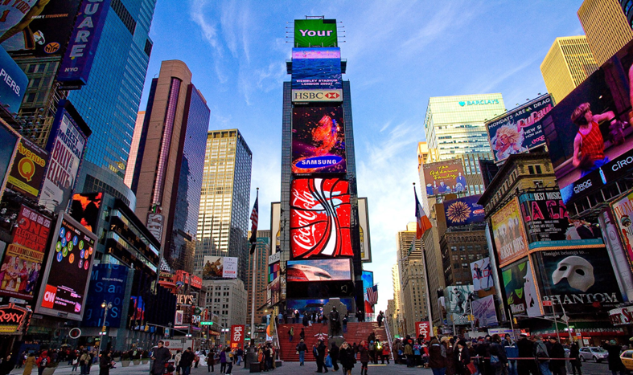
Parent Information Session
Friday 25 October
Breakfast at the Hotel – Leave by 10am.
Times Square – Shopping/browsing time
Empire state
Grand Central Station – Lunch – Food Hall
Chrysler Building
St Patrick’s Cathedral
Rockefeller Centre
5th Avenue – Saks. Etc
Radio City Music Hall
Hard Rock Café Time – Evening meal included
5 minutes walk to theatre
Broadway Show – Hamilton Richard Rogers Theatre. Starts 7pm – Arrival 6.30pm
Back to Hotel – lights out 11pm

Slide 4
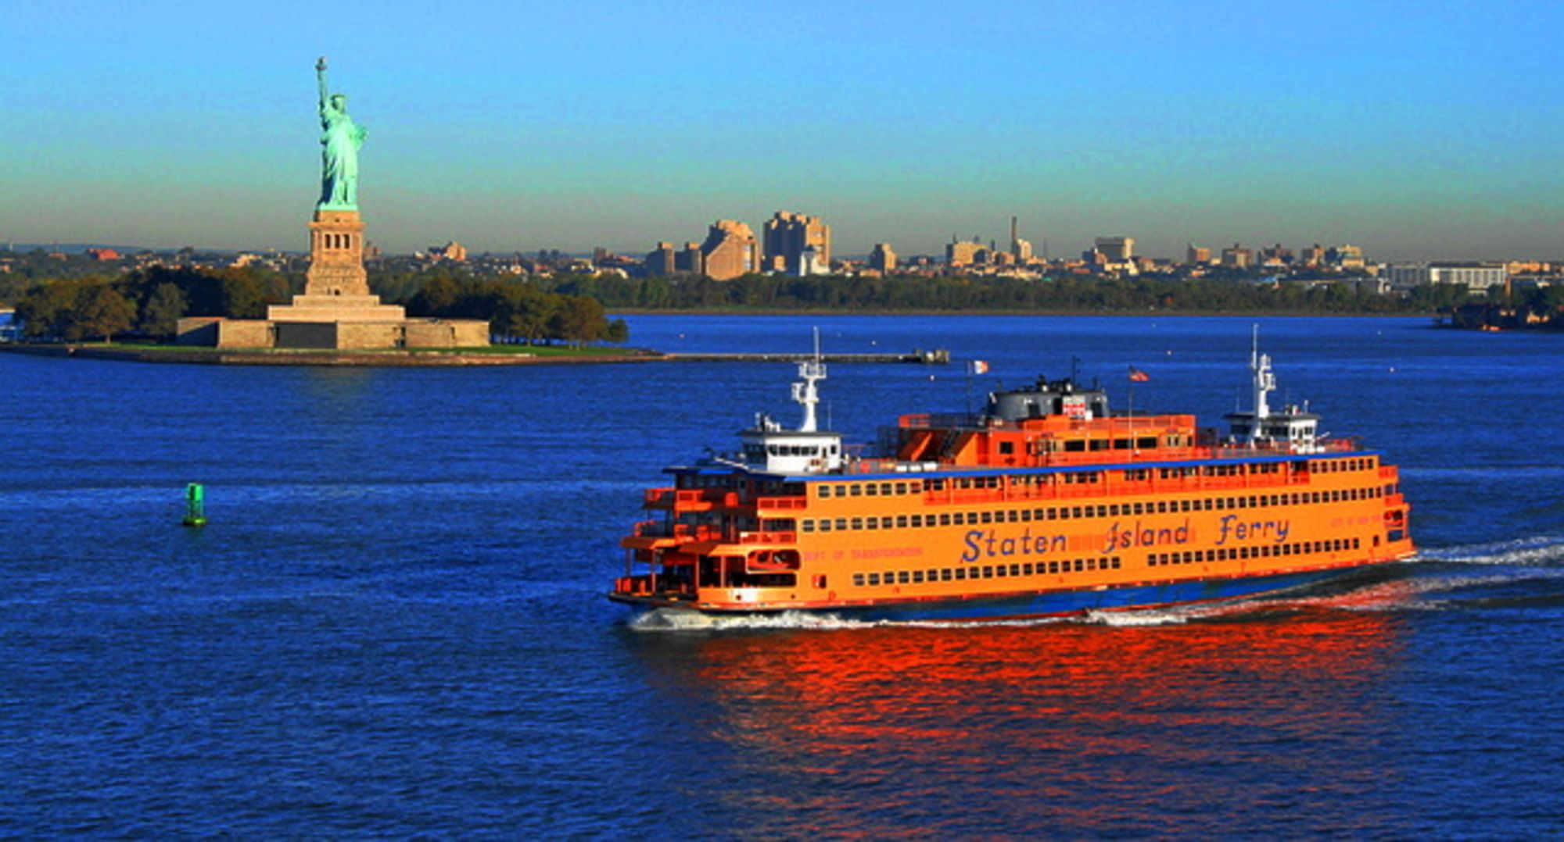
Parent Information Session
Saturday 26 October
Breakfast at the Hotel – Leave by 10am
Walking route
911 memorial – Museum – entry to museum additional cost $27.00. Optional.
LUNCH
Staten Island Ferry – the Statue of Liberty, Ellis Island
Staten Island Zoo $6 or Shopping at the retail outlet depending on time!
Chelsea Market – Food
The High Line
The Edge – 8 – 10pm
Back to Hotel – lights out 11pm

Slide 5
Parent Information Session
Sunday 27 October
Breakfast at the Hotel – Leave by 10am
Walk route
Flatiron Building
Little Italy, China Town – Lunch
Manhattan Bridge
DUMBO evening meal included – Front Street Pizza - View of the East River
Brooklyn Bridge
Ghost Busters Headquarters
Back to Hotel – Via Subway
Lights out 11pm.

Slide 6
Parent Information Session
Monday 28 October
Breakfast at the Hotel
Packing, luggage into storage.
Central Park – Walking Route
Central Park Strawberry Fields
Lunch
American museum of Natural History amnh.org/fieldtrips – TBC can only book six weeks in advance
Shopping time in Times Square
Return to hotel
Transfer from Hotel to Airport 17.30pm

Slide 7
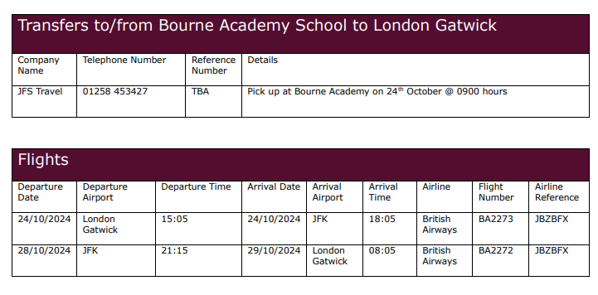
Parent Information Session

Slide 8
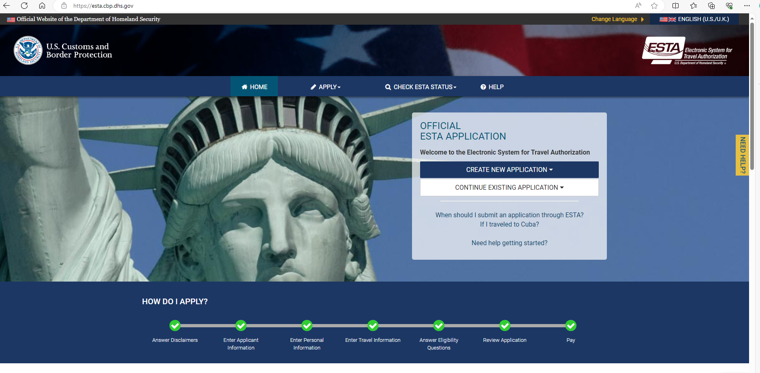
Parent Information Session ESTA VISA $21.00 - £16.58

Slide 9
Parent Information Session Check Passport – email link
Copies of all passports by 15th July – double check the expiry names to be entered accurately on travel documents.
We also need copies of ESTA once completed by 15th September 2024.

